Slide 1
Designing Integrative
Learning Experiences
Peter E. Doolittle
Assistant Provost of Teaching and Learning
Executive Director, Center for Instructional Development & Educational Research
Professor, Educational Psychology, School of Education
Virginia Tech • Blacksburg • Virginia
Notes:
Peter

Slide 2
Anticipation Guide
Directions: Agree or Disagree or Edit?
What is most important in any learning situation is what the learner already knows and can do.
Students are motivated when they have choices, when they can pursue their curiosities, and when they are free from assessments.

Slide 3
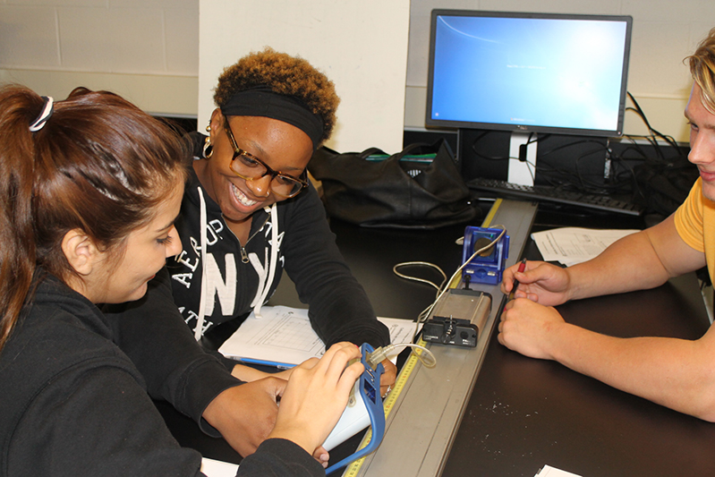
Overview
Introduction
Learning Principles
Learning Principles
Learning Strategies
Conclusion
Notes:
Tell story of first class here

Slide 4
Integrative Learning
Connecting
Reflecting
Synthesizing
Transferring

Slide 5
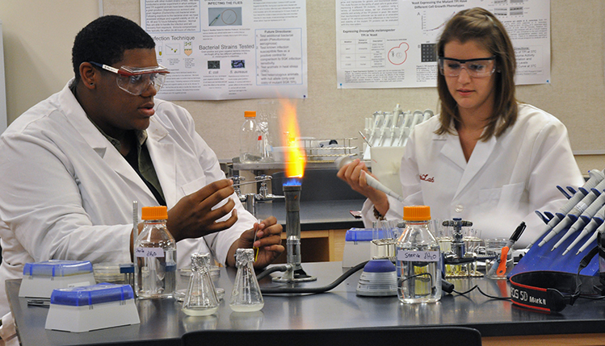
Learning & Principles
Fundamental Basis for Activities
words ☞

Slide 6
Rest
Tired
Awake
Dream
Snore
Bed
Eat
Slumber
Sound
Comfort
Wake
Night
Rest
Tired
Awake
Dream
Snore
Bed
Eat
Slumber
Sound
Comfort
Wake
Night
That’s all!

Slide 7
What does the activity tell us?
Meaning is constructed during experience and reconstructed during recall.
Construction/reconstruction result from processing.
Knowledge is organized.
When specifics are lost, meaning remains.
Strategies are used to function more effectively.
We can assess the effectiveness of our thinking.
Notes:
The most important single factor influencing learning is what the learner already knows. Ascertain this and teach him accordingly. David Ausubel

Slide 8
Cognitively
Behaviorally
Processing
Engagement
Active Learning
Hands On, Minds On
What we process
we learn.
Affectively
Socially

Slide 9
6 Principles for Developing Interdisciplinary Deep & Flexible Learning
Learning through practice at retrieval
Learning through varied tasks and purposes
Learning at the principle level
Learning awareness and control (metacognition)
Learning through developmental feedback
Learning embedded in prior knowledge & experience
(Engle, 2006; Halpern & Hakel, 2003; Mariano, Doolittle, & Hicks, 2009; Wagner, 2006)
Notes:
The most important single factor influencing learning is what the learner already knows. Ascertain this and teach him accordingly.

Slide 10
Heuristic to Principles to Strategies

Slide 11
Peer-to-Peer Review/Critique/Feedback
Peers provide feedback on each other’s writings, drawings, artifacts, presentations, posters.
(Cho & McArthor, 2011; Kulkarni, 2015; Levi Altstaedter & Doolittle, 2014;
Lundstrom & Baker, 2008; Nicol et al., 2013; Stacey et l., 2015)

Slide 12
Peer-to-Peer Review/Critique/Feedback
The findings show that producing feedback reviews engages students in multiple acts of evaluative judgment, both about the work of peers, and, through a reflective process, about their own work;
that it involves them in both invoking and applying criteria to explain those judgments; and that it shifts control of feedback processes into students’ hands, a shift that can reduce their need for external feedback.
-- Nicol, Thompson, & Breslin, 2013

Slide 13
Peer-to-Peer Review/Critique/Feedback
✔ Learning through practice at retrieval
✔ Learning through varied tasks and purposes
✔ Learning at the principle level
✔ Learning awareness and control (metacognition)
✔ Learning in response to developmental feedback
✔ Learning embedded in prior knowledge & experience
(Cho & McArthor, 2011; Kulkarni, 2015; Levi Altstaedter & Doolittle, 2014;
Lundstrom & Baker, 2008; Nicol et al., 2013; Stacey et l., 2015)

Slide 14
25-Word Summaries
Opportunity to engage in critical thinking and extract the essential meaning from a reading, lecture, video, movie, activity, or experience
Summarize the meaning clearly and concisely, based on student’s understanding, in 25 words or less.

Slide 15
Colleges provide instruction, but should produce learning. Students and teachers should co-produce knowledge. Coherent education creates flexible, adaptable, interesting people. This shift will change everything. [25 words]
The first two sentences of the summary do a nice job of addressing essential elements of the article; the second two sentences seem to lose the focus. The first sentence is an explicit central theme, while the second sentence is more implicit. Given that you have identified two themes in the two sentences, how could you combine the two sentences? Often combining such sentences will result in the use of fewer words and allow you to increase the interrelationship between the various ideas (thus increasing their meaning).
The third sentence isn’t really a central focus. The authors focus on student learning more than creating interesting people. The final sentence is more descriptive; that said, if you have the words to spare, the idea seems important to the authors.

Slide 16
25-Word Summaries
✔ Learning through practice at retrieval
✔ Learning through varied tasks and purposes
✔ Learning at the principle level
✔ Learning awareness and control (metacognition)
✔ Learning in response to developmental feedback
✔ Learning embedded in prior knowledge & experience
(Cho & McArthor, 2011; Kulkarni, 2015; Levi Altstaedter & Doolittle, 2014;
Lundstrom & Baker, 2008; Nicol et al., 2013; Stacey et l., 2015)

Slide 17
Poster Session
Opportunity to select, research, organize, summarize, and communicate specific information.
Produce a conference-style poster and present the poster (discussion) in a public poster session.
The researching, organizing, summarizing, and communicating (processing) are more important than the poster (product).

Slide 18
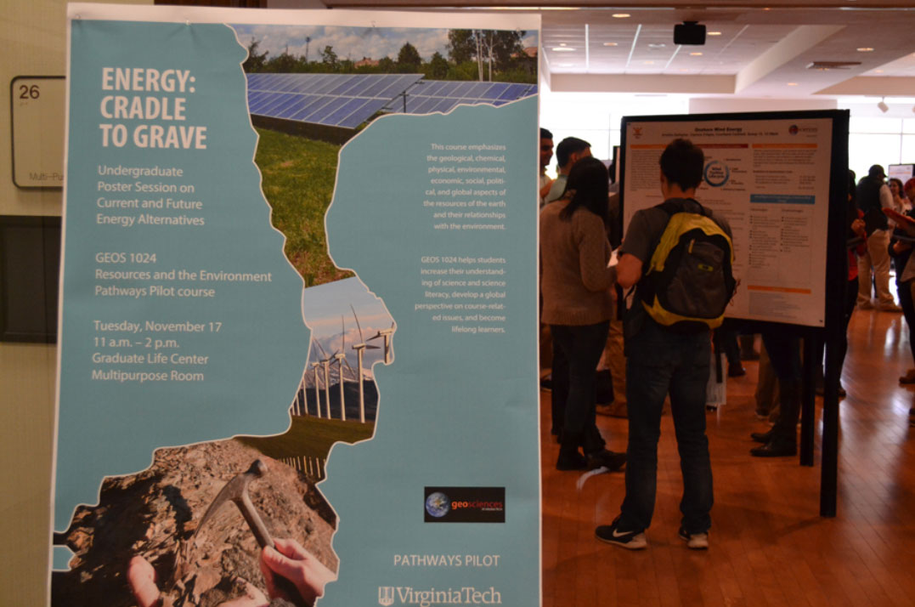
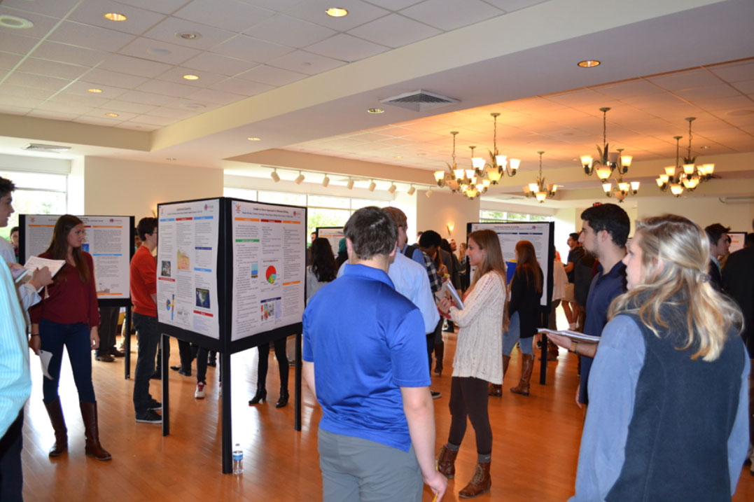
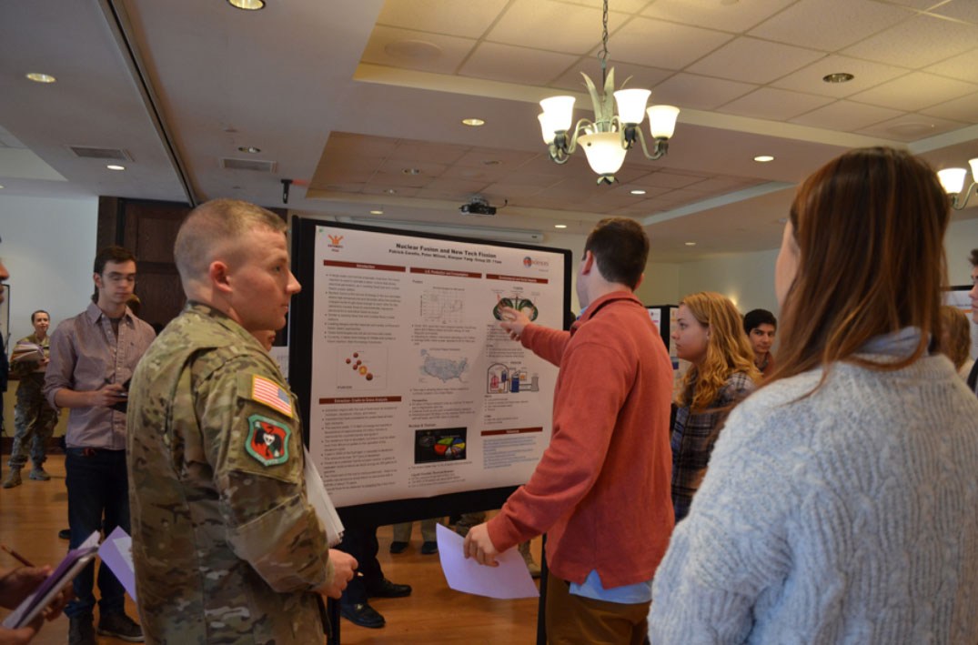
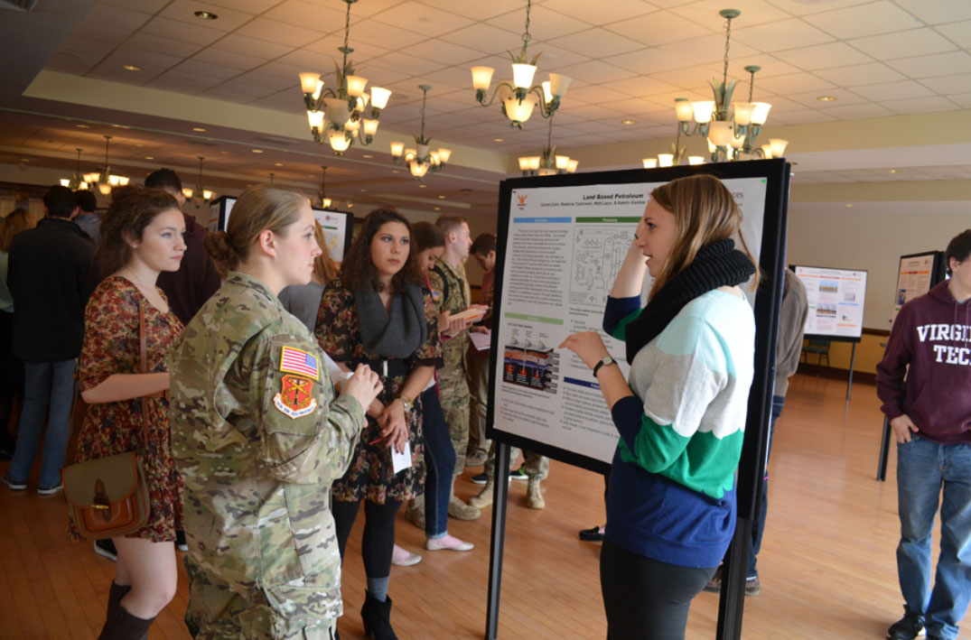
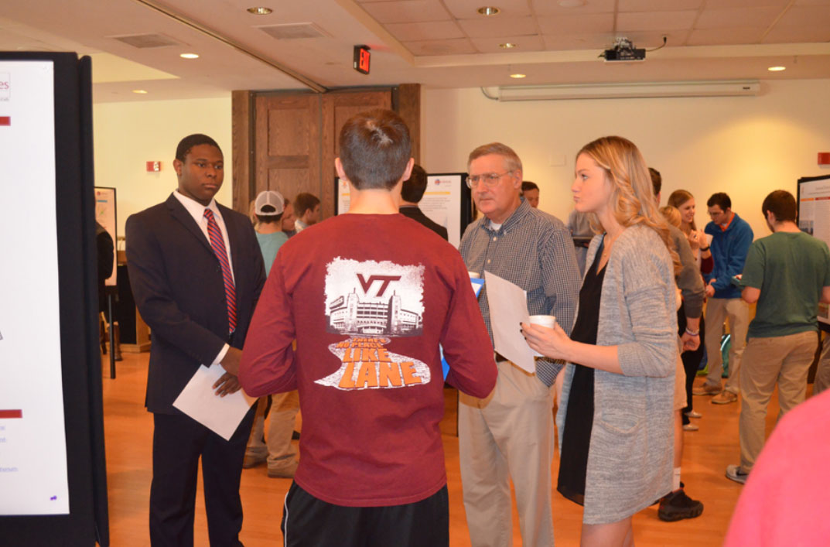
Poster Sessions

Slide 19
Poster Session
✔ Learning through practice at retrieval
✔ Learning through varied tasks and purposes
✔ Learning at the principle level
✔ Learning awareness and control (metacognition)
✔ Learning in response to developmental feedback
✔ Learning embedded in prior knowledge & experience
(Cho & McArthor, 2011; Kulkarni, 2015; Levi Altstaedter & Doolittle, 2014;
Lundstrom & Baker, 2008; Nicol et al., 2013; Stacey et l., 2015)

Slide 20
To be interdisciplinary,
one must think integratively.
Notes:
Tell story of first class here

Slide 21
Designing Flexible
Learning Experiences
Peter E. Doolittle
Assistant Provost of Teaching and Learning
Executive Director, Center for Instructional Development & Educational Research
Professor, Educational Psychology, School of Education
Virginia Tech • Blacksburg • Virginia
Notes:
Peter

Slide 22
SCALE UP
iClickers
Lecture/Discuss
PBL & CBL
Group Work
Design Projects
Field/Int’l Work
Assessment
(as an add-on)
Active Learning
Engagement
Hands-On Minds-On
Goals &
Outcomes
Learning
Environment
C, B, S, & A
Processing
Student
Learning
Purpose
Need

Slide 23
Design Projects
Posters (Session)
Writing
Problem Solving
Case/Mini-Case Studies
Peer Review
Reading Responses
Video Creation
Reflections
25-Word Summaries
Oral Explanations
Problem Sets
Blog/Vlog Posts
MC→Interpretive→Analysis
MC Item Create/Evaluate
Design Critique
Presentation
Self-Created Artifact
Learning
Assessment
Student
Feedback
summative
direct
formative
Learning
Artifact
Goals &
Outcomes
Learning
Environment
C, B, S, & A
Processing
Student
Learning
Course Embedded Assessment
Purpose
Need

Slide 24
within a single
discipline
viewing one
discipline from another
different disciplines working together
Integrating disciplinary
methods & knowledge
unifying frameworks beyond disciplines
Alexander Refsum Jensenius, University of Oslo
http://www.arj.no/2012/03/12/disciplinarities-2/

