Slide 1
Goals of Higher Education

Slide 2
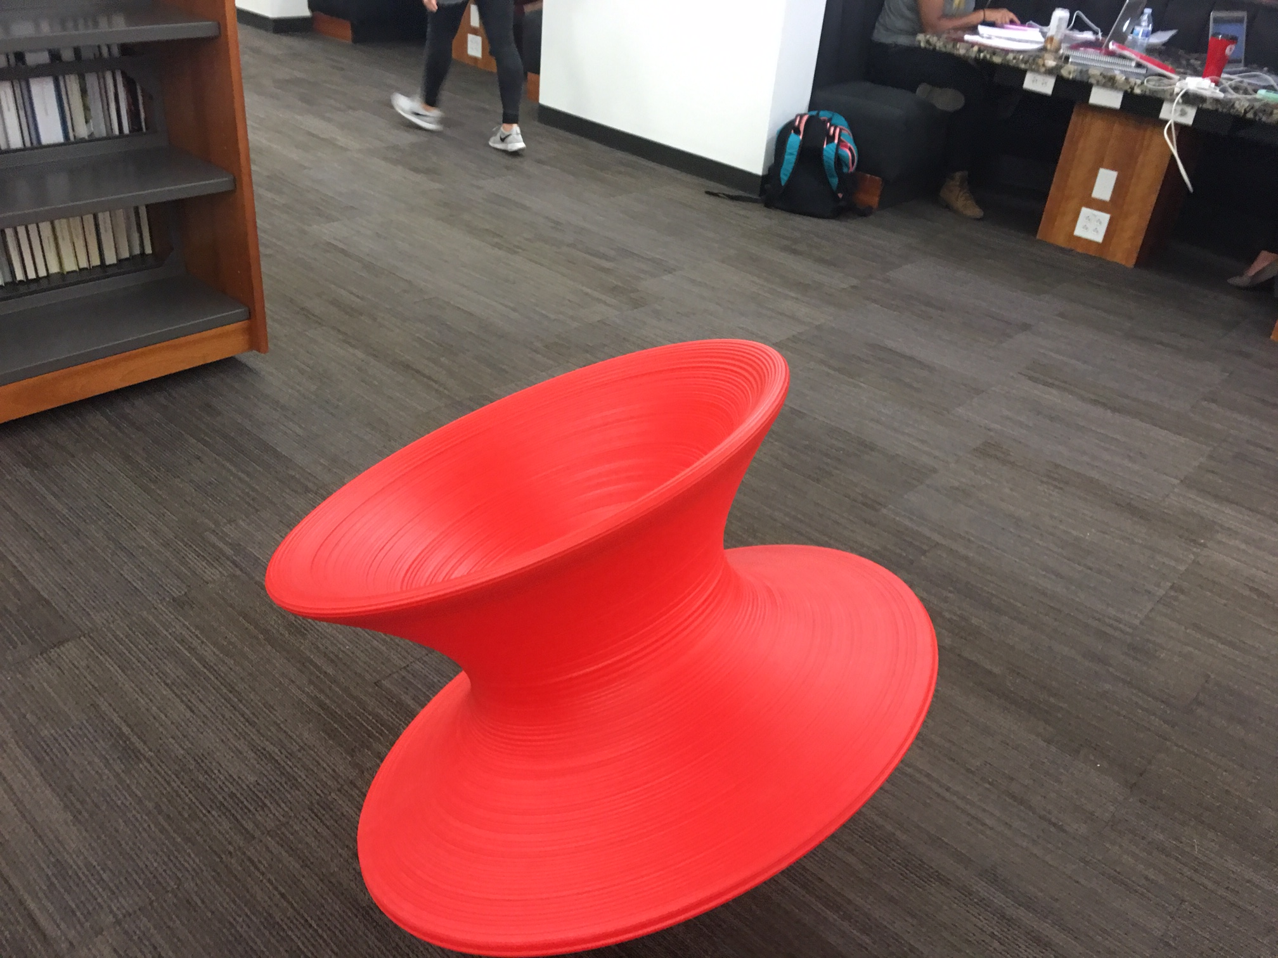
1st Goal of Higher Education
What??

Slide 3
Framing
Enrollments grew from 2000-2010, but have decreased since
Student debt will get worse, before it gets better
State appropriations are shrinking
Community colleges; 42% of all UG; 25% full-time UG
Changing demographics toward a majority-minority
Therefore, there is a need for institutions to differentiate themselves and to innovate within higher education
cats ☞

Slide 5
2015 Gallup-Purdue index
Academic Lives and Vocational Engagement
When it comes to being engaged at work and experiencing high well-being after graduation, the type of institution alumni attended matters less than what they experienced there. (p. 16)
2015 Gallup-Purdue Index Survey (30,000 alumni of U.S. universities)

Slide 6
What Mattered?
Supportive Relationships (Caring)
My professors cared about me as a person.
I had a mentor who encouraged me to pursue my goals and dreams.
I had at least one professor who made me excited about learning.
2015 Gallup-Purdue Index Survey (30,000 alumni of U.S. universities)

Slide 7
What Mattered?
Experiential Learning
I had an internship or job that allowed me to apply what I was learning in the classroom.
I was extremely active in extracurricular activities and organizations.
I worked on a project that took a semester or more to complete.
2015 Gallup-Purdue Index Survey (30,000 alumni of U.S. universities)

Slide 8
What Didn’t Matter?
Conducting a research project with a professor.

Slide 9
“Thought Leaders”
The Basics
What is “core” knowledge?
Quality education at a lower cost
Focusing education on a target career
Diverse educational environments
Mobile technology for everyday use & communication
Curricular/co-curricular integration ➔ whole student
https://www.universitybusiness.com/article/higher-ed-thought-leaders-forecast-2016-trends

Slide 10
“Thought Leaders”
Learning
On-demand, self-paced, adaptive, just-in-time learning.
Predictive analytics
Fewer large classes, more huddle spaces (informal)
Small “lightweight broadcast” studios
Balance of technology and the human element
More formative assessment
https://www.universitybusiness.com/article/higher-ed-thought-leaders-forecast-2016-trends

Slide 11
4 Goals for Students
Student Learning Basics
Focus on students; Focus on learning
Deep and flexible learning
Critical thinking
Make a difference and act
Supportive Collaborative Learning
Apprenticeships
Partnerships
Mentors

Slide 12
4 Goals for Students
Inclusive Excellence
Reshape courses with inclusive excellence in mind
Social justice thinkers
Ethical global citizens
Critical consciousness
Institutional structural alignment
Traditional & Alternative Credentialing
Majors, Minors, and Associate Degrees
Certificates & Modules
Microcredentials

Slide 13
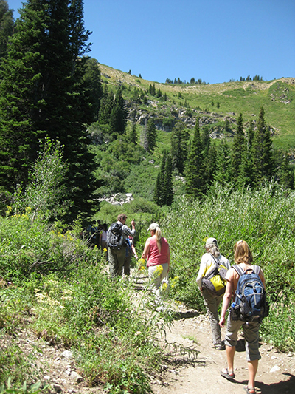
Motivation to Act
The 7 Cs of Motivation
Challenge
Choice
Control
Caring (value)
Competence
Collaboration
Curiosity

Slide 14
Off The Wall
Program Outcomes
15 weeks, 3 credits, 45 hours. Why?
Disconnect current structures
Focus on outcomes and create educational experiences regardless of time, location, faculty, and resources
EdEx 201: Comparing Groups Statistics
2 credits, 30 hours, Cosco Conference Room
R. Jones,

Slide 15
Questions
The goal of higher ed is a good job, good life, or civic life?
What would a higher education look like if it was based almost entirely on an apprenticeship?
How about a “choose your own adventure” higher ed learning experience?
What’s the best way for higher education and business/industry to partner?
Why don’t we teach students to learn?
15 weeks, 3 credits, 45 hours. Why??? No, really, why??

Slide 16
Goals of Higher Education

Slide 17
Educated individuals act.
Students who will make a difference.

Slide 18
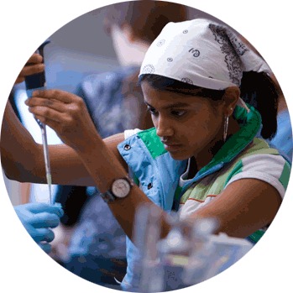
Goals for Students
Individual Identity
Class
Family
Education
Body Type
Citizenship
Occupation
Veteran
LGBTQ
Equity
Gender
Mental Health
First Generation
Religion
Language
Ability
Age
Race
Intersectionality

Slide 19
Goals for Students
Productive Pedagogies
Intellectual demand
Connectedness
Supportiveness
Working with and valuing of difference
Pedagogies of Indifference
Intellectual demand
Connectedness
Supportiveness
Working with and valuing of difference
(Lingard, 2007; Lingard & Keddie, 2013)

