Slide 1
Research, Myth, & Rhetoric
What do we know and not know about learning?
Peter E. Doolittle
Assistant Provost of Teaching and Learning
Executive Director, Center for Instructional Development and Educational Research
Professor, Educational Psychology, Department of Learning Sciences & Technology
Virginia Tech • Blacksburg • Virginia
Notes:
Peter

Slide 2
Today’s Mantra: Research, Not Rhetoric
Notes:
Guy Kawasaki, ex-Apple, Mantra, answers the question of Why

Slide 3
Anticipation Guide
Directions: Please read each statement and decide if you Agree or Disagree with the statement, or how might you want to Edit the statement.
Higher education instruction is more art than science.
Integrated learning is only possible with upper level classes, where students have a greater knowledge base.
The instructor’s job is to present; the student’s job is to learn.

Slide 4
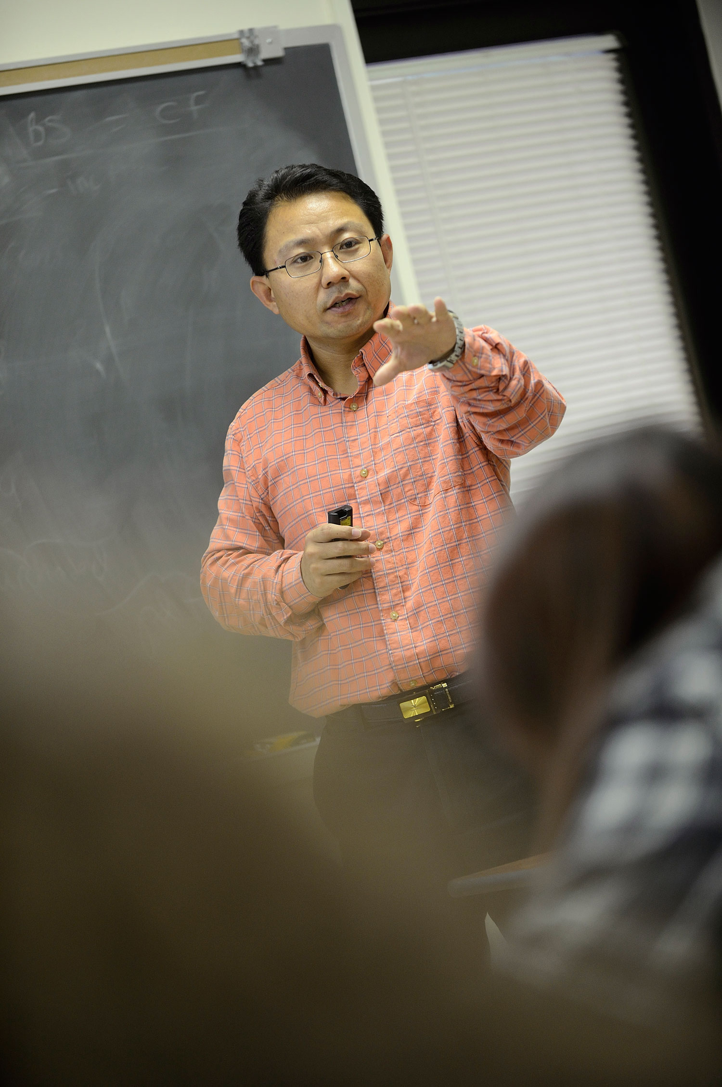
Overview
Introduction
Myth
Rhetoric
Research
Conclusion
Notes:
Tell story of first class here

Slide 5
Anderson, Reder, and Simon (1998) have lamented that the “science of human learning has never had a large influence on the practice of education” (p. 227).
irish →

Slide 6
Watch for Obstacles

Slide 7
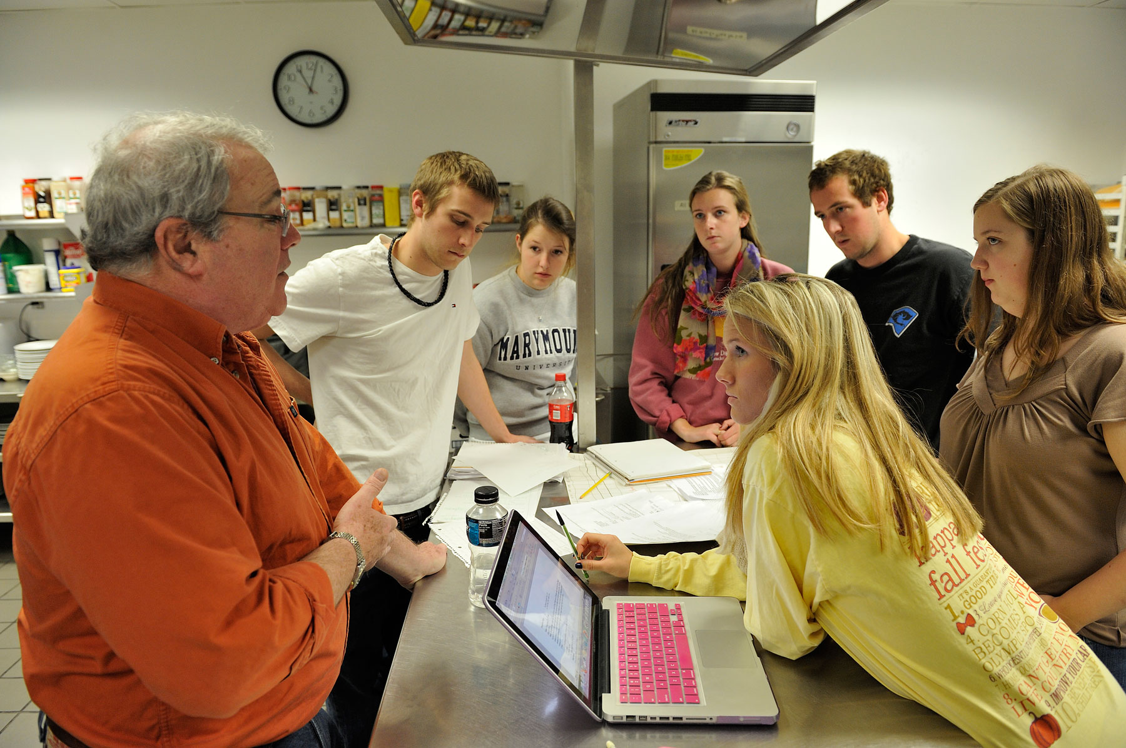
Myths
Just say no

Slide 8
Cone of Experience Cone of Learning

Slide 9
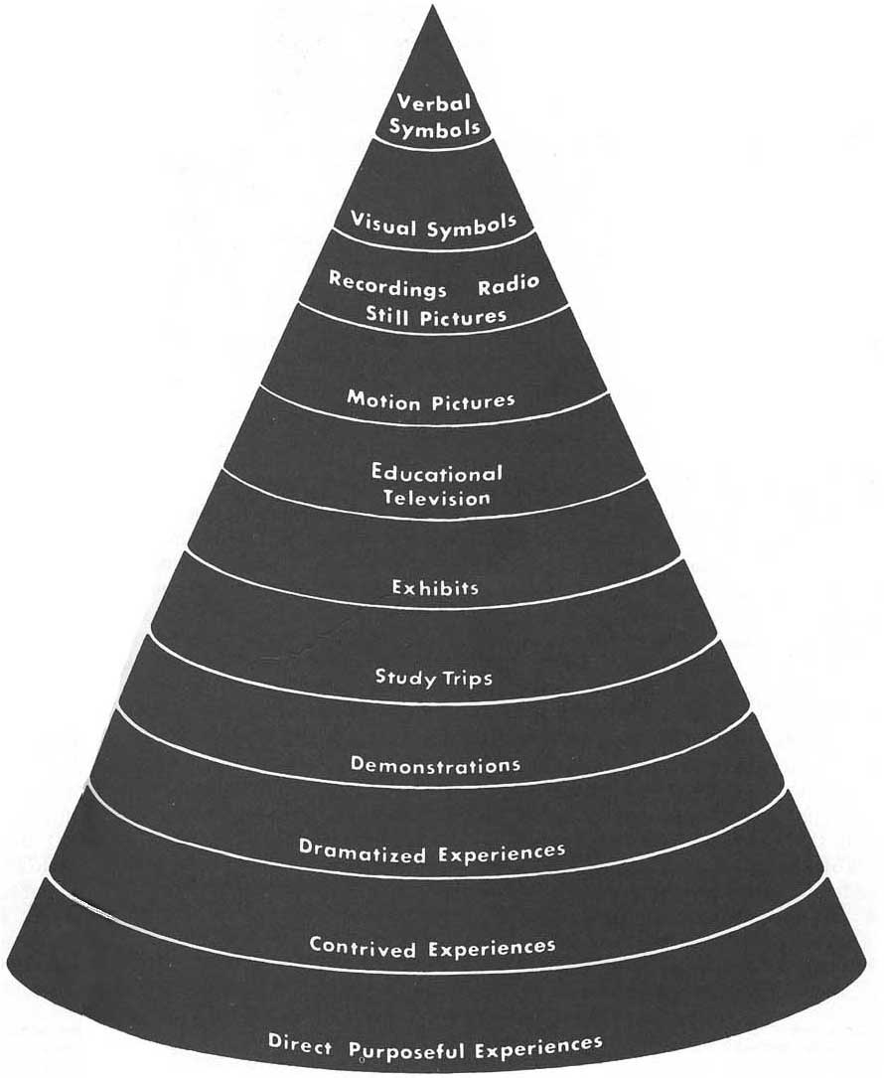
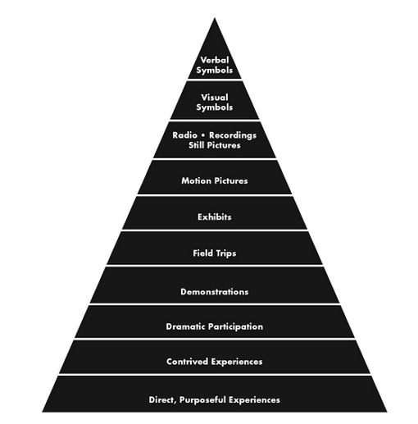
Cone of Experience/Learning
Dale, E. (1946, 1954).
Audio-video methods
in teaching. New York,
NY: Dryden Press.
First Edition
Revised Edition

Slide 10
Cone of Experience/Learning
If we realize now that the bands on the cone frequently interlap and blend into one another, and that a child who can read and write can use verbal symbols,
there will be no mistaking our cone-device for a hierarchy or rank order of learning processes.
(Dale, 1946, p. 47)
The device of the cone must be taken for nothing more than it is:
a visual metaphor of learning experiences, in which the various kinds of audio-visual materials appear in the order of increasing abstraction as one proceeds from direct experience.
(Dale, 1946, p. 38).

Slide 11
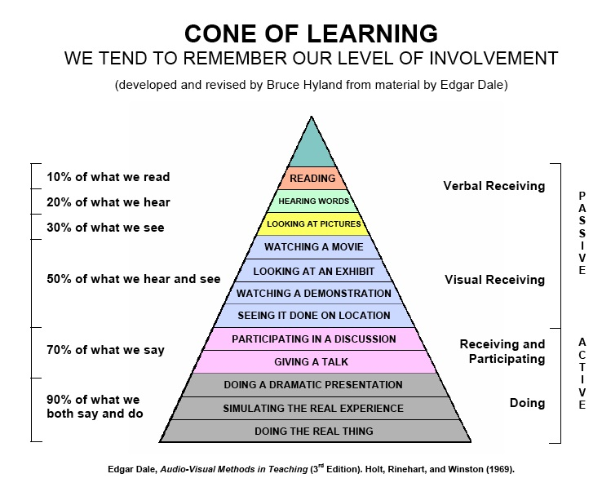
Cone of Experience/Learning
How did we get here ↑ from ← there?

Slide 12
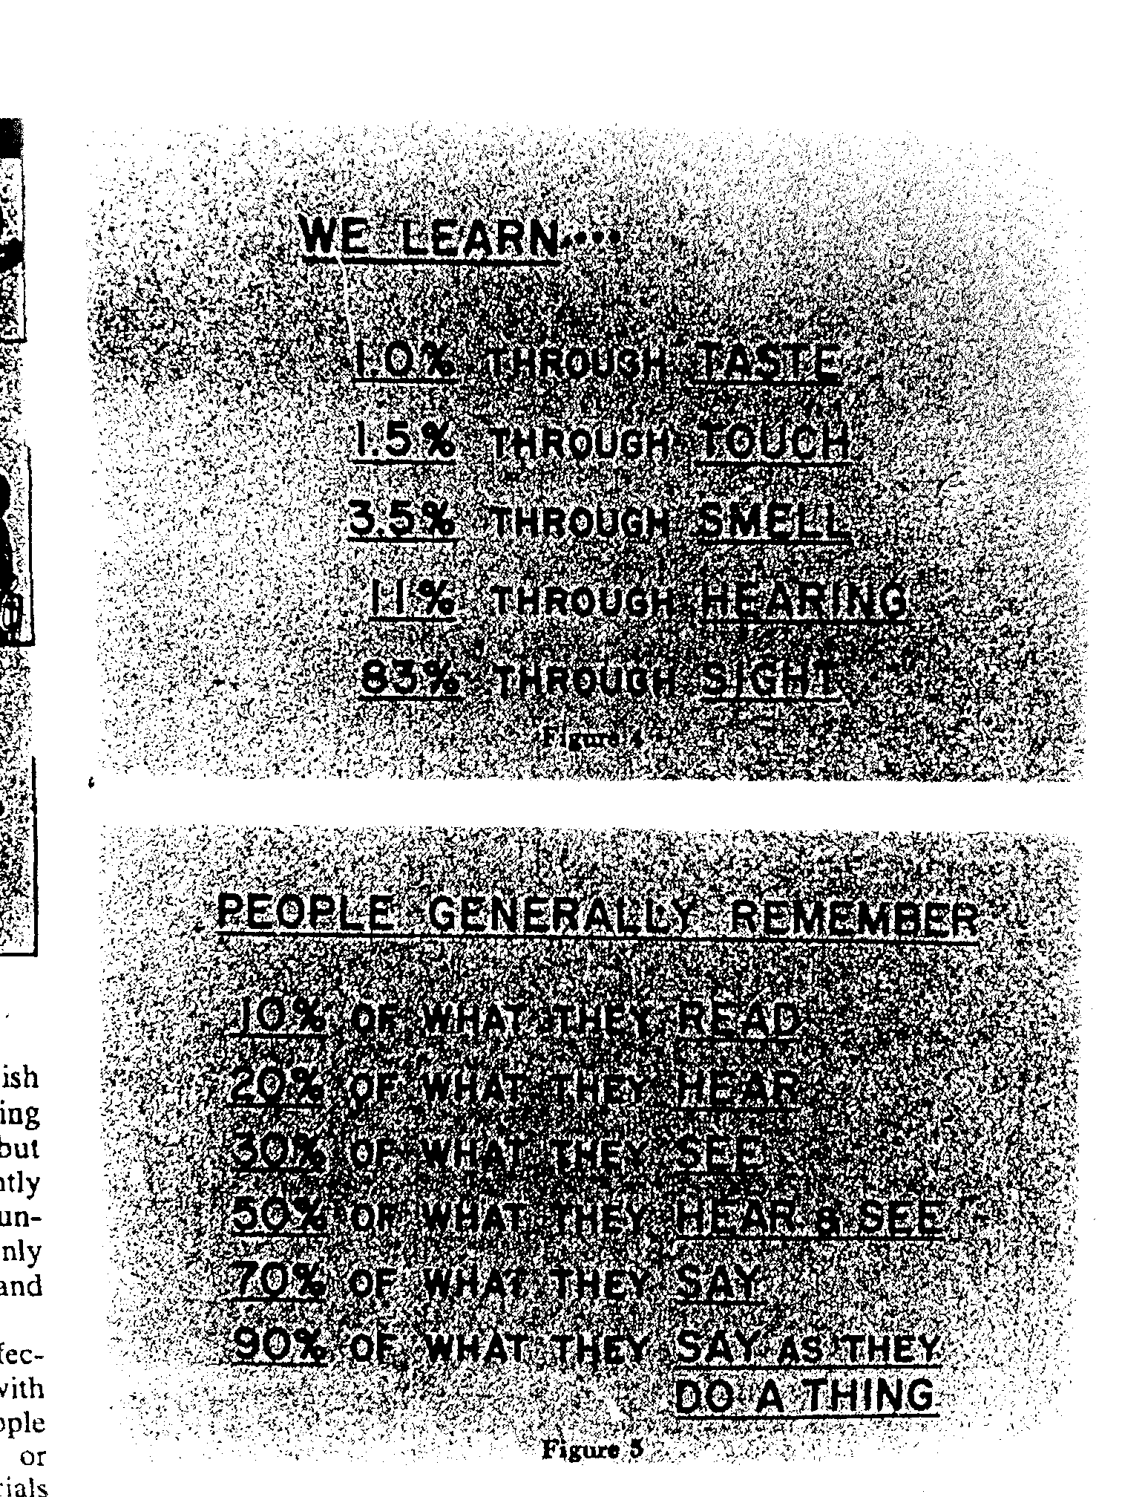
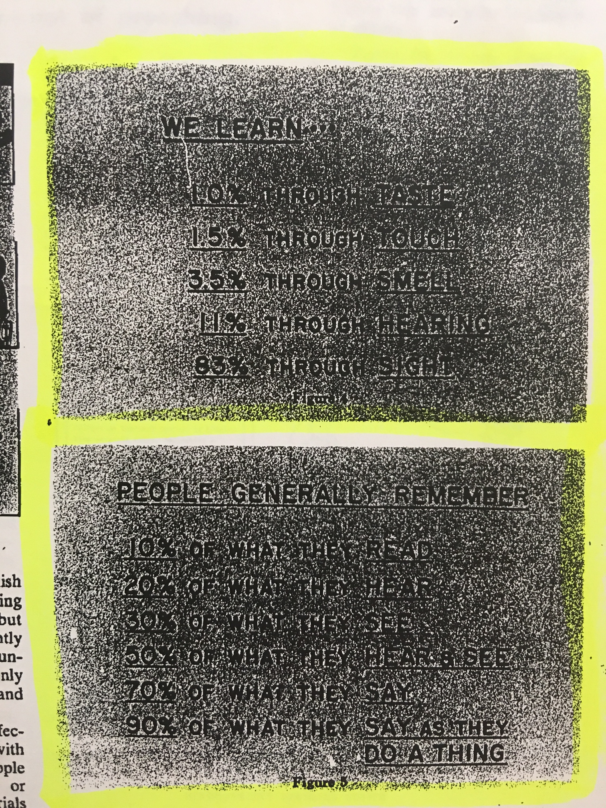
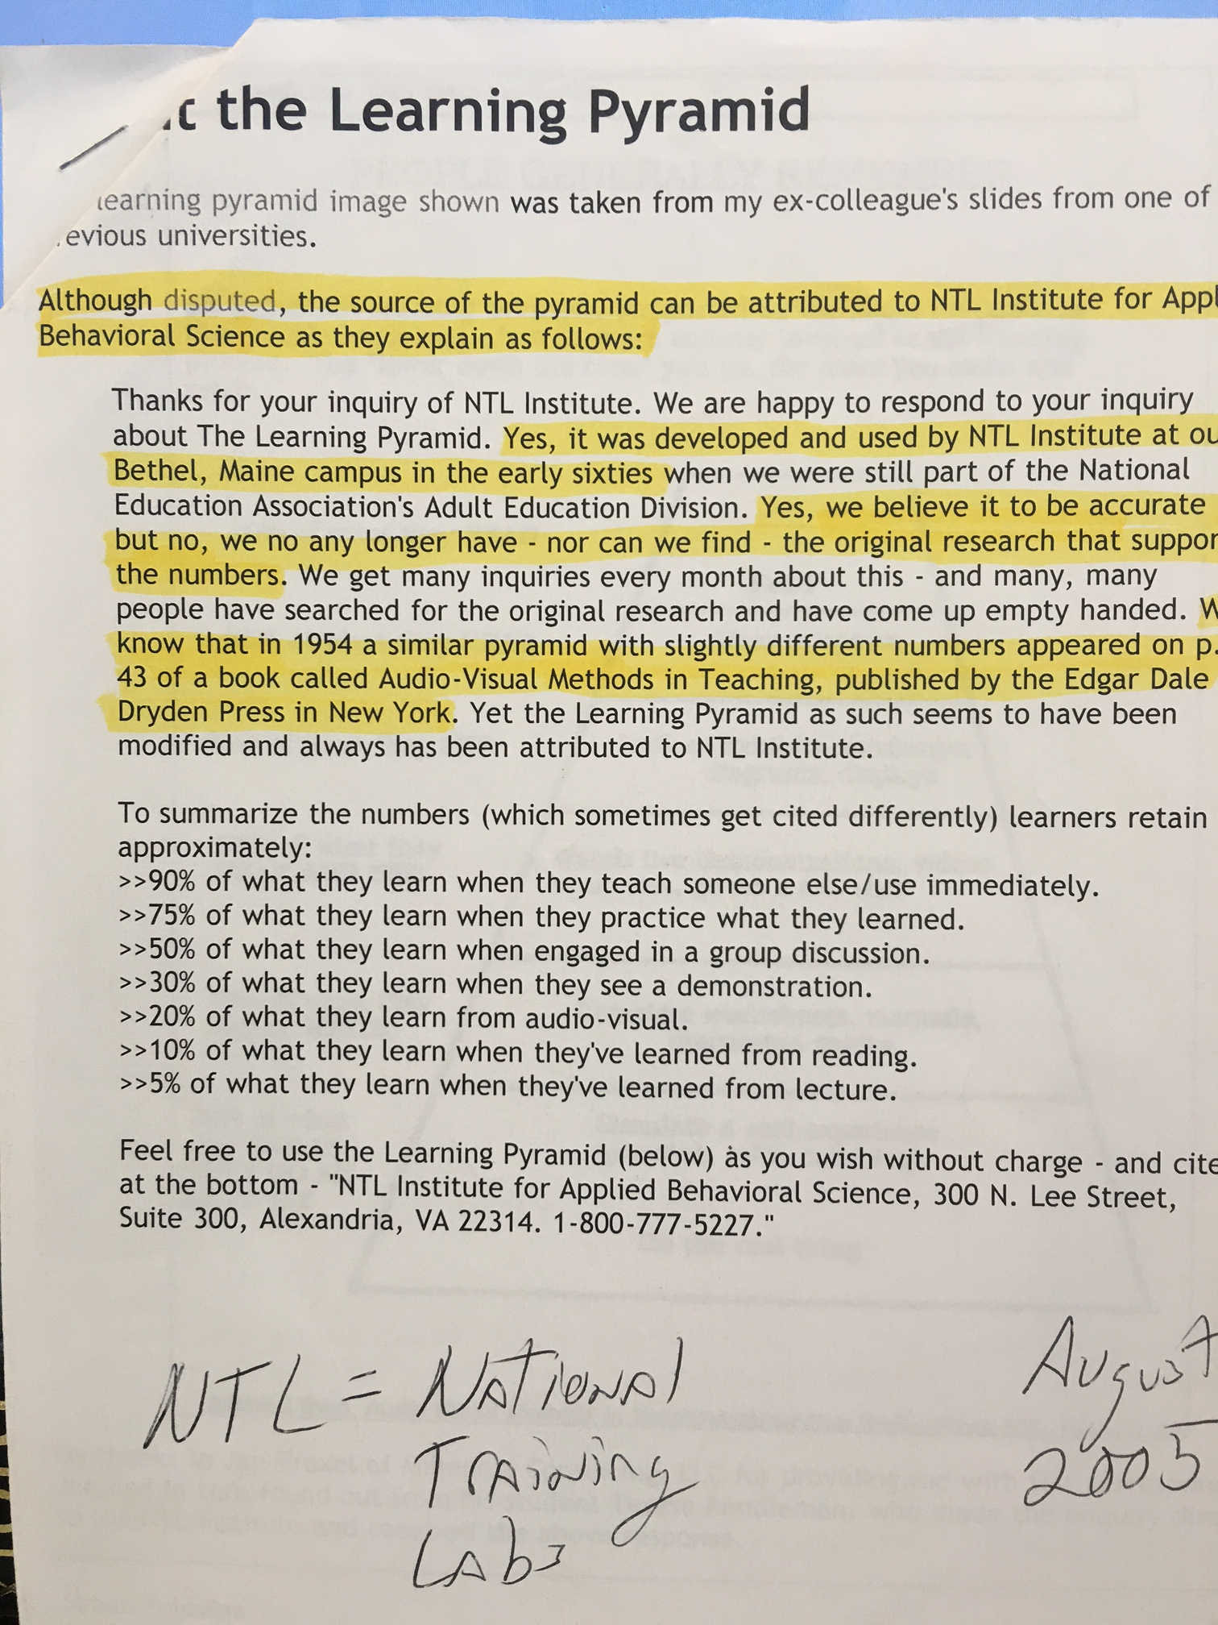
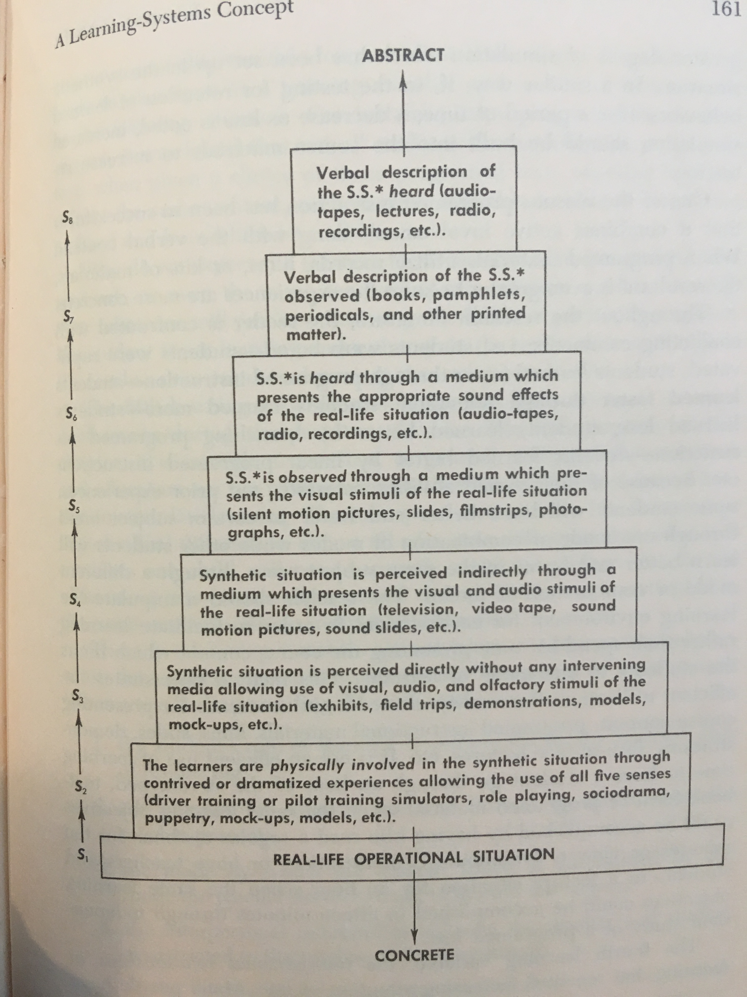
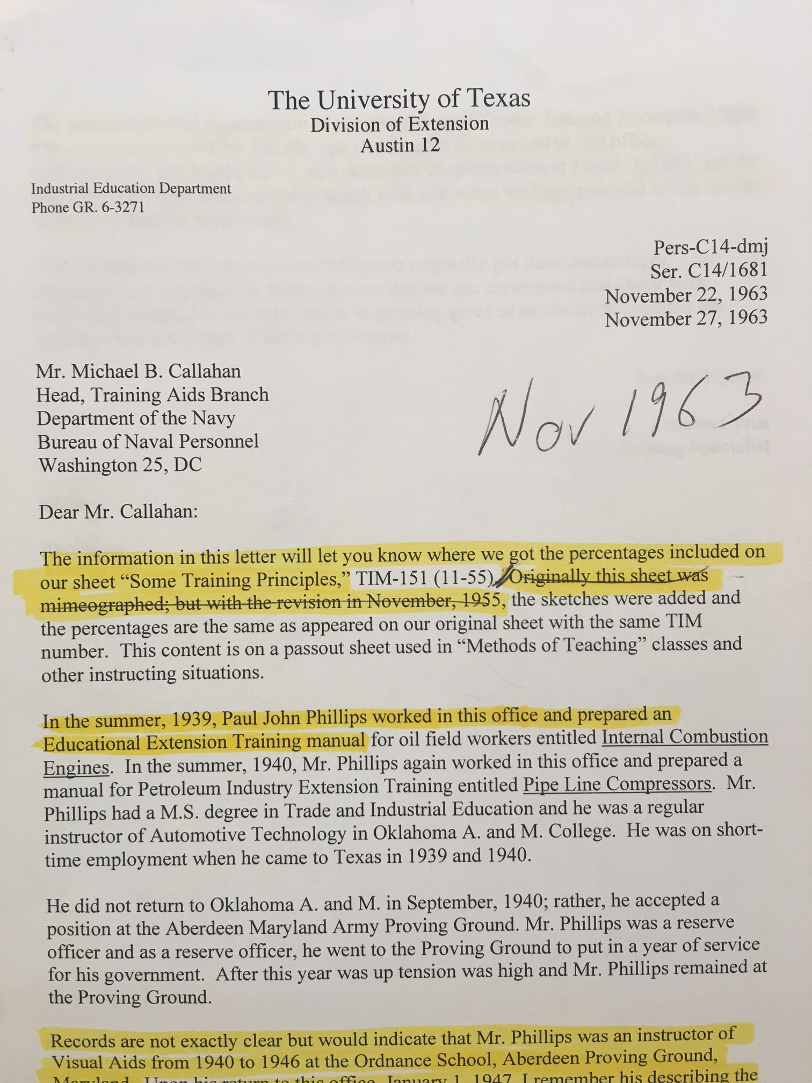
Evolution of the Cone
1946 Edgar Dale
1967 Treichler
1969 Wiman & Meirhenry
1940s Paul John Phillips
1940s National Training Labs

Slide 13
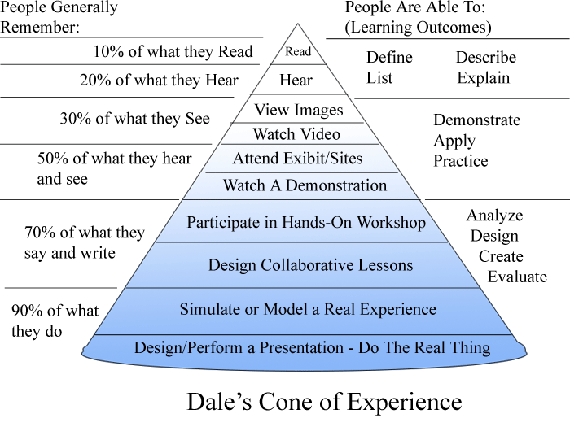
Cone of Learning
MT →

Slide 14
Multitasking

Slide 15
Multitasking: The Myth
Tapscott, 1998
multitasking
Frand, 2000
“multitasking way of life”
Prensky , 2001
“digital natives accustomed to the twitch-speed, multitasking “
Watson, C. E., Terry, K.,& Doolittle, P. (2012). Please read while texting and driving.
In J. Groccia (Ed.), To improve the academy (vol. 31) (pp. 295-310). Bolton, MA: Anchor.

Slide 16
Was Any Research Available?
Attend
Encode
Process
Store
LTM
“The greater the number of objects to which our consciousness is simultaneously extended, the smaller is the intensity with which it is able to consider each.”
Hamilton, Mansel, & Veitch
1861

Slide 17
Multitasking
2 to 60 by 2s

Slide 18
1. To what was pledged allegiance?
2. What country was mentioned in the passage?
3. For what does the flag stand?
4. The flag symbolizes how many nations?
5. What deity was mentioned in the passage?

Slide 19
Results
5
4
3
2
1
0
Task A Task B Task C
1 to 30 by 1s

Slide 20
1. What are we urged to do in the passage?
2. What was the original name of the drink?
3. What was the subsequent name of the drink?
4. How many actual liquids are mentioned?
5. What was distilled in the passage?

Slide 21
Results
5
4
3
2
1
0
Task A Task B Task C
100 to 7 by -7s

Slide 22
1. What is a good name like?
2. Why is good name good?
3. What types of odors are "more durable?”
4. Odors are more durable than what?
5. What is the general point of the passage?

Slide 23
Results
5
4
3
2
1
0
Task A Task B Task C
A + A
A + C
C + C
Low
Med
High

Slide 24
Multitasking and Research
“The truth to multitasking is evident in the empirical studies… humans lack the cognitive, behavioral, and cortical structures necessary to multitask effectively.”
-- Watson, Terry, & Doolittle (2012)

Slide 25
Multitasking and Research
“fMRI technology found that multitasking is not actually a concurrent process, but a sequential one that involves task-switching.”
-- Charron & Koechlin, 2010

Slide 26
A Few Multitasking Results
⬆ MT with a laptop in class ➔ ⬇ retention & class performance
⬆ MT while studying ➔ ⬇ class performance
⬆ laptop multitasking ➔ ⬇ performance by multitasker (11 %)
⬆ laptop multitasking ➔ ⬇ performance by nearby peers (17 %)
⬆ MT associated with ⬇ self-regulatory behaviors
⬆ FB associated with ⬆ MT associated with ⬇ class performance
(Judd, 2013; Junco & Cotton, 2011; Sana, Weston, & Cepeda, 2012; Zhang, 2015)

Slide 27
Accounting Students & Professionals
24 years old
50 years old
10
8
6
4
2
0
Professionals
Students
Group A
Basic Math +
Challenging Video
Group B
Applied Math +
Challenging Video
Negangard, Ozlanski, Pyzoha, & Doolittle (2015)

Slide 28
Students & Faculty
19 years old
41 years old
10
8
6
4
2
0
Students
Faculty
Group A
Challenging Video
Group B
Survey +
Challenging Video
Doolittle (2015)

Slide 29
Rhetoric (Hype)
Technology is neither good nor bad, but using it makes it so.

Slide 30
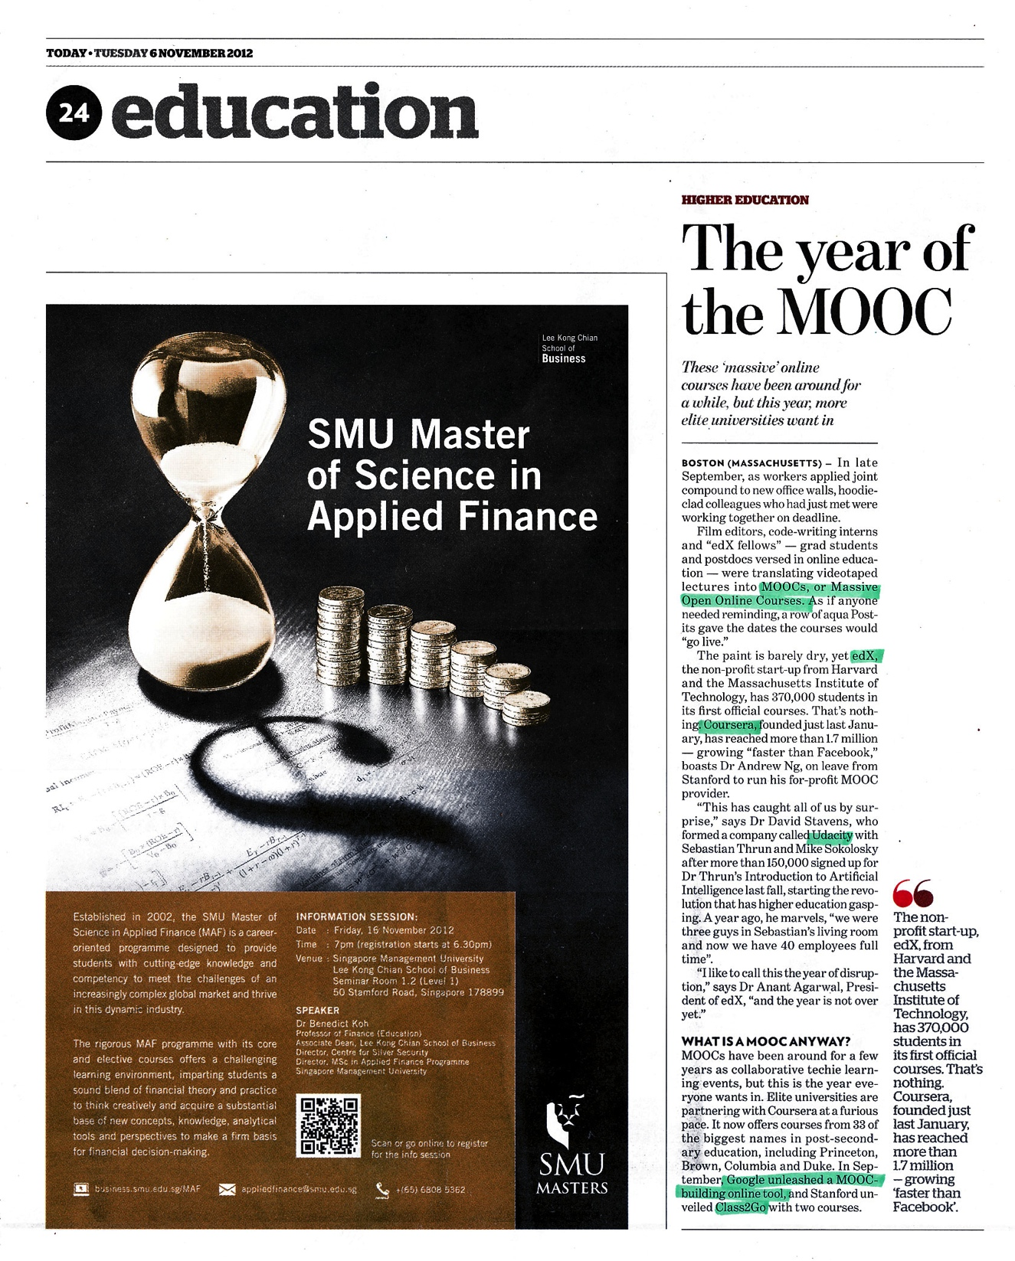
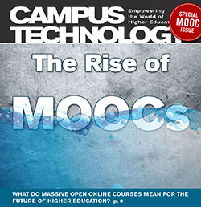
Introductory Frame
David Stearns, U of Washington
The TIEs and (TIPs) That Bind:
Fostering Massive Open Online Communities
extreme
techno-optimism ☺
We found that the majority of MOOCs scored poorly on most [learning] principles… [but] highly on organization and presentation of course material…although most MOOCs are well-packaged, their [learning] quality is low.
- Margaryan, Bianco, Littlejohn (2015)
In 50 years there will only be 10 institutions in the world delivering education, and Udacity has a shot at being one of them.
- Sebastian Thrun (Udacity)
MOOCs v1.0
technological
determinism
social-shaping of
technology
social
determinism
http://er.educause.edu/articles/2016/5/the-ties-and-tips-that-bind-fostering-massive-open-online-communities
techno-pessimism ☹

Slide 31
Rhetoric (Hype)
David Stearns, U of Washington
Gartner Hype Cycle
peak of inflated
expectations
slope of
enlightenment
plateau of
productivity
techno-optimism ☺
MOOCs
techno-optimism
rhetoric-based
hype
techno-pragmatism
research-based
theory
technological
determinism
social-shaping of
technology
technological
trigger
trough of
disillusionment
social
determinism
techno-pessimism ☹

Slide 32
Google Trends

Slide 33
Rhetoric (Hype): ePortfolios
Google Trends
2005
2007
2009
2011
2013
2015
techno-optimism
rhetoric-based
techno-pragmatism
research-based

Slide 34
Rhetoric (Hype): ePortfolios
1996-2014
Article Type | N | %
Descriptive (examples, do/don’t) | 92 | 42
Affective (opinions, perceptions) | 63 | 29
Outcomes (learning, motivation) | 36 | 17
Technology (user interface, platform) | 18 | 8
Assessment (use of rubrics/tools) | 8 | 4
Total | 217
Bryant, L., & Chittum, J. (2013). ePortfolio effectiveness: A(n ill-fated) search for empirical support. International Journal of ePortfolio, 3(2),189-198.
Chittum, J., Woodyard, J., & Bryant, L. (2015).

Slide 35
Rhetoric (Hype): ePortfolios
Google Trends
2005
2007
2009
2011
2013
2015
techno-optimism
rhetoric-based
techno-pragmatism
research-based

Slide 36
Rhetoric (Hype): Others
Google Trends

Slide 37
Rhetoric (Hype)
Utilize technology based on need (outcomes) and impact (research), not rhetoric.

Slide 38
Research

Slide 39
Research
show words here

Slide 40
Research
XX
XX
XX
XX

Slide 41
What does this experiment tell us?

Slide 42
Cognitively
Behaviorally
Processing
Engagement
Active Learning
Hands On, Minds On
What we process
we learn.
Affectively
Socially

Slide 43
7 Principles for Developing Deep & Flexible Learning
Learning through practice at retrieval
Learning through varied tasks
Learning for varied purposes
Learning at the principle level
Learning awareness and control (metacognition)
Learning embedded in prior knowledge & experience
Learning in response to developmental feedback
(Engle, 2006; Halpern & Hakel, 2003; Mariano, Doolittle, & Hicks, 2009; Wagner, 2006)

Slide 44
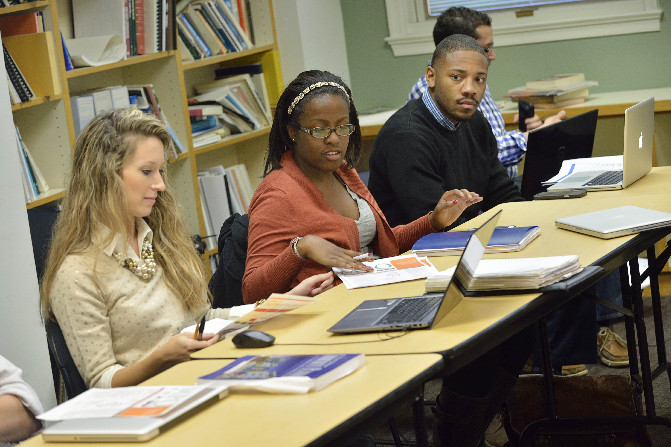
Conclusion
Introduction
Myth
Rhetoric
Research
Conclusion
Notes:
Tell story of first class here

