Slide 1
What No One’s Telling You About Active Learning
Krista Wojdak, Professor
Appalachian State University
wojdakkp@appstate.edu
Peter Doolittle, Professor
Virginia Tech
pdoo@vt.edu
All images from Unsplash.com

Slide 2
Agenda
Defining Active Learning
Problematizing Active Learning
Active Learning and Cognition
Active Learning and Emotions
Active Learning and Instructional Strategies
Notes:
Do we need this? We need some intro slide . . . ideas?

Slide 3
Notes:
So let’s make sure we’re all speaking the same language when it comes to active learning. Here’s a quick video exemplifying active learning/

Slide 4
Defining Active Learning: Part I
1
Notes:
So let’s make sure we’re all speaking the same language when it comes to active learning. Here’s a quick video exemplifying active learning/

Slide 5
Defining Active Learning
What do you think?
Write a one sentence definition of active learning.

Slide 6
Defining Active Learning
Driessen et al. (2020)
Defining Active Learning in Biology Education
Examined 148 Articles

Slide 7
Defining Active Learning
Driessen et al. (2020)
30% No Definition
53% No Definition, But Listed Active Learning Strategies
17% Yes Definition, Primary Theme:
Students Interacting or Engaging with Course Materials

Slide 8
Defining Active Learning
The many definitions of active learning all boil down to getting students to learn by doing something other than passively listening to lectures, watching videos, or reading.
(Berstein, 2018, p. 291)

Slide 9
Problematizing Active Learning
2
Notes:
Active learning involves cognition and emotion

Slide 10
Problematizing Active Learning
1. Broad recommendations do not tell teachers how to create activities that overcome 'passive learning'.
2. Teachers have few criteria to use to decide which are best activities.
3. No guidelines on how to modify activities to enhance active learning.
Chi, M.T.H. & Wylie, R. (2014). The ICAP Framework: Linking Cognitive Engagement to Active Learning Outcomes
Notes:
Active learning involves cognition and emotion

Slide 11
Cognitive
Emotional
Behavioral

Slide 12
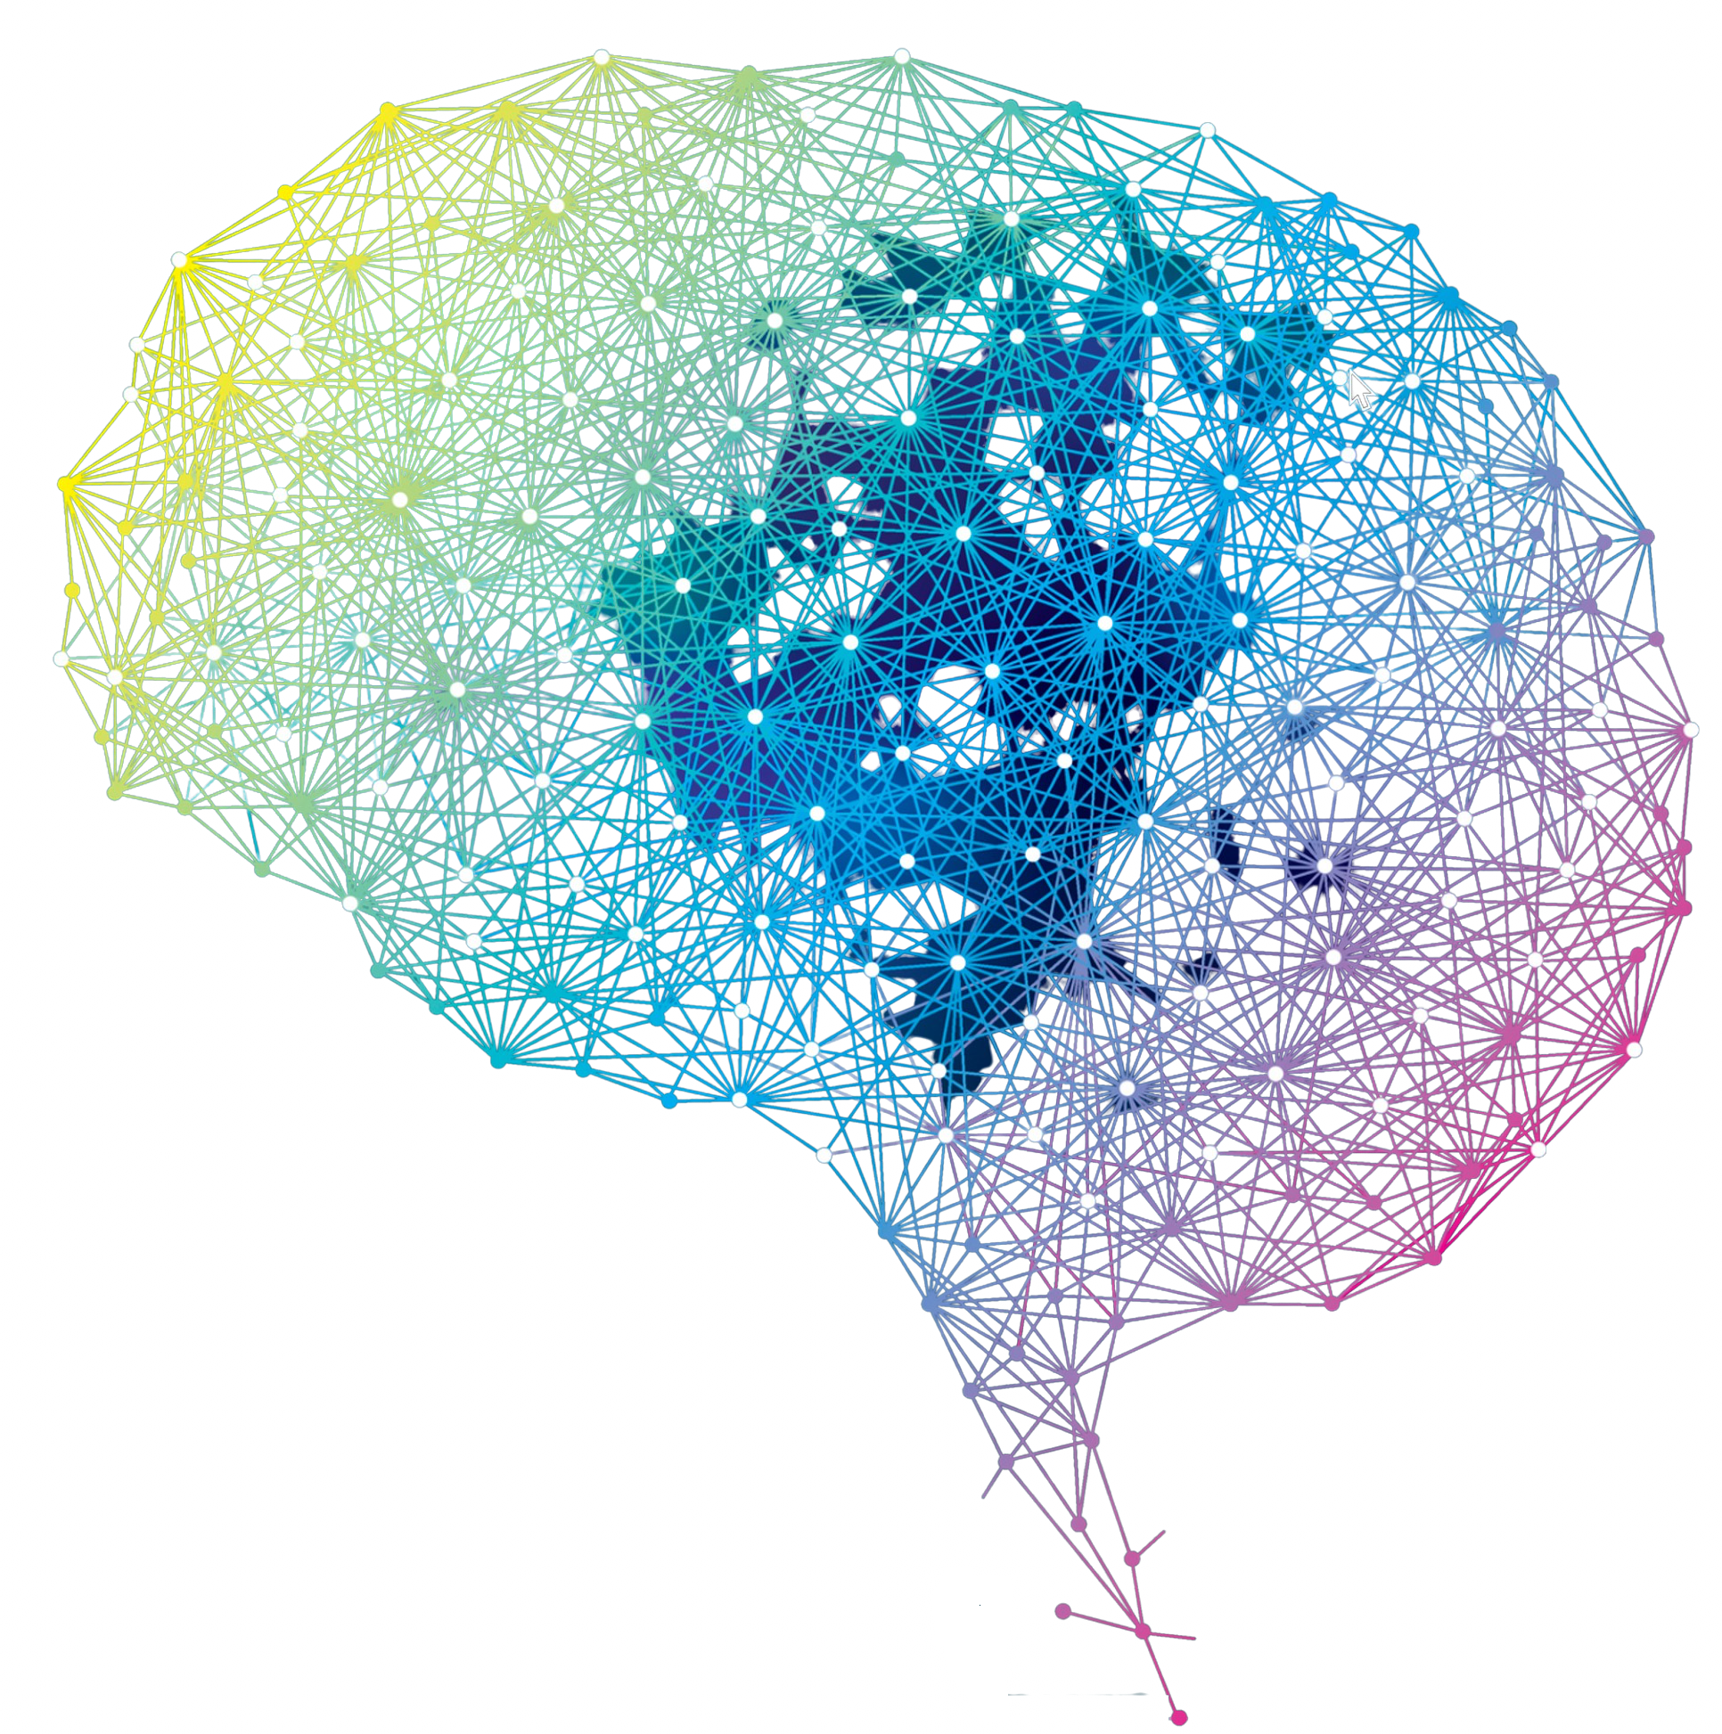
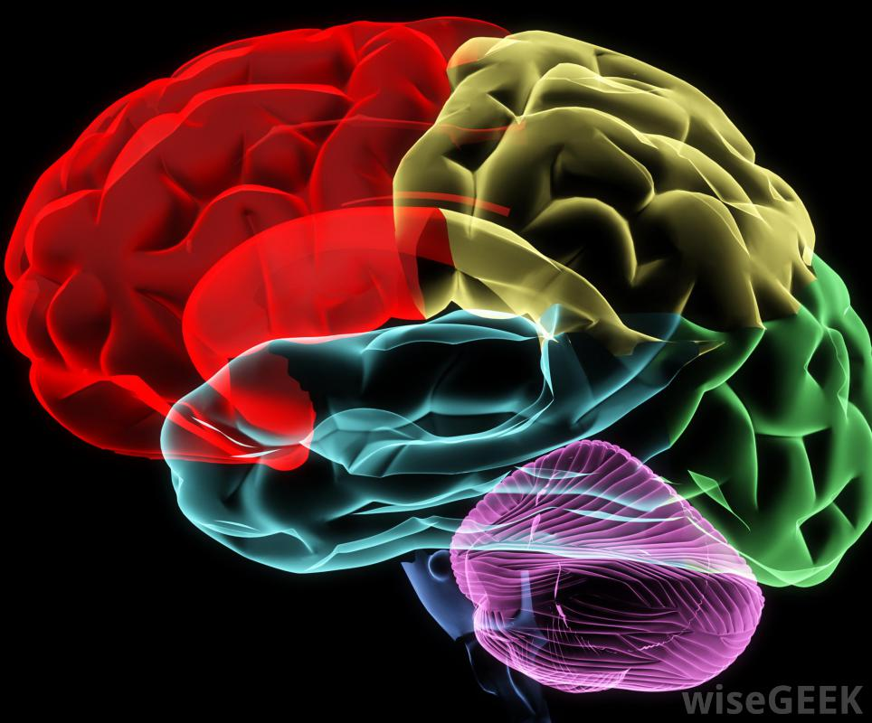

Slide 13
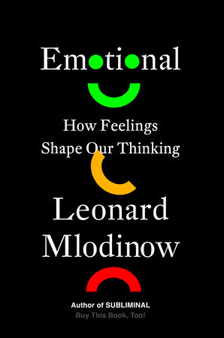
"Affective neuroscience tells us that biological information processing cannot be divorced from emotion, nor should it be. In humans, that means that emotion is not at war with rational thought, but rather a tool of it".

Slide 14
Problematizing Active Learning
Goal: Provide principles for thinking about how best to overcome passivity by addressing the integrated cognitive and affective processing strategies.

Slide 15
Active Learning and Cognition
3

Slide 16
Active Learning and Cognition
Cognitively, active learning involves three components:
Building Strong Memories
Building Flexible Memories
Building Control of Memories
knowledge, skills, experiences

Slide 17
Active Learning and Cognition
1. Building Strong Memories:
Meaningful Practice/Experience (Relate NK to PK)
Retrieval Practice/Experience (Testing Effect)
Spacing Practice/Experience (Spacing Effect)
Verbal Practice/Experience (Production Effect)

Slide 18
Active Learning and Cognition
2. Building Flexible Memories:
Elaborative Practice/Experience (PK to NK)
Purposeful Practice/Experience (Vary Use)
Prioritize Practice/Experience (Attention)
(Re)Organize Practice/Experience (Vary Organization)

Slide 19
Active Learning and Cognition
3. Building Control of Memories:
Metacognition
Self-Regulated Learning
Agency

Slide 20
Active Learning and Cognition
Cognitively, active learning involves three components:
Building Strong Memories
Building Flexible Memories
Building Control of Memories

Slide 21
Active Learning and Emotions
4

Slide 22
One minute reflection
Consider a learning experience that you recall being 'emotional'. What did you feel (body state)? What did you name that feeling? How did that feeling either detract or enhance your process?

Slide 23
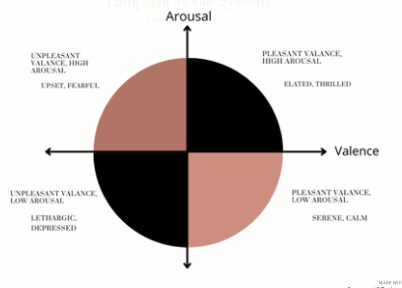
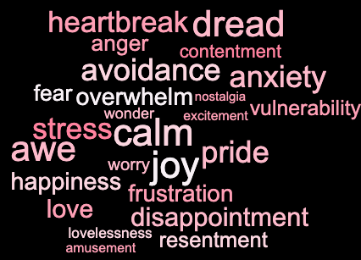
Affect/Emotion

Slide 24
Active Learning and Emotions
Regulating emotions
Motivating emotions
Managing emotional/cognitive resources

Slide 25
Regulating emotions

Slide 26
Regulating emotions
Cognitive re-appraisal:
reframing of negative appraisal to one that is more desirable (still based in reality)

Slide 27
Regulating emotions

Slide 28
Regulating Emotions
Cognitive reappraisal/mindfulness intervention:
Student performed better on final exam items from intervention days
Brief focusing activities at beginning of class increased long-term learning
Instructed reappraisal (online)
Instructed reappraisal
Reappraisal = higher engagement; higher learning outcomes
1. Cavanagh, S.R., Lang, J.M., Birk, J.L., Fulwiler, C.E., & Urry, H.L. (2019). A Multicourse, Multisemester investigation of the impact of cognitive reappraisal and mindfulness instruction on short-and long-term learning in the college classroom.
2. Strain, A. C., D’Mello, S.K. (2015). Affect regulation during learning: The enhancing effect of cognitive reappraisal

Slide 29
Motivating Emotions
Control-value theory
(Pekrun, 1992)
Appraisal of control and value
ACTIVATING OR DEACTIVATING ACTIVITY EMOTIONS
LEARNING & ACHIEVEMENT

Slide 30
Motivating emotions
 | Activating | Deactivating
Positive | Enjoyment Hope Joy Pride | Relaxation Relief Contentment
Negative | Anger Anxiety Shame | Boredom Frustration Hopelessness Sadness Disappointment
(Pekrun, 2014)

Slide 31
Emotions and motivation: A study
Learner control
Learning outcomes
Learner task value + control
Learning outcomes
Stark, L., Malkmus, E., Stark, R., Brunken, R., & Park, B. (2018). Learning-related emotions in multimedia learning: An application of control-value theory

Slide 32
Managing emotional/cognitive resources
/
impact of
affect/emotion
support
Img: mcdreeamiemusings.com

Slide 33
New approaches
Cognitive-affective theory of learning with media (CATLM), (Moreno, 2005):
Augmented Cognitive Load theory (Huk & Ludwigs, 2009)
Integrated Model of Cognitive-Affective Learning with Media (ICALM), (Plass & Kaplan, 2016)

Slide 34
Active Learning and Instructional Strategies
5

Slide 35
Problematizing Active Learning
Goal: Provide principles for thinking about how best to overcome passivity by addressing the integrated cognitive and affective processing strategies.

Slide 37
Active Learning and Instructional Strategies
Retrieval & Reappraisal
Can I provide opportunities for students to retrieve and apply knowledge & skills across time?
Can I help my students reframe negative/deactivating emotions before beginning the activity?

Slide 38
Active Learning and Instructional Strategies
Agency & Motivation
Can I provide opportunities for students to choose their own paths of learning and expression.
What opportunities can I provide for them to have choice/control with the assignment? How can I help them see the value?

Slide 39
Active Learning and Instructional Strategies
Flexibility & Focus
Can I provide opportunities for students to practice in various ways and for various purposes?
How can I design activities to decrease extraneous load and provide them opportunities to focus?

Slide 40
What No One’s Telling You About Active Learning
Active learning has no agreed upon definition.
Active learning is more complicated than a strategy.
Active learning fosters strong, deep, and controlled cognition.
Active Learning leverages emotions.
Active Learning is the synthesis of cognition, emotion, & behavior.

Slide 41
What No One’s Telling You About Active Learning
Krista Wojdak, Professor
Appalachian State University
wojdakkp@appstate.edu
Peter Doolittle, Professor
Virginia Tech
pdoo@vt.edu
All images from Unsplash.com

