Slide 1
Active Learning
Teaching • Learning • Engagement
Peter Doolittle, Professor
Educational Psychology
Virginia Tech • pdoo@vt.edu

Slide 2
Active Learning
I
Teaching • Learning • Engagement
Peter Doolittle, Professor
Educational Psychology
Virginia Tech • pdoo@vt.edu
all images either twu.edu or unsplash.com

Slide 3
What is active learning?

Slide 4
Anticipation Guide
Directions: For each of the following 3 sentences,
Agree
Disagree
Edit into agreement

Slide 5
Anticipation Guide
Active learning involves students doing things and thinking about the things they are doing.
Active learning-based classes result in more student learning than lecture-based classes.
Active learning works best in small STEM classes focused on problem solving.

Slide 6
Anticipation Guide
Active learning involves students doing things and thinking about the things they are doing.
Active learning-based classes result in more student learning than lecture-based classes.
Active learning works best in small STEM classes focused on problem solving.
It Depends.

Slide 7
Words
Rest
Tired
Awake
Dream
Snore
Bed
Eat
Slumber
Sound
Comfort
Wake
Night
Rest
Tired
Awake
Dream
Snore
Bed
Eat
Slumber
Sound
Comfort
Wake
Night
That’s all!

Slide 8
Connection
→
→
Meaning
Learning
Meaning is always an inside job.
(Agarwall, 2018; Craik, 2023; Craik & Tulving, 1975; Mayer, 1992)

Slide 9
scíthe
tuirseach
dúiseacht
aisling
snor
leaba
ithe
pillín
fuaim
compord
úisigh
oíche
Rest
Tired
Awake
Dream
Snore
Bed
Eat
Slumber
Sound
Comfort
Wake
Night

Slide 10
Active Learning – Part 1

Slide 11
Active Learning: A Beginning
Freeman et al. (2014)
AL vs Lecture Courses (225)
UG STEM Courses
Exam Scores & DFW Rates
AL → ↑ Exams & ↓ DFWs
Theobald et al. (2020)
AL vs Lecture Courses (41)
UG STEM Courses
Exam Scores & DFW Rates
AL → ↑ Exams & ↓ DFWs
Larger gains for students from underrepresented groups (narrowed achievement gap)

Slide 12
Active Learning: A Beginning
Freeman et al. (2014)
Theobald et al. (2020)
Lecture Classroom
Test Scores
Active Learning Classroom
Test Scores
Global Effect Size
Moderator Variables
Active Learning Intensity → ↓ Achievement Gap
Class Size, Course Level

Slide 13
What is Active Learning?
First Generation Active Learning Research
Second Generation Active Learning Research
Bernstein, 2018
Freeman et al., 2014
Streveler & Menekse, 2017

Slide 14
Active Learning – Part 2

Slide 15
What is Active Learning?
Driessen et al., 2020
Biology Ed
2016-2018
148 articles
83.5%
16.5%
Doolittle et al., 2023
STEM & Social Sci
2017-2022
586 articles
70.1%
29.9%
No Definition
Definition
Notes:
Dreissen: Top 2 Strategies: Discussion, Group Work Top Definition: Engaging and interacting
Doolittle: Top 2 Strategies: Group Work, Problem Solving Top Definition: ? ? ?

Slide 16
What is Active Learning?
Qualitative Analysis : 161 Definitions – 3 Themes
Active learning as grounded in student-centered constructivist theory.
Active learning promotes higher-order thinking and deeper learning.
Active learning as an instructional strategy involving activity, participation, and engagement.
Notes:
Dreissen: Top 2 Strategies: Discussion, Group Work Top Definition: Engaging and interacting
Doolittle: Top 2 Strategies: Group Work, Problem Solving Top Definition: ? ? ?

Slide 17
What is Active Learning Domains
accounting
biology
biomedical education
calculus
chemical education
chemistry
computer science
construction mgmt
cybersecurity
economics
education
engineering
English as a FL
geosciences
health sciences
Info technology
library science
mathematics
medical education
moral education
nutrition education
pharmacy education
philosophy
physical therapy
physics
political science
quantum field theory
recreational therapy
STEM
transportation
Active learning is not domain specific.
Notes:
WHATEVER ACTIVE LEARNING IS . . .

Slide 18
What is Active Learning? 190 Strategies
case-based learning
clickers
concept-point-recovery
controversial issues
cooperative learning
debate
design-based learning
discussion
dramatization
films
flipping
focused listening
group work
inquiry-based learning
jigsaw
laboratory learning
minute papers
music
online forums
peer instruction
flipping the class
questioning
reflection journals
role play
serious games
service learning
simulations
social media
student presentations
team-based learning
Active learning is not a strategy.
Notes:
48% of definitions were ”definition by strategy”

Slide 19
What is Active Learning? Application
flipping the class
flipping the class
flipping the class
flipping the class
flipping the class
flipping the class
flipping the class
flipping the class
flipping the class
flipping the class
flipping the class
flipping the class
flipping the class
flipping the class
flipping the class
flipping the class
flipping the class
flipping the class
flipping the class
flipping the class
flipping the class
flipping the class
flipping the class
flipping the class
flipping the class
flipping the class
flipping the class
flipping the class
flipping the class
flipping the class
Active learning is NOT a strategy.

Slide 20
What is Active Learning?
Active learning is not domain specific.
Active learning is not a strategy.
Active learning is not magic.

Slide 21
Active Learning – Part 3
No, really, what is it? 😳

Slide 22
→
→
Learning
Connection
Meaning
New
Knowledge
Prior
Knowledge
Meaningful Learning NK → PK
Elaborative Learning NK ← PK
Integrated Learning PK ⚡︎ PK
(Agarwal et al., 2021; Dunlosky et al., 2013; Norris & Kalm, 2021)
Notes:
Halloween was invented in Ireland - 2,000 years to the Celtic Samhain (SAH-win) festival: usher in “the dark half of the year.”

Slide 23
Processing
→
→
Learning
Connection
Meaning
→
→
→
Notes:
Halloween was invented in Ireland - 2,000 years to the Celtic Samhain (SAH-win) festival: usher in “the dark half of the year.”

Slide 24
Active
Learning
Processing
Connection
Meaning
Learning
→
→
→
Active learning fosters deep & flexible knowledge through
cognitive, social, behavioral, and affective processing
of one’s knowledge and experience.
deep
flexible
cognitive, social, behavioral, and affective processing
Notes:
Halloween was invented in Ireland - 2,000 years to the Celtic Samhain (SAH-win) festival: usher in “the dark half of the year.”

Slide 25
Cognitive
(thinking)
Behavioral
(doing)
What we process
we learn.
Affective
(feeling)
Social
(interacting)

Slide 26
Active Learning – Part 4

Slide 27
Word Pairs
Falling Snow
Laughing Child
Friendly Wolf
Picture Frame
Cold Food
Bright Sun
Writing Poetry
Windy Day
Quiet Forest
Big Airplane
Walking Tiger
Blue Sky
That’s it!

Slide 28
Let’s See What You Remember
Falling _____
Blue _____
Quiet _____
Friendly _____
Picture _____
Walking _____
_____ Sun
_____ Poetry
_____ Day
_____ Child
_____ Airplane
_____ Food
That’s it!

Slide 29
Where’s the active learning?
Performance
1
2
3
4
# of
Vowels
Repeat
5 Times
Write a
Sentence
Create an
Image
Groups
Notes:
Meaning

Slide 30
PROCESSING
`
Retrieved Relevant Prior Knowledge
Made Meaning of the Statement
Evaluated the Statement
Edited the Statement, as Needed
Indicated the Judgement
Retrieved Previous Judgement & Rationale
Organized an Explanation
Expressed the Explanation
Read Your Colleague for Understanding
Re-Generate a Response & Re-Express
Listen to Other’s Response
Make Meaning of their Response
Ask Questions, as Needed
Compare Self and Other’s Meanings
Generate Response and Respond
Deep
&
Flexible
Meaning
Learning
Think-Pair-Share
AL is NOT a strategy
AL is processing

Slide 31
PROCESSING
`
Retrieve Prior Knowledge as “true” or “false”
Express “true” or “false”
Listen to Other’s Response
Compare Self and Other’s Meanings
Generate Response and Respond
True / False Questions
Meaning?
Learning?
Think-Pair-Share

Slide 32
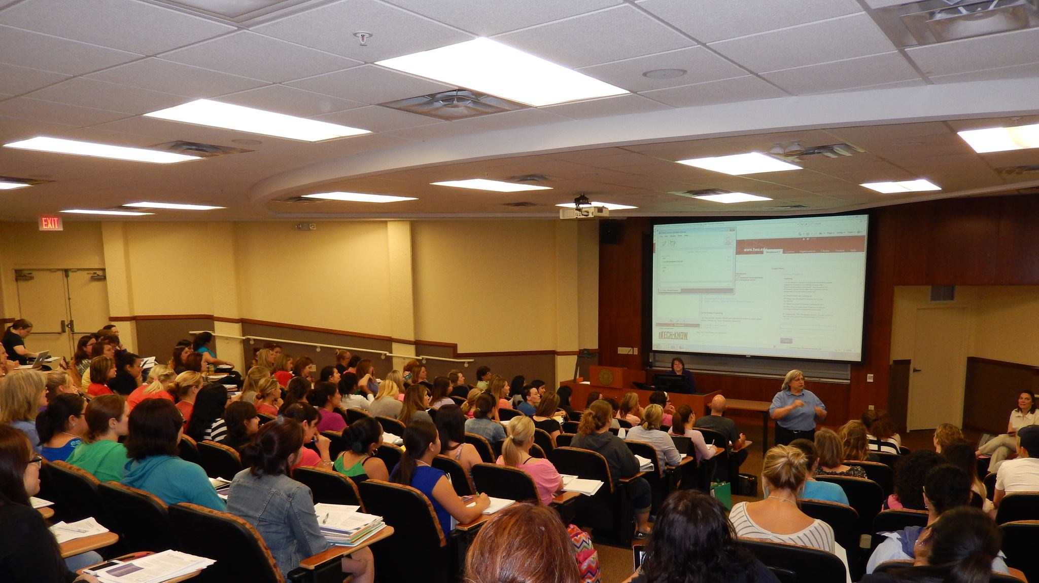
Active Learning – Part 5

Slide 33
Active
Learning
Processing
Connection
Meaning
Learning
→
→
→
Retrieval Effect
Spacing Effect
Generation Effect
Production Effect
Enactment Effect
Intuition
What we process
we learn.
Notes:
Halloween was invented in Ireland - 2,000 years to the Celtic Samhain (SAH-win) festival: usher in “the dark half of the year.”

Slide 34
Closure

Slide 35
What is active learning? (In your own words.)

Slide 36
Active Learning
II
Teaching • Learning • Engagement
Peter Doolittle, Professor
Educational Psychology
Virginia Tech • pdoo@vt.edu
all images either twu.edu or unsplash.com

Slide 37
Teaching for Active Learning

Slide 38
Cognitive
Behavioral
#1
#2
What we process
we learn.
#4
#3
Affective
Social

Slide 39
Active
Learning
Processing
Connection
Meaning
Learning
→
→
→
Retrieval Effect
Spacing Effect
Generation Effect
Production Effect
Enactment Effect
Intuition
What we process
we learn.
Notes:
Halloween was invented in Ireland - 2,000 years to the Celtic Samhain (SAH-win) festival: usher in “the dark half of the year.”

Slide 40
Why?
18 Letters
GLXRMSWPLBNZJQVCTD
GAXRESWOLBEZJUVCED
GAPREDLOLBETJUGPED
DARK DAYS BRING RAIN AND SNOW

Slide 41
Meaning is Everything

Slide 43
From the Student’s Perspective:
Active learning seems like a lot more work.
I know how to lecture + test, leave me alone.
If I don’t understand the material the first time
I’m not smart enough, or
you’re not a good enough teacher.
(Avargil et al., 2013; Bernstein, 2018; Deslauriers et al., 2019)

Slide 44
Implementation matters.
Active Learning is not magic.

Slide 45
Constructivism and Education

Slide 46
Constructivism and Education
20 Students (STEM, Social Science, Liberal Arts)
Knowledge and Knowing
Universal Truth versus Local Truth
Reading, Discussing, Explaining, Applying

Slide 47
Active Learning Course Components
Plan for
Processing
Cultivate
Meaning
Foster
Engagement
Encourage
Reflection

Slide 48
Plan for
Processing
Cultivate
Meaning
Foster
Engagement
Encourage
Reflection

Slide 49
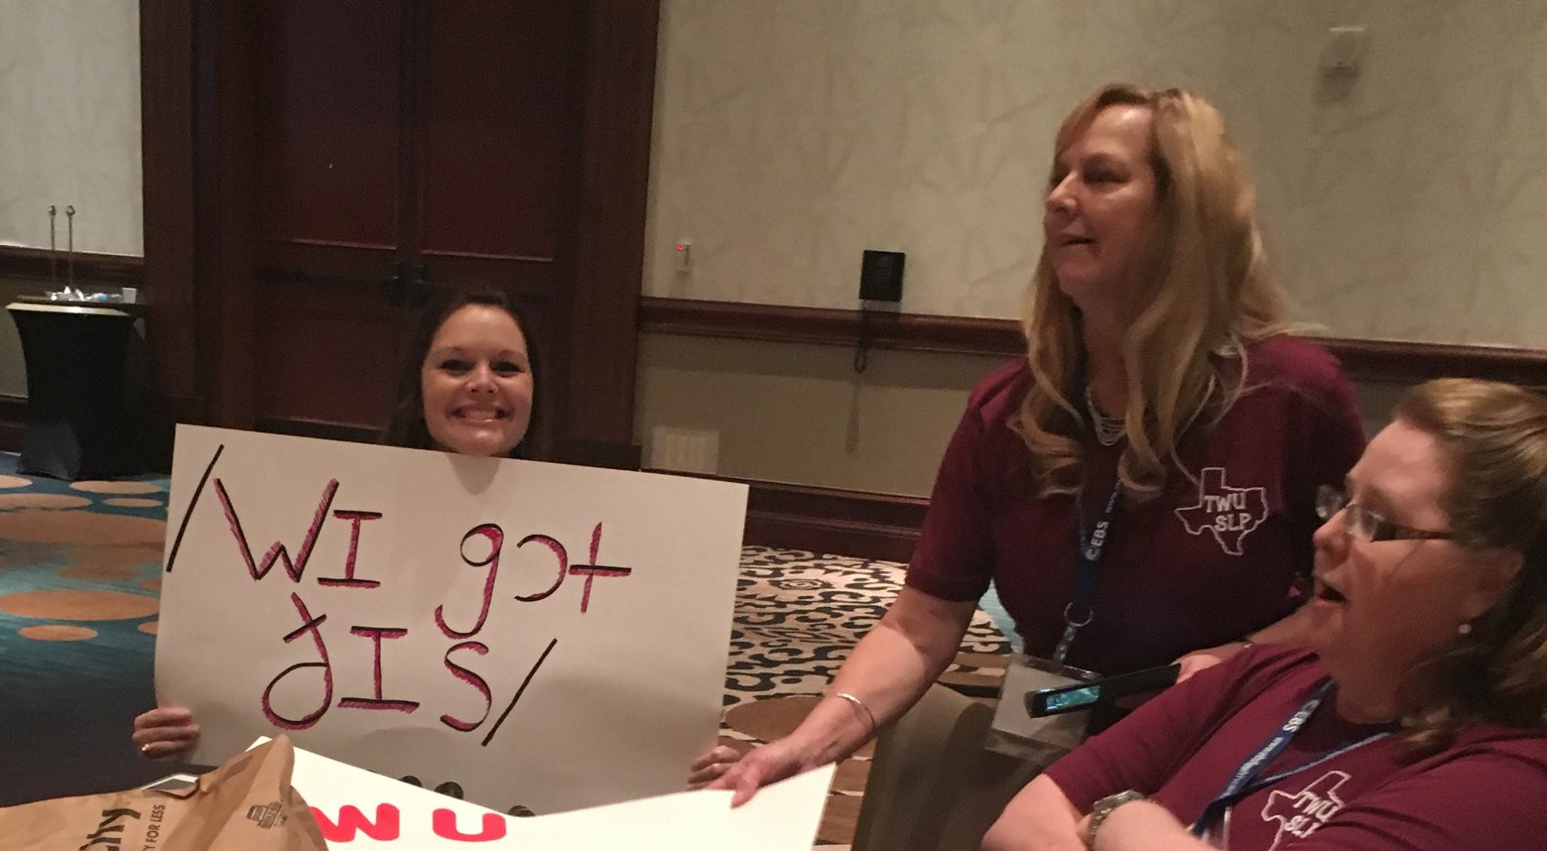
Active Learning Instructional Design
learning alignment
Purpose
Need
Goals &
Outcomes
Learning
Environment
C, B, S, & A
Processing
Student
Learning

Slide 50
Design Projects
Posters (Session)
Writing
Problem Solving
Case/Mini-Case Studies
Peer Review
Reading Responses
Video Creation
Reflections
25-Word Summaries
Design Critique
Problem Sets
Blog/Vlog Posts
Multiple-Choice Questions
MC Item Create/Evaluate
Oral Explanations
Presentation
Self-Created Artifact
Learning
Assessment
Developmntl
Feedback
Performance
Feedback
direct
formative
summative
Learning
Artifact
Purpose
Need
Goals &
Outcomes
Learning
Environment
C, B, S, & A
Processing
Student
Learning
Course Embedded Assessment
Be Better
Assess Better

Slide 51
Developmntl
Feedback
formative
Learning
Activity
C, B, S, & A
Processing
Purpose
Need
Goals &
Outcomes
Learning
Environment
Student
Learning
Be Better

Slide 52
Learning Effects & Instructional Design
Retrieval Effect
Spacing Effect
Generation Effect
Production Effect
Enactment Effect

Slide 53
Retrieval + Spacing, + Generation
Read Article
Write Summary
Summary Feedback
Complete Priming Quiz
Engage Activity
Daily Evaluation
Review Next Week
Complete Chart

Slide 54
25-Word Summaries
1-2 Readings per Class (Chapter, Article)
Write a 25-Word Summary (essential meaning)
Developmental Feedback of 2-3 Paragraphs
Grading Based on Scoring Rubric
Due Tues; Grade/Return on Wed; Class Thurs
70% of Course Grade

Slide 56
Oral Explanations
1 Explanation per Chapter (specific foci provided)
5-10 Minute Oral Explanations (essential meaning)
Developmental Feedback of 5-10 Minute Oral Explan
Grading Based on Scoring Rubric
Due Sun; Grade/Return on Mon; Class Tues
50% of Course Grade

Slide 57
Reading Responses
1-2 Response per Class (Article)
4 Questions (RQs, Method, Results, Discussion)
Developmental Feedback of 2-3 paragraphs
Grading Based on Scoring Rubric
Due Sun; Grade/Return on Mon; Class Tues
84% of Course Grade

Slide 58
Plan for
Processing
Cultivate
Meaning
Foster
Engagement
Encourage
Reflection

Slide 59
In-Class Activities
Clear Group Directions
Individual Think Time
Small Group Interaction Time
Large Group Reporting Out

Slide 60
In-Class Activity
Social Constructionism
List three events, language uses, or social institutions, that you know personally, that have a history (and a little about that history).
These could be global, national, local, or familial events, language uses, or social institutions of which you are familiar.

Slide 61
In-Class Activity

Slide 62
Plan for
Processing
Cultivate
Meaning
Foster
Engagement
Encourage
Reflection

Slide 63
Motivation & Engagement
Motivation The intent to act.
Engagement Acting.
Self-Efficacy Belief in successful action.

Slide 64
Effort
Persistence
Engagement
Achievement
Active Learning
Self-Efficacy
Motivation

Slide 65
Self-Efficacy
Motivation
Past Performance
Observation of Others
Persuasion by Others
Physiological Response
Control (Agency)
Constructive (Useful)
Competence (Success/SE)
Choice (Options)
Curiosity (Interest/Value)
Caring (Relationships)
Challenge (Difficult)
Notes:
Physiological Response (feeling) -> Emotion (label); cognitive reappraisal; affective processing interfaces with cognitive, behavioral, social

Slide 66
Effort
Persistence
Active Learning
Engagement
Achievement
Self-Efficacy
Motivation

Slide 67
Foster Engagement
Control: Summary Cycle, Group Work,
(choices) Q & A, Opportunities to Voice
Useful: Theory + Practice, Applied Group
(relevant) Work, Readings & Discussions
Caring: Day 1 Intros, Quiz, Name Plates,
(relationships) Always Call by Name, Greet,
Evaluation + Feedback
Notes:
Useful -> Relevant

Slide 68
Plan for
Processing
Foster
Engagement
Cultivate
Meaning
Encourage
Reflection

Slide 69
Encourage Reflections
Self-Focused / Self-Applied Activities
ddd

Slide 70
Daily Course Evaluations
Complete in 48 hours; Report back next class
1. What aspects of the content addressed in class are still confusing?
2. What elements of the instruction were particularly effective in stimulating learning?
3. Other comments/thought?

Slide 71
Confusing?
I'm kind of understanding the terms and very abstract things you explained. However, today my brain hurt so much. I think if you could provide us with more examples would be better.

Slide 72
Stimulating?
I loved that you addressed/invited the questions from the class on such deep/new/complex topics, rather than powering through the slides for the sake of "coverage".

Slide 73
Comments?
I really liked this article! It made sense and I knew exactly what it was talking about based on my own life experiences.
This week's article reminded me of the Oprah interview with Meghan Markle: "Were you silenT or silencED?"

Slide 74
What is active learning? (In your own words.)

Slide 75
Active
Learning
Processing
Connection
Meaning
Learning
→
→
→
Retrieval Effect
Spacing Effect
Generation Effect
Production Effect
Enactment Effect
Intuition
What we process
we learn.
Notes:
Halloween was invented in Ireland - 2,000 years to the Celtic Samhain (SAH-win) festival: usher in “the dark half of the year.”

Slide 76
Questions?

Slide 77
Active Learning
Teaching • Learning • Engagement
Peter Doolittle, Professor
Educational Psychology
Virginia Tech • pdoo@vt.edu

Slide 78
