Slide 1
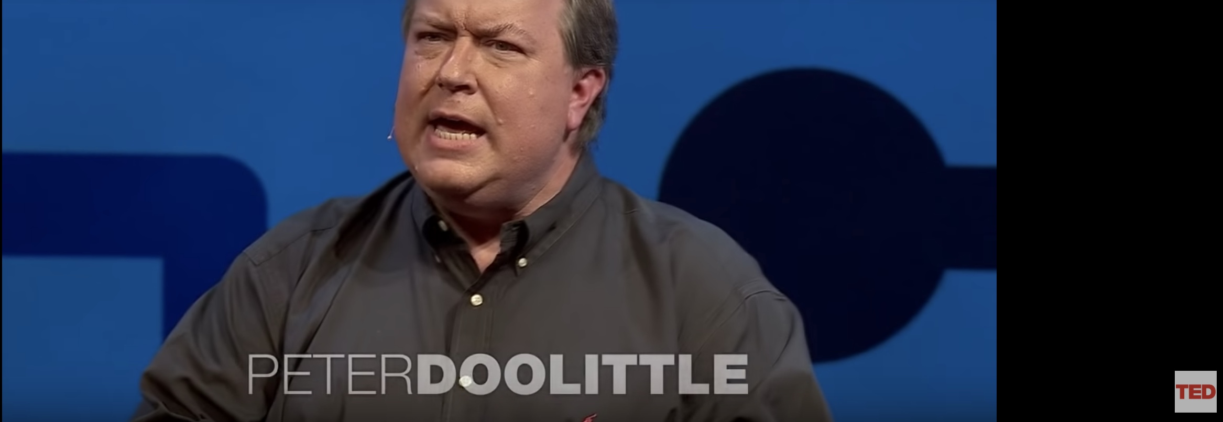
Questions For Doo

Slide 2
Questions for Doo
So what is wrong with me talking about learning styles? Isn’t that what multiple intelligences are all about?

Slide 3
Questions for Doo
So what is the problem with the idea of Digital Natives? I mean little kids are great on ipads and love Minecraft.

Slide 4
Questions for Doo
So how come all my friends seem really good at multi-tasking and getting their work done, why can’t I?

Slide 5
Questions for Doo
So which strategies or multimedia are best tools to support learning? How can I compare or determine which strategy or tool will work best?

Slide 6
Questions for Doo
So when people talk about constructivist teaching what makes group work the best thing to do to help all children learn?

Slide 7
Questions for Doo
So what’s the point in even having teachers if we can use technologies to create personalized learning paths for all students?

Slide 8
Questions for Doo
So why does hicks lose his S#%t when I write: SWBAT: Understand the causes of the civil war
(Slavery)

Slide 9
Questions for Doo
So how can I align instruction with student learning if is it freaking invisible and so hard to measure?

Slide 10
Questions for Doo
So, how do I know when I am supporting student learning? What types of evidence can I use in my instructional design?

Slide 11
Questions for Doo
So, isn’t inquiry learning just a fad same as problem based learning? I already know how to teach why bother with such fads?

Slide 12
Questions for Doo
So what digital technologies do you feel can support learning? What do you like to use with students? How do you choose when and why to use them

