Slide 1
Working Memory & Mindfulness
Reducing Distractions and Increasing Learning
Peter E. Doolittle
Assistant Provost for Teaching and Learning
Executive Director, Center for Instructional Development and Educational Research
Professor, Educational Psychology
Virginia Tech

Slide 2
Agenda
Introduction
Mind Wandering
Working Memory
Multitasking
Mindfulness
Conclusion

Slide 3
Cognitively
Behaviorally
What we process
we learn.
Affectively
Socially

Slide 4
Learning is not by magic, it’s by design.
Learning
Assessment
Student
Feedback
Learning
Artifact
C, B, S, & A
Processing
Goals &
Outcomes
Learning
Environment
Student
Learning
Course Embedded Assessment
Purpose
Need

Slide 5
Mindfulness – The Basics
Washing the dishes to wash the dishes.
Teaching the class
to teach the class.
Driving the car to drive the car.

Slide 6
Mindfulness – The Basics
Mindfulness
is being present,
conscious, & aware.

Slide 7
Mind Wandering

Slide 8
A shift from an
ongoing activity to
task-unrelated thoughts
↑
Task
Performance
↓
Mind
Wandering
→
↑ task complexity → ↓ mind wandering
↑ task difficulty → ↓ mind wandering
↑ task interest → ↓ mind wandering
↑ boredom → ↑ mind wandering
↑ time on task → ↑ mind wandering
↑ pre-existing concerns → ↑ mind wandering
(Hollis & Was, 2016; Jha et al., 2010; McVay & Kane, 2010; Mrazek et al., 2013)

Slide 9
Mind Wandering Probe
I am focused on the task. Raise your hand.
My mind as wandering.

Slide 10
Becoming Mindful
Breathing
Conscious breathing
Conscious controlled breathing
Conscious
Breathing
Awareness
Focus
Present
Moment
Distraction
“By concentrating on our breath, we bring body and mind back together, and become whole again.”

Slide 11
Benefits of Mindfulness
Reduction of stress and depression.
Reduction of distraction.
Reduction of work burnout.
Better communication in relationships.
Increase in relationship wellbeing and empathy.
Increase in sleep quality, creativity, and productivity.
Increase in quality of life.
Grossman, Niemann, Schmidt & Walach (2003); Klatt, Buckworth, Malarkey (2011)

Slide 12
Mindfulness and Learning
Zhang, C., et al. (2016). The effects of mindfulness training on beginner’s skill acquisition in dart throwing. Psychology or Sport and Exercise, 22, 269-285.
43 First-Year College Students
G1: Psychology Lectures (n = 21)
G2: Mindfulness Training (n = 22)
8-week dart training program
Dart Performance Assessed pre/post/follow-up

Slide 13
Mindfulness and Learning

Slide 14
↑
Working Memory
Capacity
→
↓
Mind
Wandering
→
↑
Task
Performance
(Hollis & Was, 2016; Jha et al., 2010; McVay & Kane, 2010; Mrazek et al., 2013)

Slide 15
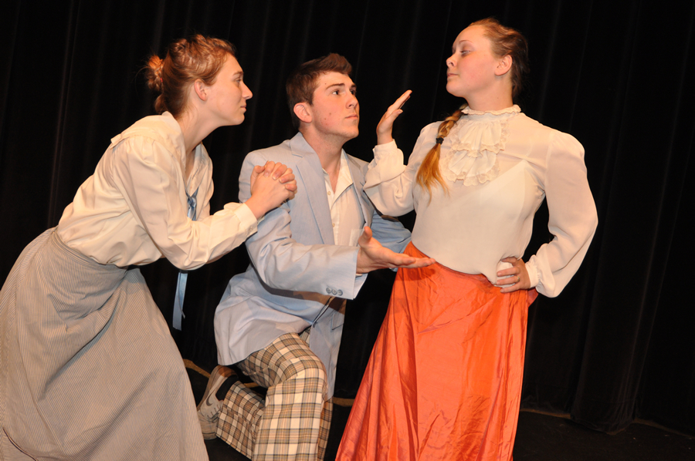
Working Memory Capacity
Short Term Memory

Slide 16
Write down as many letters as you can remember, in order.
Letters
BCYHLPFTNWBNWZSCPL

Slide 17
Short-Term Memory
Short term memory = retention of a small amount of information for a short amount of time
100%
50%
0%
2 4 6 8 10 12

Slide 18
Working Memory Capacity
Crucible of Thought
Attention to Experience
Stores Immediate Experiences
Access Long-Term Memory
Processes Experience and Memory
Maintains Current Goal for Processing
(especially in the presence of distraction)
STM = Storage
WMC = Storage + Processing = Attentional Control
(Doolittle & Mariano, 2008; Unsworth & Engle, 2007; Vergauwe et al., 2015)

Slide 19
Mind Wandering Probe
I am focused on the task. Raise your hand.
My mind as wandering.

Slide 20
Mindfulness & Working Memory
Present
Conscious
Aware
Attention
Control
Working
Memory
Capacity
Mindfulness

Slide 21
Working Memory Capacity
Recall the words out loud, in order.
(3 + 7) / 2 = 5 ? Cow
(8 - 3) + 1 = 7 ? Star
Cow, Star
Operation Span Task

Slide 22
Working Memory Capacity
Recall the words out loud, in order.
(9 - 6) / 3 = 2 ? Grass
Grass, Phone
(5 + 3) - 6 = 2 ? Phone

Slide 23
Working Memory Capacity
100%
50%
0%
2 3 4 5

Slide 24
Working Memory Capacity
Recall the words out loud, in order.
White, Cement, Pony
(3 + 4) + 2 = 9 ? Cement
(7 + 2) + 1 = 9 ? White
(2 - 0) / 2 = 2 ? Pony

Slide 25
Working Memory Capacity
100%
50%
0%
2 3 4 5

Slide 26
Working Memory Capacity
Recall the words out loud, in order.
Book, Printer, Speaker, Duck
(4 / 2) - 4 = 4 ? Duck
(3 + 2) - 4 = 2 ? Book
(6 + 2) / 4 = 2 ? Printer
(8 - 3) * 2 = 10 ? Speaker

Slide 27
Working Memory Capacity
100%
50%
0%
2 3 4 5

Slide 28
Working Memory Capacity
Recall the words out loud, in order.
(2 + 1) * 3 = 9 ? Lips
(6 - 4) * 3 = 8 ? Wired
(1 + 7) / 4 = 2 ? Explore
System, Explore, Lips, Wired, Spring
(5 + 5) - 6 = 4 ? Spring
(9 - 2) - 2 = 4 ? System

Slide 29
Working Memory Capacity
100%
50%
0%
2 3 4 5 6 7 8
Working Memory Capacity
Short Term Memory

Slide 30
Mind Wandering Probe
I am focused on the task. Raise your hand.
My mind as wandering.

Slide 31
Working Memory Capacity
Positive impacts (↑WMC) include:
Fluid Intelligence
LTM Activation
Attentional Control
Reading/Language Comprehension
Reasoning
Storytelling
Complex Cognition
(Doolittle & Mariano, 2008; Unsworth & Engle, 2007; Vergauwe et al., 2015)

Slide 32
Working Memory Capacity
WMC = Storage + Processing = Attentional Control
High WMC = Competent Complex Cognition
Low WMC = Challenging Attentional Control

Slide 33
Working Memory Capacity
Working Memory Training ≠ ⬆ WMC
Learn & Use Strategies
(Redick, Shipstead, Wiemers, Melby-Lervag, &Hulme, 2015)

Slide 34
Working Memory Capacity
WMC Strategies
Segmenting Instruction
Scaffolding Instruction
Lower Cognitive Load/Lower Information Density
Examples, Examples, Examples
Practice with Feedback
multitasking

Slide 35
↑
Mindfulness
Practice
→
↑
Working Memory
Capacity
→
↓
Mind
Wandering
→
↑
Task
Performance
(Hollis & Was, 2016; Jha et al., 2010; McVay & Kane, 2010; Mrazek et al., 2013)

Slide 36
Mrazek et al. (2013)
48 UG students in 2 sections of a 2 week class
Sections randomly assigned to mindfulness or nutrition condition
Mindfulness condition: 10-20 minutes of mindfulness exercises per class &
10 minutes of mindful meditation per day
Nutrition condition: 10-20 minutes of nutrition science & strategies per class
10 minutes of logging food intake per day
Working Memory Capacity: One week prior and following class (OSPAN)
GRE Reading Comprehension: One week prior and following class
Mind Wandering: Thought sampling and self reports
during WMC and GRE testing
↑
Mindfulness
Practice
→
↑
Working Memory
Capacity
→
↓
Mind
Wandering
→
↑
Task
Performance
Mindful
Nutrition
Pre Post
Pre Post
Pre Post
(Hollis & Was, 2016; Jha et al., 2010; McVay & Kane, 2010; Mrazek et al., 2013)

Slide 37
Mindfulness Strategies
STOP – when stressed and breath
Stop what you are doing
Take five conscious breaths
Observe your body and mind
Proceed
Create a routine of mindful breathing
Before entering first class/all classes
In the middle of a class
Before meals
Before studying

Slide 38
Mindfulness Strategies
Do one thing at a time (no multitasking)
Turn off all technology for a period of time
Actively listen to the teacher and peers
Take a body scan during the day to identify potential sites of stress and tension in the body
Get out and move (around campus/building/halls)
Use mind wandering probes to make wandering conscious
Reflect on the day, noting accomplishments

Slide 39
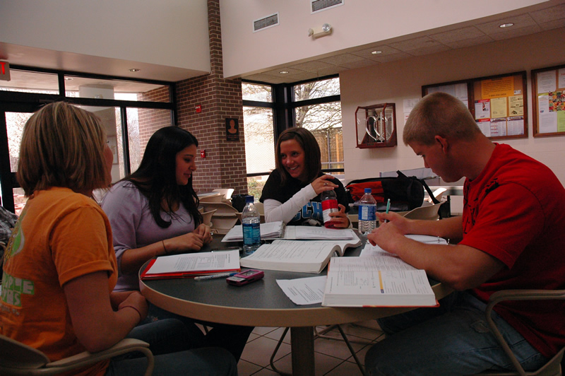
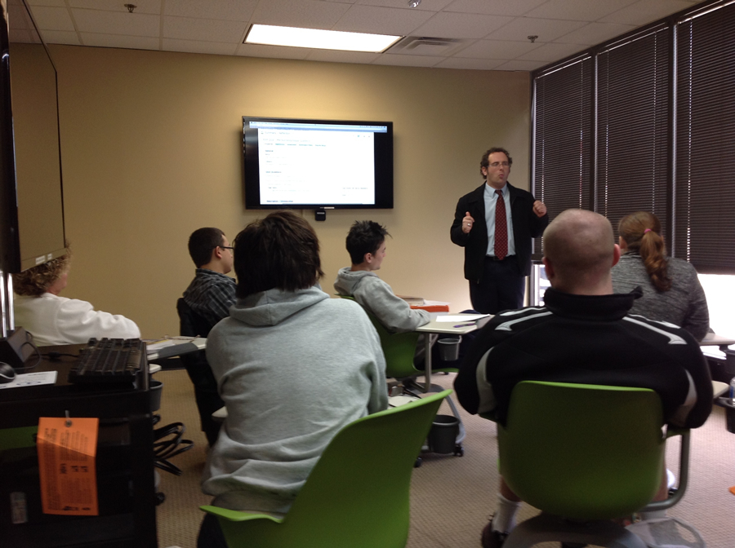
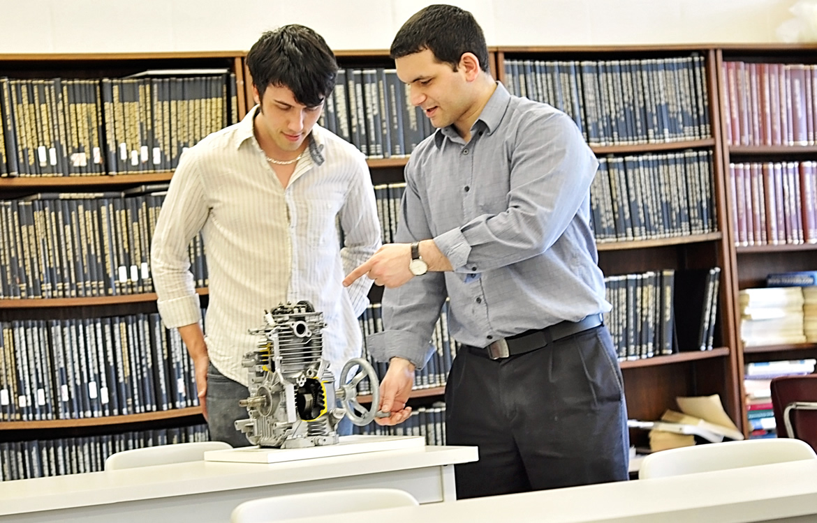
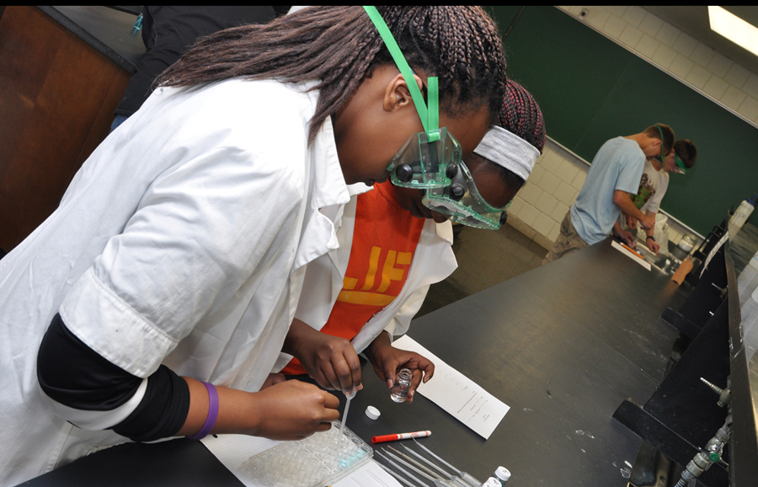
Be Attentive + Mindful + Engaged

Slide 40
Working Memory & Mindfulness
Reducing Distractions and Increasing Learning
Peter E. Doolittle
Assistant Provost for Teaching and Learning
Executive Director, Center for Instructional Development and Educational Research
Professor, Educational Psychology
Virginia Tech

Slide 41
Processing…

Slide 42
When Hype & Research Collide
Multitasking

Slide 43
Multitasking: The Myth
Tapscott, 1998
multitasking
Frand, 2000
“multitasking way of life”
Prensky , 2001
“digital natives accustomed to the twitch-speed, multitasking “
Watson, C. E., Terry, K.,& Doolittle, P. (2012). Please read while texting and driving.
In J. Groccia (Ed.), To improve the academy (vol. 31) (pp. 295-310). Bolton, MA: Anchor.

Slide 44
Was Any Research Available?
“The greater the number of objects to which our consciousness is simultaneously extended, the smaller is the intensity with which it is able to consider each.”
Hamilton, Mansel, & Veitch
1861
Attend
Encode
Store
Process
LTM

Slide 45
Processing and WMC
2 to 60 by 2s

Slide 46
1. To what was pledged allegiance?
2. What country was mentioned in the passage?
3. For what does the flag stand?
4. The flag symbolizes how many nations?
5. What deity was mentioned in the passage?

Slide 47
Results
5
4
3
2
1
0
Task A Task B Task C
1 to 30 by 1s

Slide 48
1. What are we urged to do in the passage?
2. What was the original name of the drink?
3. What was the subsequent name of the drink?
4. How many actual liquids are mentioned?
5. What was distilled in the passage?

Slide 49
Results
5
4
3
2
1
0
Task A Task B Task C
100 to 7 by -7s

Slide 50
1. What is a good name like?
2. Why is good name good?
3. What types of odors are "more durable?”
4. Odors are more durable than what?
5. What is the general point of the passage?

Slide 51
Results
5
4
3
2
1
0
Task A Task B Task C
A + A
A + C
C + C
Low
Med
High

Slide 52
Multitasking and Research
“The truth to multitasking is evident in the empirical studies… humans lack the cognitive, behavioral, and cortical structures necessary to multitask effectively.”
-- Watson, Terry, & Doolittle (2012)

Slide 53
Multitasking and Research
“fMRI technology found that multitasking is not actually a concurrent process, but a sequential one that involves task-switching.”
-- Charron & Koechlin, 2010

Slide 54
Multitasking and Research
“There is no evidence that multitasking is a new phenomenon exclusive to digital natives … there is a clear mismatch between the confidence with which [digital native] claims are made and the evidence for such claims.”
-- Bennett, Maton & Kervin, 2008

Slide 55
A Few Multitasking Results
⬆ MT with a laptop in class ➔ ⬇ retention & class performance
⬆ MT while studying ➔ ⬇ class performance
⬆ laptop multitasking ➔ ⬇ performance by multitasker (11 %)
⬆ laptop multitasking ➔ ⬇ performance by nearby peers (17 %)
⬆ MT associated with ⬇ self-regulatory behaviors
⬆ FB associated with ⬆ MT associated with ⬇ class performance
(Judd, 2013; Junco & Cotton, 2011; Sana, Weston, & Cepeda, 2012; Zhang, 2015)

Slide 56
Accounting Students & Professionals
24 years old
50 years old
10
8
6
4
2
0
Professionals
Students
Group A
Basic Math +
Challenging Video
Group B
Applied Math +
Challenging Video
Negangard, Ozlanski, Pyzoha, & Doolittle (2015)

Slide 57
Students & Faculty
19 years old
41 years old
10
8
6
4
2
0
Students
Faculty
Group A
Challenging Video
Group B
Survey +
Challenging Video
Doolittle (2015)

Slide 58
Multitasking, Teaching, and Learning
Students need to be conscious of multitasking - multitasking decreases learning and performance.
Students need to create non-multitasking environments in which to read, plan, & think – be self-regulated.
Students should foster automaticity and expertise though practice and feedback to reduce the effects of multitasking.

Slide 59
Multitasking, Learning, & Technology
Faculty need to be conscious of multitasking - multitasking decreases learning and performance.
Faculty need to scaffold students’ learning when multitasking is likely to be necessary.
Faculty should foster automaticity and expertise though practice and feedback to reduce the effects of multitasking.

