Slide 1
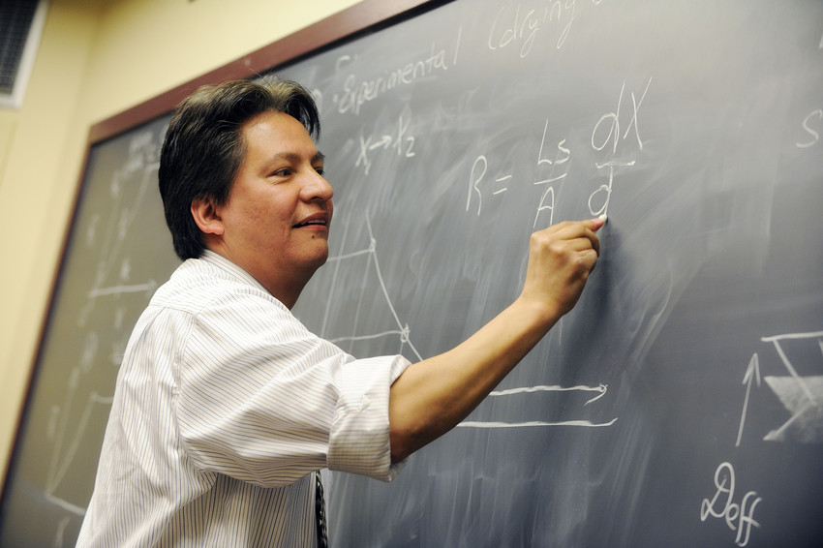
Fair and Defensible Grading Strategies for Enhancing Student Learning and Assessment
Peter E. Doolittle
Assistant Provost of Teaching and Learning
Executive Director, Center for Instructional Development and Educational Research
Professor, Educational Psychology, Department of Learning Sciences & Technology
Virginia Tech • Blacksburg • Virginia
http://www.cider.vt.edu/temp/grading2.pdf
Notes:
Peter

Slide 2
Overview
Introduction
Learning First
Instructional Design & Grading
Syllabus Design & Grading
Course Embedded Assessments/Learning Assessments
Conclusion
http://www.cider.vt.edu/temp/grading2.pdf
Notes:
Tell story of first class here

Slide 3
Anticipation Guide
Grades are, and always have been, useless.
Grading should be based on achievement, performance, and attendance.
Students’ learning is best determined by their ability to “do,” not their ability to “know.”
http://www.cider.vt.edu/temp/grading2.pdf

Slide 4
What’s in a Grade?
A
academic achievement & performance
http://www.cider.vt.edu/temp/grading2.pdf

Slide 5
Learn: Knowledge is Power

Slide 6
Learning First
The processing of knowledge, experience, and self.

Slide 7
Activity #2 – Task A
Directions: Count from 2 to 60 by 2s, writing down the math.
1. To what was pledged allegiance?
2. What country was mentioned in the passage?
3. For what does the flag stand?
4. The flag symbolizes how many nations?
5. What deity was mentioned in the passage?

Slide 8
Results
5
4
3
2
1
Task A Task B Task C

Slide 9
Activity #2 – Task B
Directions: Count from 1 to 30 by 1s, writing down the math.
1. What are we urged to do in the passage?
2. What was the original name of the drink?
3. What was the subsequent name of the drink?
4. How many actual liquids are mentioned?
5. What was distilled in the passage?

Slide 10
Results
5
4
3
2
1
Task A Task B Task C

Slide 11
Activity #2 – Task C
Directions: Count from 100 down to 2 by subtracting 7s, writing down the math.
1. What is a good name like?
2. Why is good name good?
3. What types of odors are "more durable?”
4. Odors are more durable than what?
5. What is the general point of the passage?

Slide 12
Results
5
4
3
2
1
Task A Task B Task C
A + A
A + C
C + C

Slide 13
Multitasking and Research
“The truth to multitasking is evident in the empirical studies… humans lack the cognitive, behavioral, and cortical structures necessary to multitask effectively.”
-- Watson, Terry, & Doolittle (2012)

Slide 14
Multitasking and Research
“fMRI technology found that multitasking is not actually a concurrent process, but a sequential one that involves task-switching.”
-- Charron & Koechlin, 2010

Slide 15
Multitasking and Research
“There is no evidence that multitasking is a new phenomenon exclusive to digital natives … there is a clear mismatch between the confidence with which [digital native] claims are made and the evidence for such claims.”
-- Bennett, Maton & Kervin, 2008

Slide 16
Results
5
4
3
2
1
Task A Task B Task C
A + A
A + C
C + C

Slide 17
Cognitively
Behaviorally
What we process
we learn.
PROCESSING
Affectively
Socially

Slide 18
Design: Plan Ahead

Slide 19
Instructional Design & Grading
Integrating grading into the design of effective instruction.

Slide 20
Instructional Design & Grading
Instructional design involves systematically
planning,
developing,
evaluating, and
managing
the instructional process, based on principles of learning and instruction.
Proactive Teaching

Slide 21
Instructional Design & Grading
Needs Assessment
Learner Assessment
alignment
Context Assessment
Content Assessment
Instructional Outcomes
Instructional Sequence
Instructional Lesson Design
Instructional Assessment
Instructional Grading

Slide 22
Instructional Grade
Academic Achievement & Performance
Attendance & Participation
Extra-credit & Bonus-points
Effort & Labor
Growth & Improvement
Conduct & Manners

Slide 23
Design, Assessment, Grading
Student
Assessment
Learning
Outcomes
Learning
Environment
C, B, S, & A
Processing
Student
Learning
Active Learning
Engaged Students
Hands On Minds On
Learning
Artifact
Accrediting
Assessment
Learning
Assessment
Assessment for Free
Course embedded assessment is not magic, it’s by design.

Slide 24
Design, Assessment, Grading
Explain Social
Interaction
Read
Articles
Analyze,
Synthesize,
Organize
Explain Social
Interaction
25-Word
Summaries
Scoring
Guide
Assessment for Free

Slide 25
Design, Assessment, Grading
Course
Purpose
Instructional
Outcomes
Instructional
Assessments
Instructional
Grades
Clearly and Explicitly Communicated on Syllabus

Slide 26
Grade Principles
Grades should be a natural extension of good instructional design.
Grades should be based on academic achievement and performance.
Grades should emerge from course embedded assessments.
Grade determination should be clearly explained on the course syllabus.

Slide 27
Grading is Ill-structured

Slide 28
Grading in the Weeds

Slide 29
Assessing is Sampling
Potential
Course Content
Course
Assessments
Indicator 1
Indicator 2
Indicator 3
Indicator 4
Indicator 5
Infer Learning
Assign Grade
Actual
Course Content

Slide 30
Sampling is Aligning
Course
Purpose
Instructional
Outcomes
Instructional
Assessments
Instructional
Grades
Align the assessments with the outcomes.
Create assessments, rather than selecting them.

Slide 31
Types of Assessments
Generate a list of two (2) assessments that are not “standard.”

Slide 32
Aligning Assures Validity
How might we assess the following indicator?
The student will be able to explain relevant course terms and concepts.

Slide 33
Aligning Assures Validity
How might we assess the following indicator?
The student will be able to analyze historical primary source materials using the SCIM strategy.

Slide 34
Aligning Includes Evaluations
Course
Purpose
Instructional
Outcomes
Instructional
Assessments
Instructional
Grades
Performance
Measurement
Performance
Evaluation
Test, Quiz,
Presentation
# Correct,
Rubric

Slide 35
Rubrics vs Scoring Guides
Rubrics and scoring guides are designed to
reduce the variability in evaluating
decrease the time it takes to grade
provides foci for student performance

Slide 36
Rubrics
 | Missing (0 pts) | Poor (2 pts) | Good (4 pts) | Excellent (6 pts)
Dimension 1 | Description | Description | Description | Description
Dimension 2 | Description | Description | Description | Description
Dimension 3 | Description | Description | Description | Description
Dimension 4 | Description | Description | Description | Description

Slide 37
Scoring Guide
1. Dimension 1 6 points
Attribute 1.1
Attribute 1.2
Attribute 1.3
2. Dimension 2 6 points
Attribute 2.1
Attribute 2.2
Attribute 2.3
___/12 points

Slide 38
Points are Feedback
Course
Purpose
Instructional
Outcomes
Instructional
Assessments
Instructional
Grades
Performance
Measurement
Performance
Evaluation
Test, Quiz,
Presentation
# Correct,
Rubric
Performance
Points

Slide 39
Points are Feedback
Performance evaluation points should represent students’ achievement and performance on a specific performance measure.
Performance evaluation points should reflect the c, s, b, & a processing importance of the learning activity/artifact.

Slide 40
Points are Feedback
Microteaching 400 pts
Oral Explanations 200 pts
Scholarly Reading 200 pts
Teaching/Learning Philosophy 200 pts
Most points =
Most important c, s, b, & a processing
in order to fulfill the course purpose

Slide 41
Points and Motivation
The 7 C’s of Motivation
1. Challenge 5. Caring (interest/value)
2. Choice 6. Competence
3. Control 7. Collaboration/Connectedness
4. Curiosity
Keep in mind that points are not the same as grades.
Points are performance and performance is processing.

Slide 42
Grading on the Curve
Just say no.

Slide 43
Guidelines for Clarity

Slide 44
Guidelines for F & D Grading
Discuss with students the basis of all grading – make grading transparent.
Make grading explicit through the syllabus and activity guides.
Base grades on achievement and performance only.
Return evaluated assessments promptly and with feedback.

Slide 45
Guidelines for F & D Grading
Align assessments with course outcomes, instructional strategies, and purposes.
Base grades on a composite of several aligned assessments.
Assign course points based on which learning assessment activities are most important in achieving the course purpose.

Slide 46
The End

