Slide 1
Active Learning
II
Educate a woman, empower the world.
Peter Doolittle, Professor
Educational Psychology
Virginia Tech • pdoo@vt.edu
All images from
unsplash.com or twu.edu

Slide 2
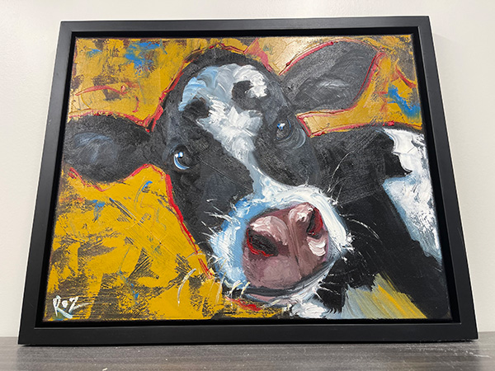
Introductions
Name
Domain
An achievement this summer
Why?
Caring
Trust & Safety
Notes:
Trust, Safety, Caring

Slide 3
Anticipation Guide
Directions: For each of the following 3 sentences,
Agree
Disagree
Edit into agreement

Slide 4
Anticipation Guide
Strategies that foster active learning include: case studies, lectures, and experiments.
Effective active-learning instruction makes learning more effortful, collaborative, and engaging.
We learn more from doing than reading, and more from reading than listening (doing > reading > listening).
Why?
It Depends.
Interactive Pedagogy
Priming
Spread of Activation

Slide 5
What do you remember from last year?

Slide 6
Teaching & Learning
Take Risks with Your Teaching
Notes:
(a) We’ve all spent 20+ years in class as a student; 1-20 years in the class as a teacher. None of that makes us knowledgeable and skilled at teaching. (b) That’s the way learning works—domain specific. Cooking meals, driving car, writing. 30 seconds to lose control of my first class. (c) I’m not here to tell you how to teach. I’m here to offer you ways to teach. (d) We are among friends.

Slide 7
Knowledge
Knowledge Structures
Declarative
Facts
Concepts
“Knowing That”
Procedural
Processes
Skills
“Knowing How”
Conditional
Strategies
Decisions
“Knowing When”
Schemas
Domains
Models
Frameworks

Slide 8
I say moreover that you make a great, a very great mistake, if you think that psychology, being the science of the mind's laws, is something from which you can deduce definite . . . methods of instruction for immediate schoolroom use.
An intermediary inventive mind must make the application, by using its originality.
- William James, 1899, Talks to Teachers (p. 10)

Slide 9
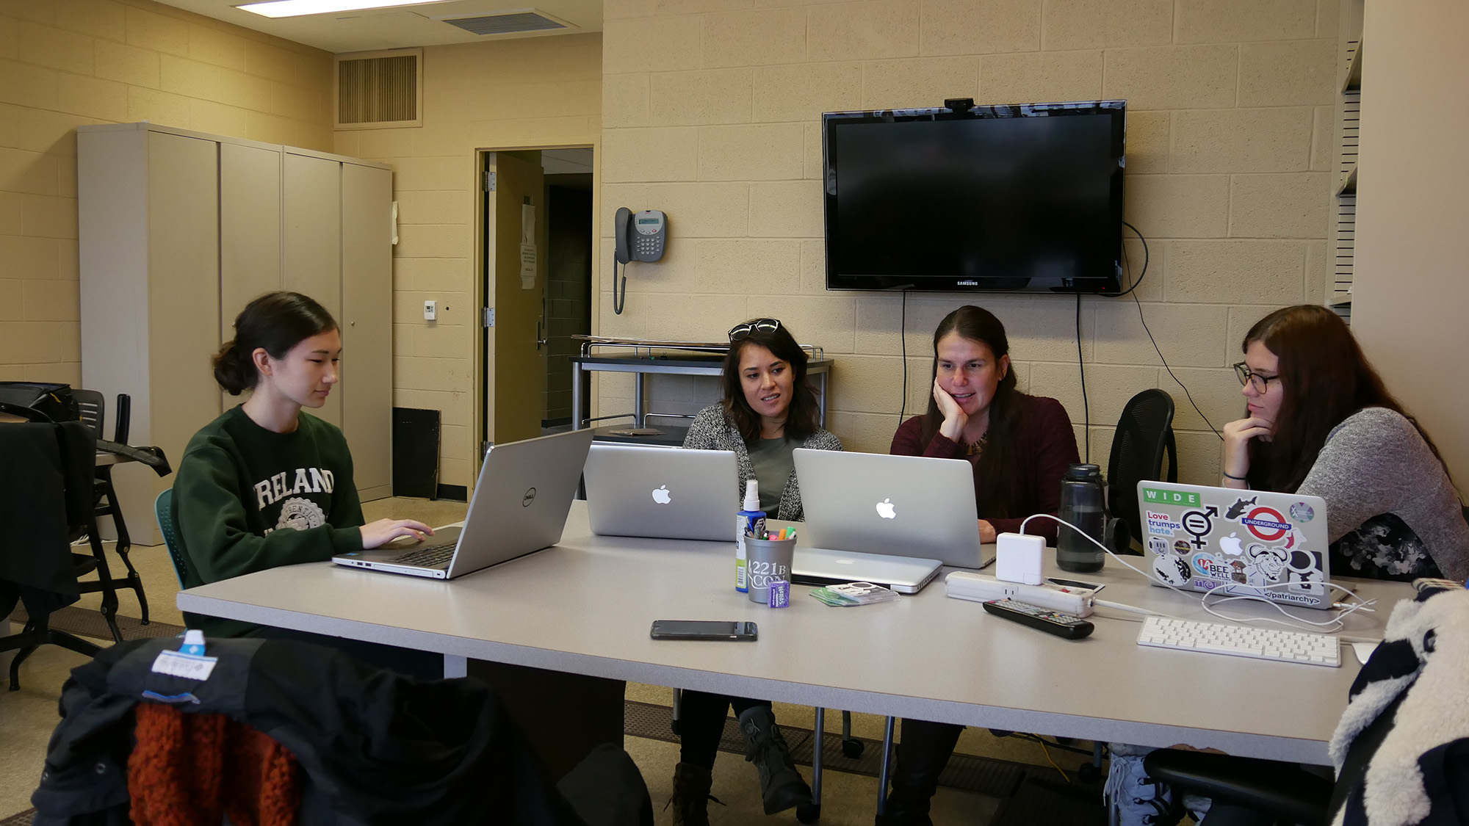
Active Learning
From Novice Toward Expert

Slide 10
What is Expertise?

Slide 11
Performance
Novice
Expert
Time & Experience & Processing
Continuum

Slide 12
Ah Ha! Discovering the DNA Structure in 2 Hours James Watson & Francis Crick
Notes:
Knowledge is not enlightenment for free. It takes effort and processing.

Slide 13
15 Years
Teaching
Botanist
Performance
Forgetting
College
Post-Grad
Forgetting
Novice
Expert
Time & Experience & Processing
Continuum

Slide 14
Active Learning
A Processing Model

Slide 15
What is Active Learning?

Slide 16
What is Active Learning?
Active learning fosters deep and flexible knowledge through
cognitive, behavioral, social, and affective processing
of one’s knowledge and experience.
Doolittle & Wojdak

Slide 17
A Processing Model of Active Learning
Inform
Foster
Foster
Foster
Learning
Outcomes
Instructional
Strategies
Processing
Meaning & Memory
Learning &
Performance
Knowing
Doing
Thinking
Caring
Knowing
Doing
Thinking
Caring

Slide 18
Inform
Foster
Foster
Foster
Learning
Outcomes
Instructional
Strategies
Processing
Meaning & Memory
Learning &
Performance
Directions
(sentences)

Slide 19
What we
process
we learn.
High Meaning
High Learning
? ? ? Meaning
? ? ? Learning
What do these results tell us?
Performance
Low Meaning
Low Learning
Incidental
Learning
=
Intentional
Learning
Pronunciation
Mental Image
Your Strategy

Slide 20
Inform
Foster
Foster
Foster
Learning
Outcomes
Instructional
Strategies
Processing
Meaning & Memory
Learning &
Performance
What we process we learn.
Learning occurs to the extent that processing fosters
meaning and memory.
Time

Slide 21
Inform
Foster
Foster
Foster
Learning
Outcomes
Instructional
Strategies
Processing
Meaning & Memory
Learning &
Performance
Short-Term Memory
(hippocampus)
What: episodic memories
Form: encoding, neural representations, patterns, connections
Lasts: seconds-minutes depending . . .
Episode, Context Specific, Details
↑ Fragile, ↑ Interference, ↑ Decay
making memory

Slide 22
Active Learning
Meaning and Memory

Slide 23
Inform
Foster
Foster
Foster
Learning
Outcomes
Instructional
Strategies
Processing
Meaning & Memory
Learning &
Performance
Making
Meaning
Making
Memory
Prior Knowledge
Notes:
Paul Ausebel

Slide 24
Inform
Foster
Foster
Foster
Learning
Outcomes
Instructional
Strategies
Processing
Meaning & Memory
Learning &
Performance
What is Meaning?
Subjective Interpretation

Slide 25
Inform
Foster
Foster
Foster
Learning
Outcomes
Instructional
Strategies
Processing
Meaning & Memory
Learning &
Performance
Processing that Fosters Meaning Making
Attention
Recognition
Activation
Emotions
Organization
Contextualization
Socialization
Application
Prediction
Inferencing
Reflection
Abstraction

Slide 26
Inform
Foster
Foster
Foster
Learning
Outcomes
Instructional
Strategies
Processing
Meaning & Memory
Learning &
Performance
Memory
Declarative & Procedural
Knowledge
Making
Meaning
Learning Episode
Fragile & Weak..
Consolidation
Synaptic & Systems
Stabilization & Strengthening
Resting (offline) & Sleeping (offline)
Making
Memory

Slide 27
Inform
Foster
Foster
Foster
Learning
Outcomes
Instructional
Strategies
Processing
Meaning & Memory
Learning &
Performance
Consolidation
Synaptic & Systems
Stabilization & Strengthening
Resting (offline) & Sleeping (offline)
But first . . .
(sentences)

Slide 28
What do these results tell us?
Performance
Initial
Learning
2+ Hours
Later
Initial
Learning
2+ Hours
Later
Pronunciation
Mental Image

Slide 29
Inform
Foster
Foster
Foster
Learning
Outcomes
Instructional
Strategies
Processing
Meaning & Memory
Learning &
Performance
Consolidation
Synaptic & Systems
Stabilization & Strengthening
Resting (offline) & Sleeping (offline)
Synaptic Consolidation
(hippocampus)
Forms: Seconds-Minutes-Hours
Lasts : Hours-Days+
Reactivation & Replay; Discrimination
Episodic, Context-Specific, Details
⇡ Stability, ⇡ Strength
Intermediate-Term Memory
Systems Consolidation
(neocortex)
Forms: Days-Months-Years
Lasts : Months-Years-Forever ☺
Reactivation & Retrieval
Integrate, Organize, Generalize
↑ Stability, ↑ Strength
Long-Term Memory

Slide 30
Inform
Foster
Foster
Foster
Learning
Outcomes
Instructional
Strategies
Processing
Meaning & Memory
Learning &
Performance
Consolidation
Synaptic & Systems
Stabilization & Strengthening
Resting (offline) & Sleeping (offline)
Initial
Learning
Timely
Review
Over-Time
Use Use Use Use Use Use
Short-Term
Memory
Intermediate
Memory
Long-Term
Memory

Slide 31
Active Learning
Processing

Slide 32
Inform
Foster
Foster
Foster
Learning
Outcomes
Instructional
Strategies
Processing
Meaning & Memory
Learning &
Performance
Meaningful Learning
Elaborative Learning Connecting & Integrating
Integrative Learning
Retrieval Practice
Spaced Practice Reactivation & Strengthening
Generative Practice
Interleaving
Meaning
Memory

Slide 33
Inform
Foster
Foster
Foster
Learning
Outcomes
Instructional
Strategies
Processing
Meaning & Memory
Learning &
Performance
Meaning
Generation
Knowledge
Integration
Spaced Retrieval

Slide 34
Inform
Foster
Foster
Foster
Learning
Outcomes
Instructional
Strategies
Processing
Meaning & Memory
Learning &
Performance
Meaning
Generation
Knowledge
Integration
Spaced Retrieval

Slide 35
Inform
Foster
Foster
Foster
Learning
Outcomes
Instructional
Strategies
Processing
Meaning & Memory
Learning &
Performance
Meaning
Meaning
Generation
Knowledge
Integration
Meaning
Spaced Retrieval
Memory

Slide 36
Inform
Foster
Foster
Foster
Learning
Outcomes
Instructional
Strategies
Processing
Meaning & Memory
Learning &
Performance
What we process we learn.
Learning occurs to the extent that processing fosters
meaning and memory.

Slide 37
Active Learning
Educate a woman, empower the world.
Peter Doolittle, Professor
Educational Psychology
Virginia Tech • pdoo@vt.edu
All images from
unsplash.com or twu.edu

