Slide 1




all images from unsplash.com
MEANING
Meaning → Learning → Performing
Peter Doolittle
Educational Psychology, Virginia Tech
pdoo@vt.edu • peterdoolittle.org
Gracie
Stormy
Valentine

Slide 2

all images from unsplash.com
Veterinary Medicine
A Metaphor
Never let AI do your thinking for you.

Slide 3
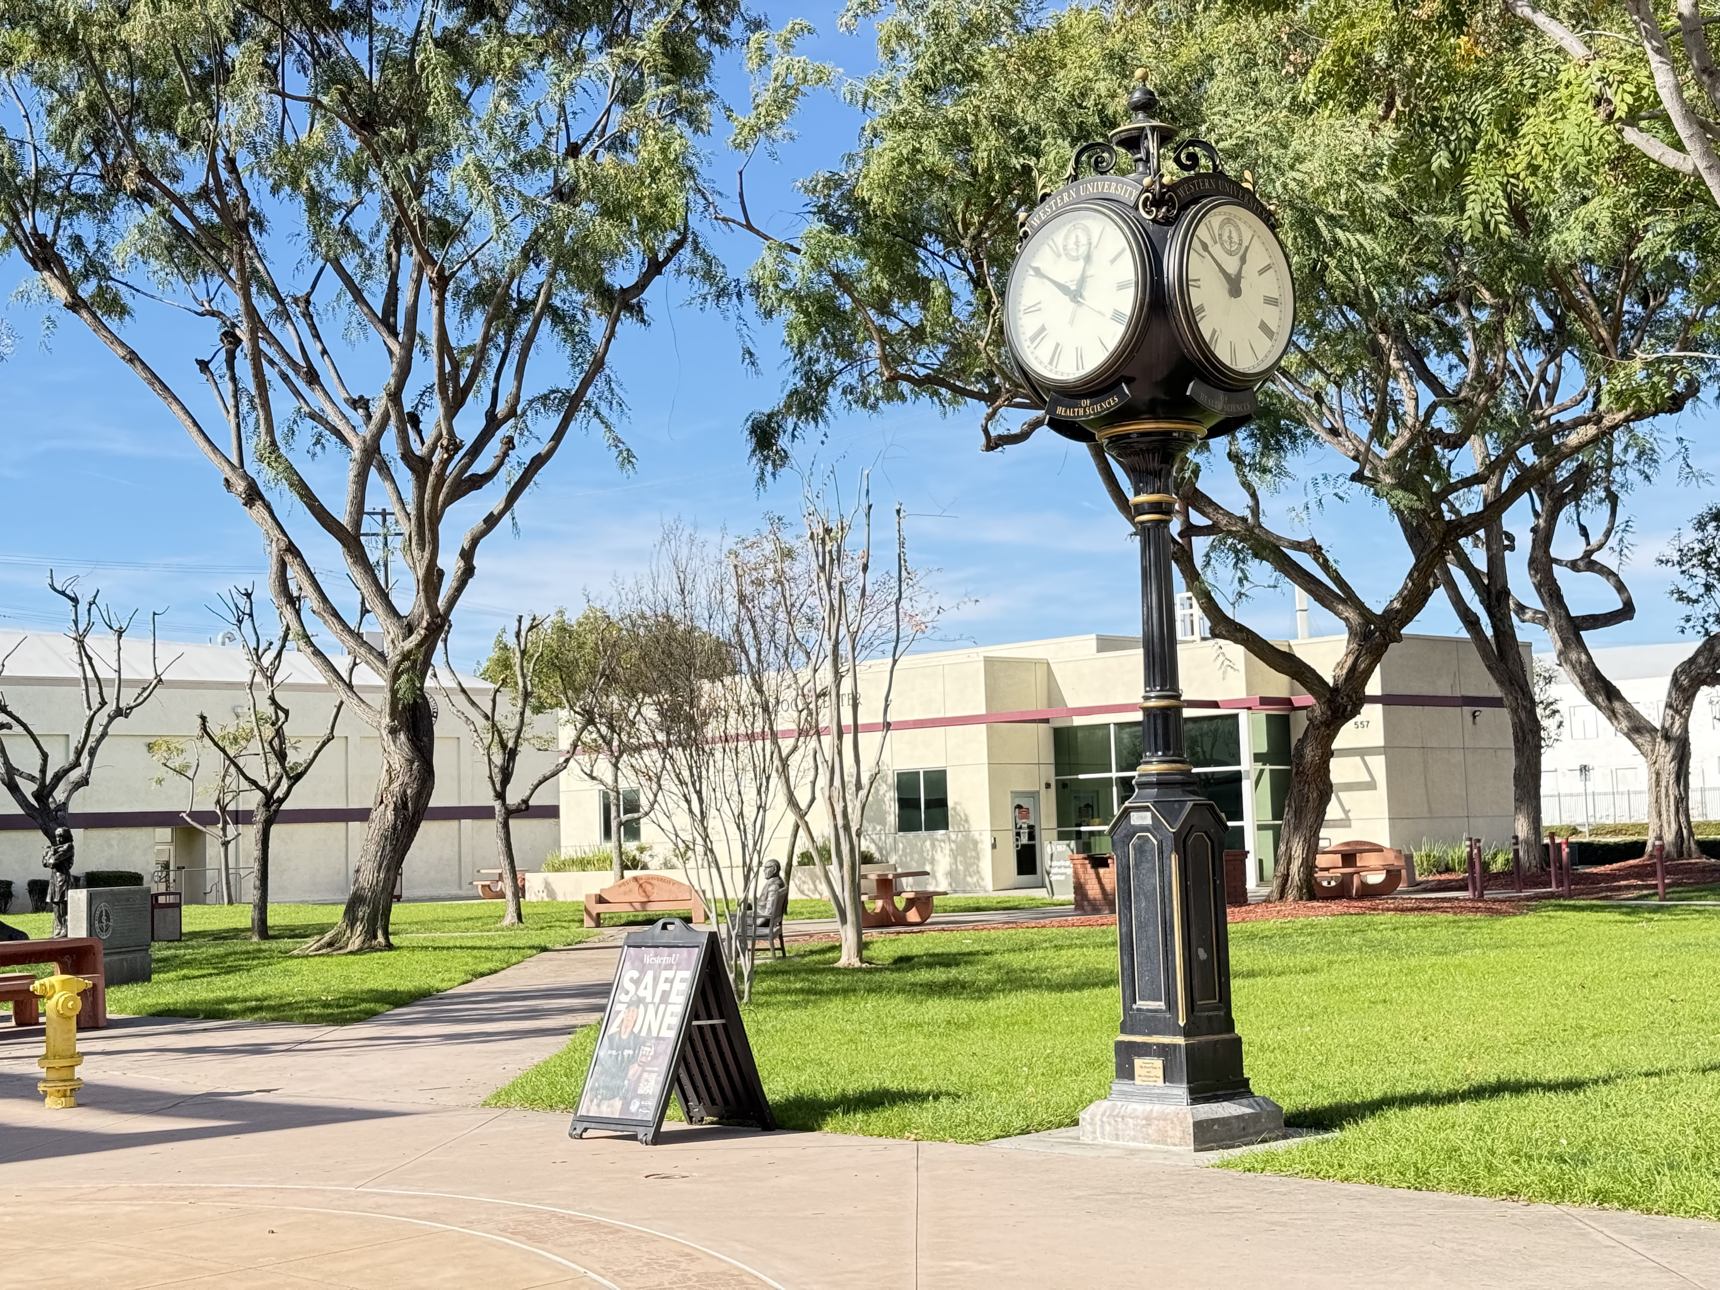
Introduction
Directions:
  Read the following statements and decide if you
  Agree
  Disagree
  or would like to Edit
  each sentence.

Slide 4
Introduction
Deep learning is fostered by students doing thigns and thinking about the things they are doing.
Deep learning-based experiences result in more student learning than lecture-based experiences.
Deep learning works best in formal (e.g., class) versus informal (e.g., meetings) learning environments.

Slide 5
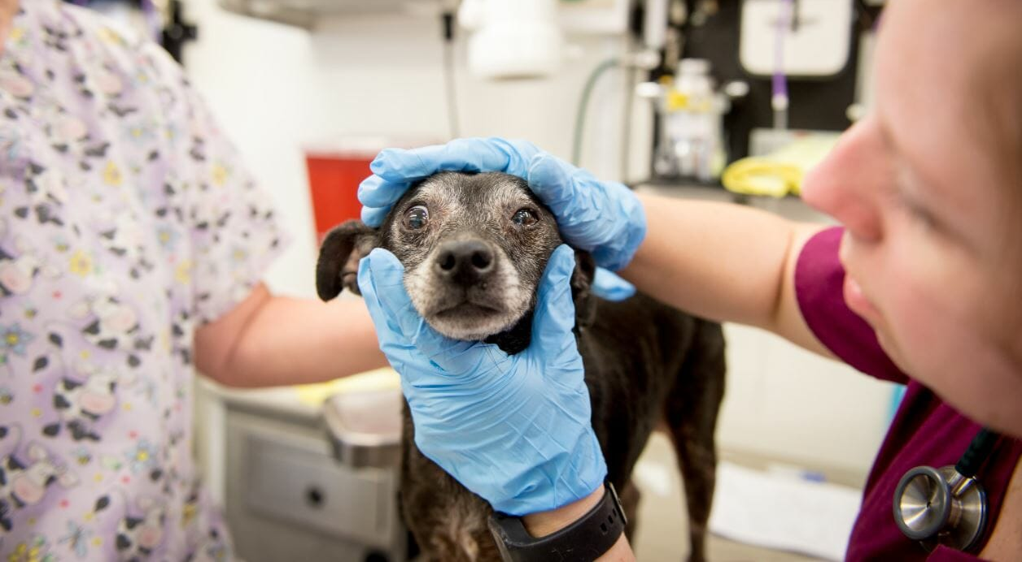
From Novice Toward Expert
Perspective

Slide 6
Performance
Novice
Expert
Time & Experience & Processing
Continuum

Slide 7
Veterinarian
Teaching Veterinarian
Teaching
Performance
First 4 Years of Work
Vet Med School
High School
If you’re not learning, you’re forgetting
College
Forgetting
Veterinary Practitioner ≠ Veterinary Instructor
Novice
Expert
Time & Experience & Processing
Continuum

Slide 8
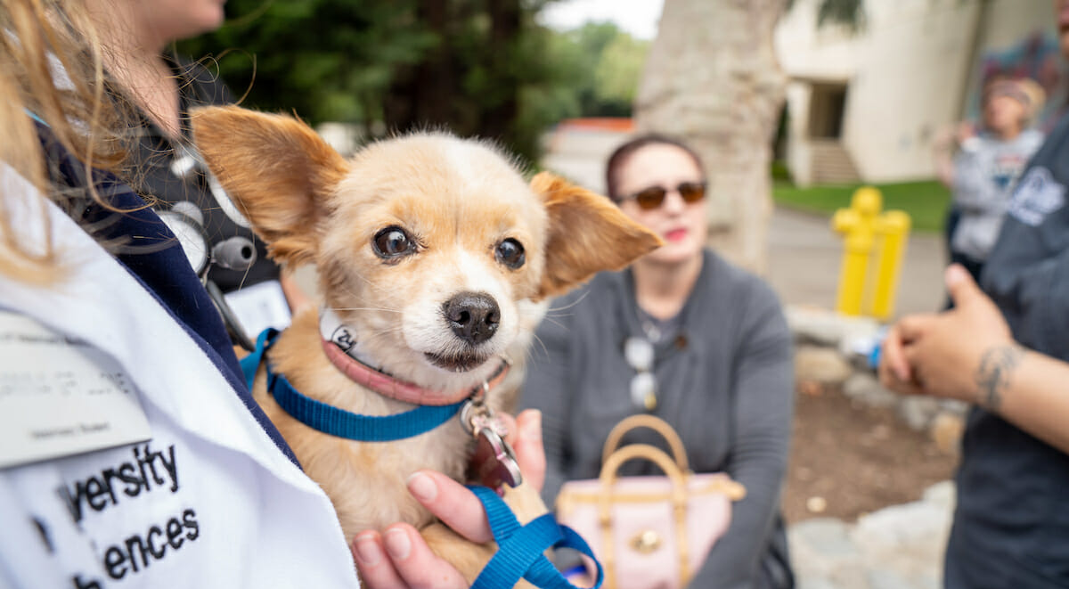

Meaning
Meaning is always inside out.
What is “meaning”?

Slide 9
Words
Rest
Tired
Awake
Dream
Snore
Bed
Eat
Slumber
Sound
Comfort
Wake
Night
Rest
Tired
Awake
Dream
Snore
Bed
Eat
Slumber
Sound
Comfort
Wake
Night
That’s all!
Notes:
1: Knowledge is connected; 2: Connections based on/form meaning; 3: Brain has a life of its own.

Slide 10
Making meaning is always
an inside out process.

Slide 11
scíthe
tuirseach
dúiseacht
aisling
snor
leaba
ithe
pillín
fuaim
compord
úisigh
oíche
Rest
Tired
Awake
Dream
Snore
Bed
Eat
Slumber
Sound
Comfort
Wake
Night
Notes:
Scithe = sh-kee duiseacht = doo-shot
Tuirseach = tur-shah

Slide 12
Making Sense of the World
Learning is fostered when experience is meaningful.
How do you create meaning?
Intellectually (connecting knowledge to knowledge)
Personally / Culturally / Emotionally (connections)
Functionally / Usefully (connections)
Significant & Important (connections)
meaning
connections
connections
connections
connections
(Bertsch et al., 2007; Chi et al., 1981; Dunlosky et al., 2013; Rawson 2016)

Slide 13
connections
connections
meaning
connections
connections

Slide 14
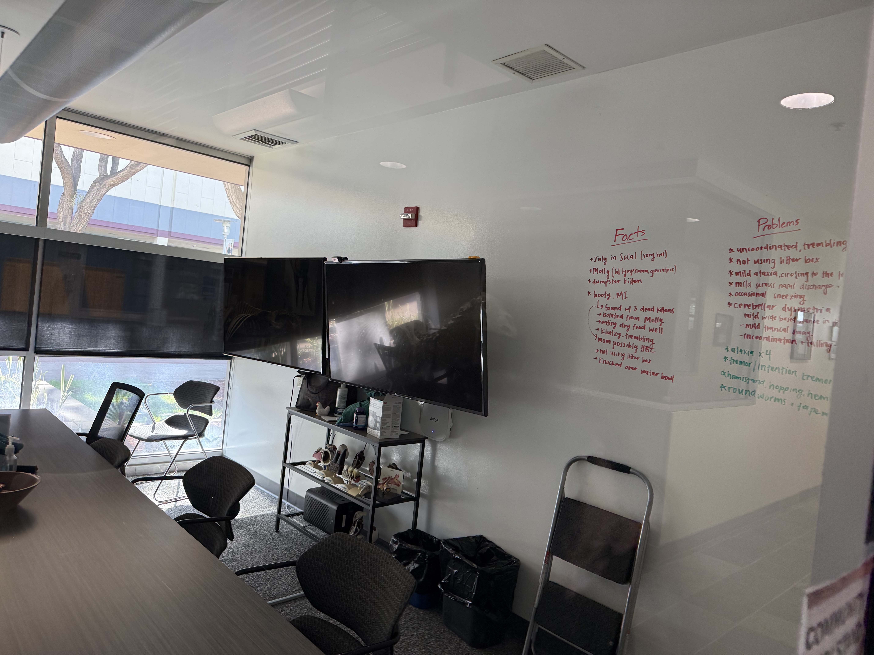
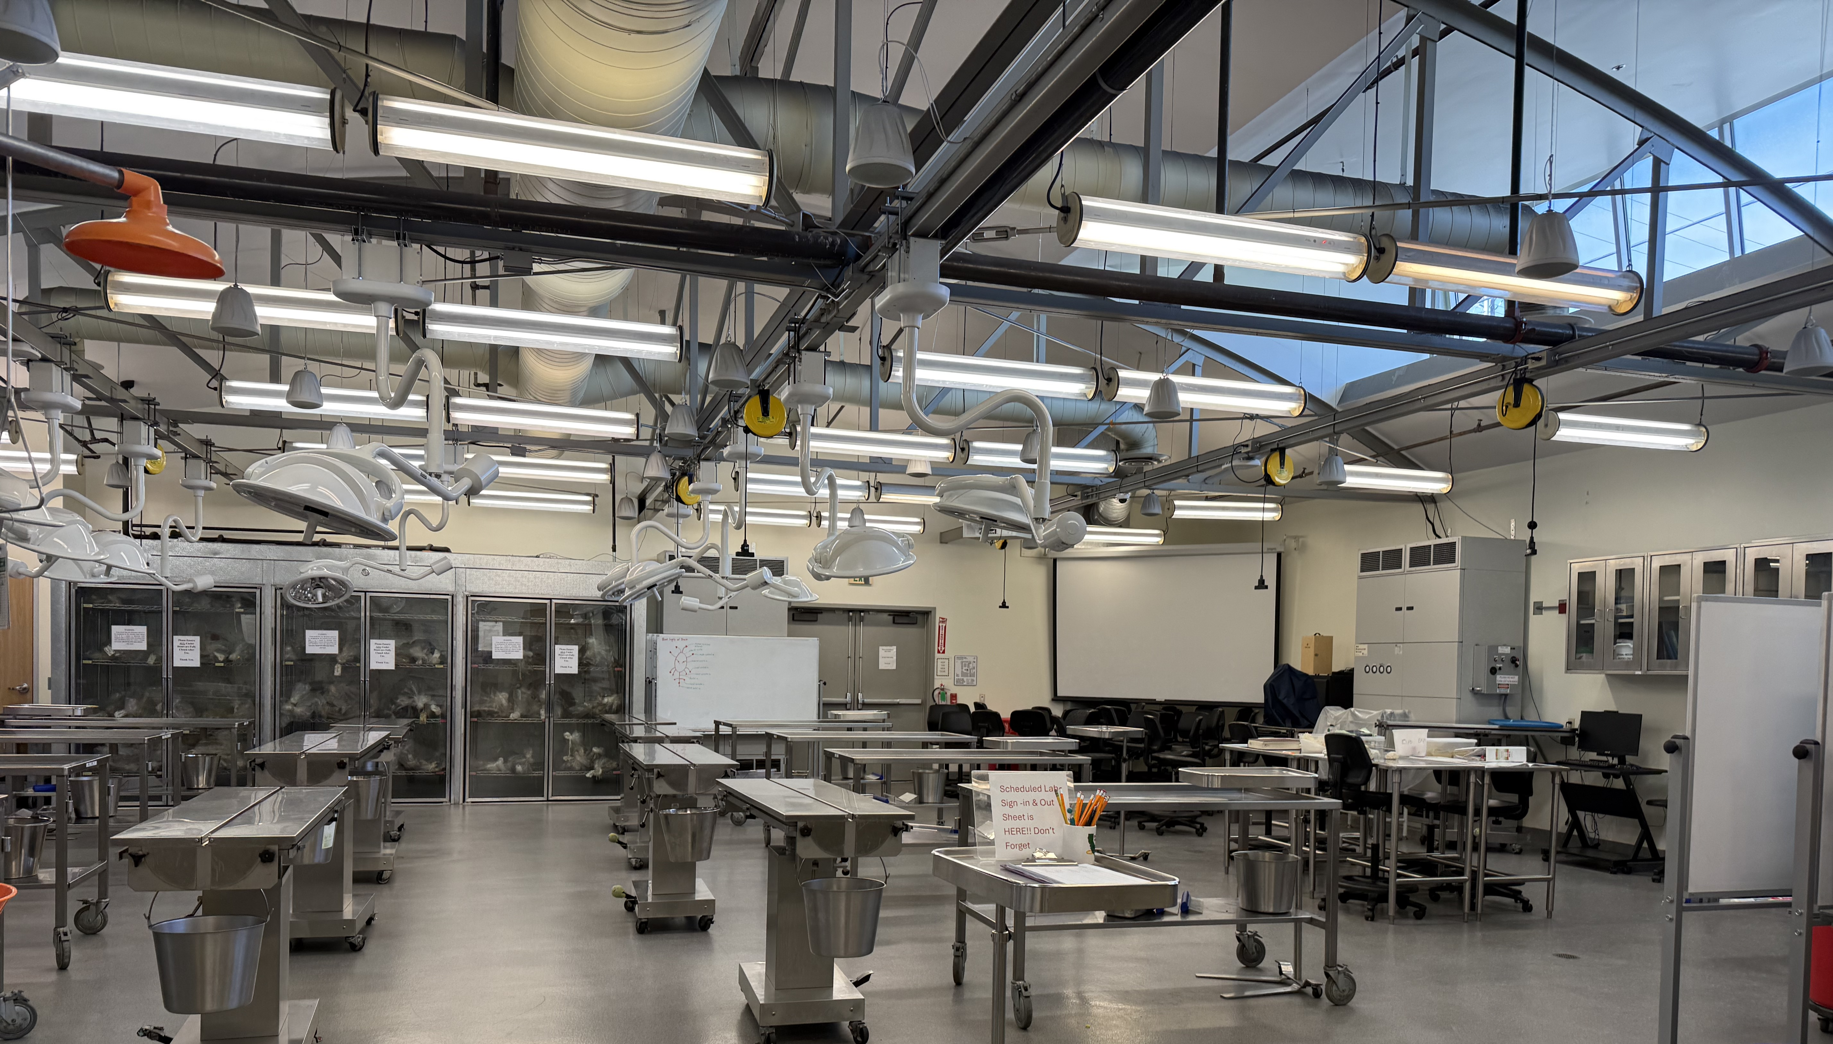

Slide 15
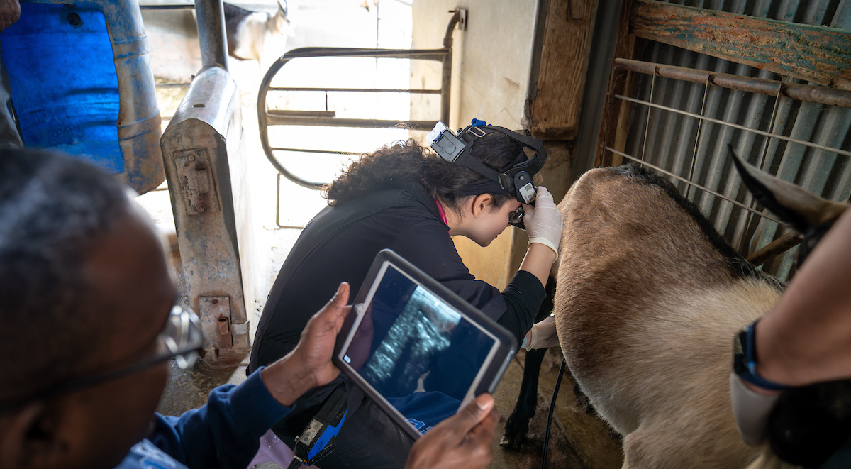
Processing
Making Meaning

Slide 16

Cognitive Processing for Learning
Rote Learning
Elaborative Learning
Learners tend to remember information better when they
repeat information verbatim over and over, rather than elaborating on information… but only in the short term.
(memorization)
Learners tend to remember information better when they
engage in deeper, more meaningful processing, rather than simply repeating or reviewing information verbatim.
(meaningful learning)

Slide 17
Cognitive Processing for Learning
Retrieval Effect
Spacing Effect
Generative Learning
Learners tend to remember information better when they
recall or retrieve information from memory, rather than simply rereading or reviewing the information.
Learners tend to remember information better when they
practice retrieving the information across multiple sessions, rather than massing practice in a single session.
Learners tend to remember information better when they
construct meaning by connecting new and prior knowledge, rather than reviewing or repeating information verbatim.

Slide 18
Retrieve
Knowledge
Generate
Meaning
Spaced
Generative
Retrieval
Practice
Apply & Adapt
Over Time

Slide 19
Retrieval Practice Effect
Roediger & Karpicke (2006)
  180 undergraduate students
  Study = reading 265-word passage (< ½ page), repeatedly for 5 min
  Test = write down as much as could be remembered for 7 min
  Recall = 5 minutes or 1 week later, write down as much as could be remembered for 10 min

Slide 20
What did they find?
 | 5 Minutes | 1 Week
S S S S | 83% | 40%
S S S T | 78% | 56%
S T T T | 71% | 61%
SSSS SSST STTT
SSSS SSST STTT
1.0
0.8
0.6
0.4
0.2
0.0
Recall
5 Min 1 Week

Slide 21
Desirable Difficulties
Review / Reread / Rote → ↑ Short Term ↓ Long Term
Spaced Generative Retrieval → ↓ Short Term ↑ Long Term
↑ Initial Learning → ↑ Subsequent Development
(strengthening & organization)

Slide 22
Interleaving
AAA BBB CCC
(Blocked)
A C B C B A A B C
(Interleaved)

Slide 23
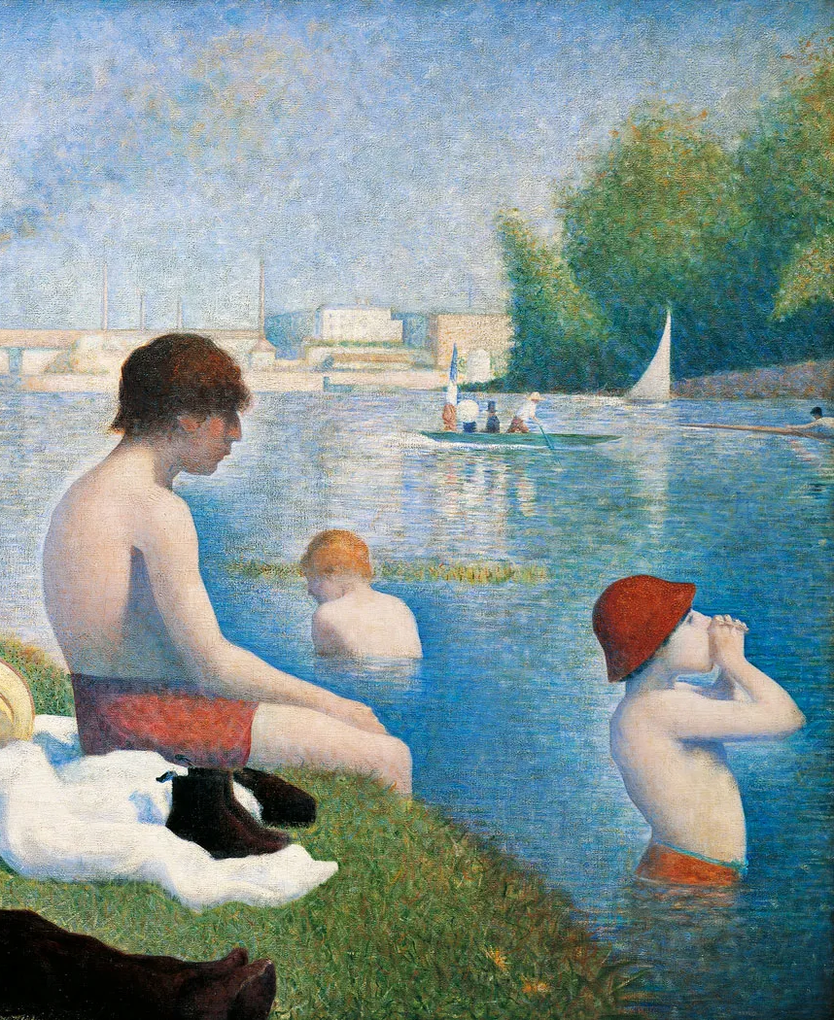
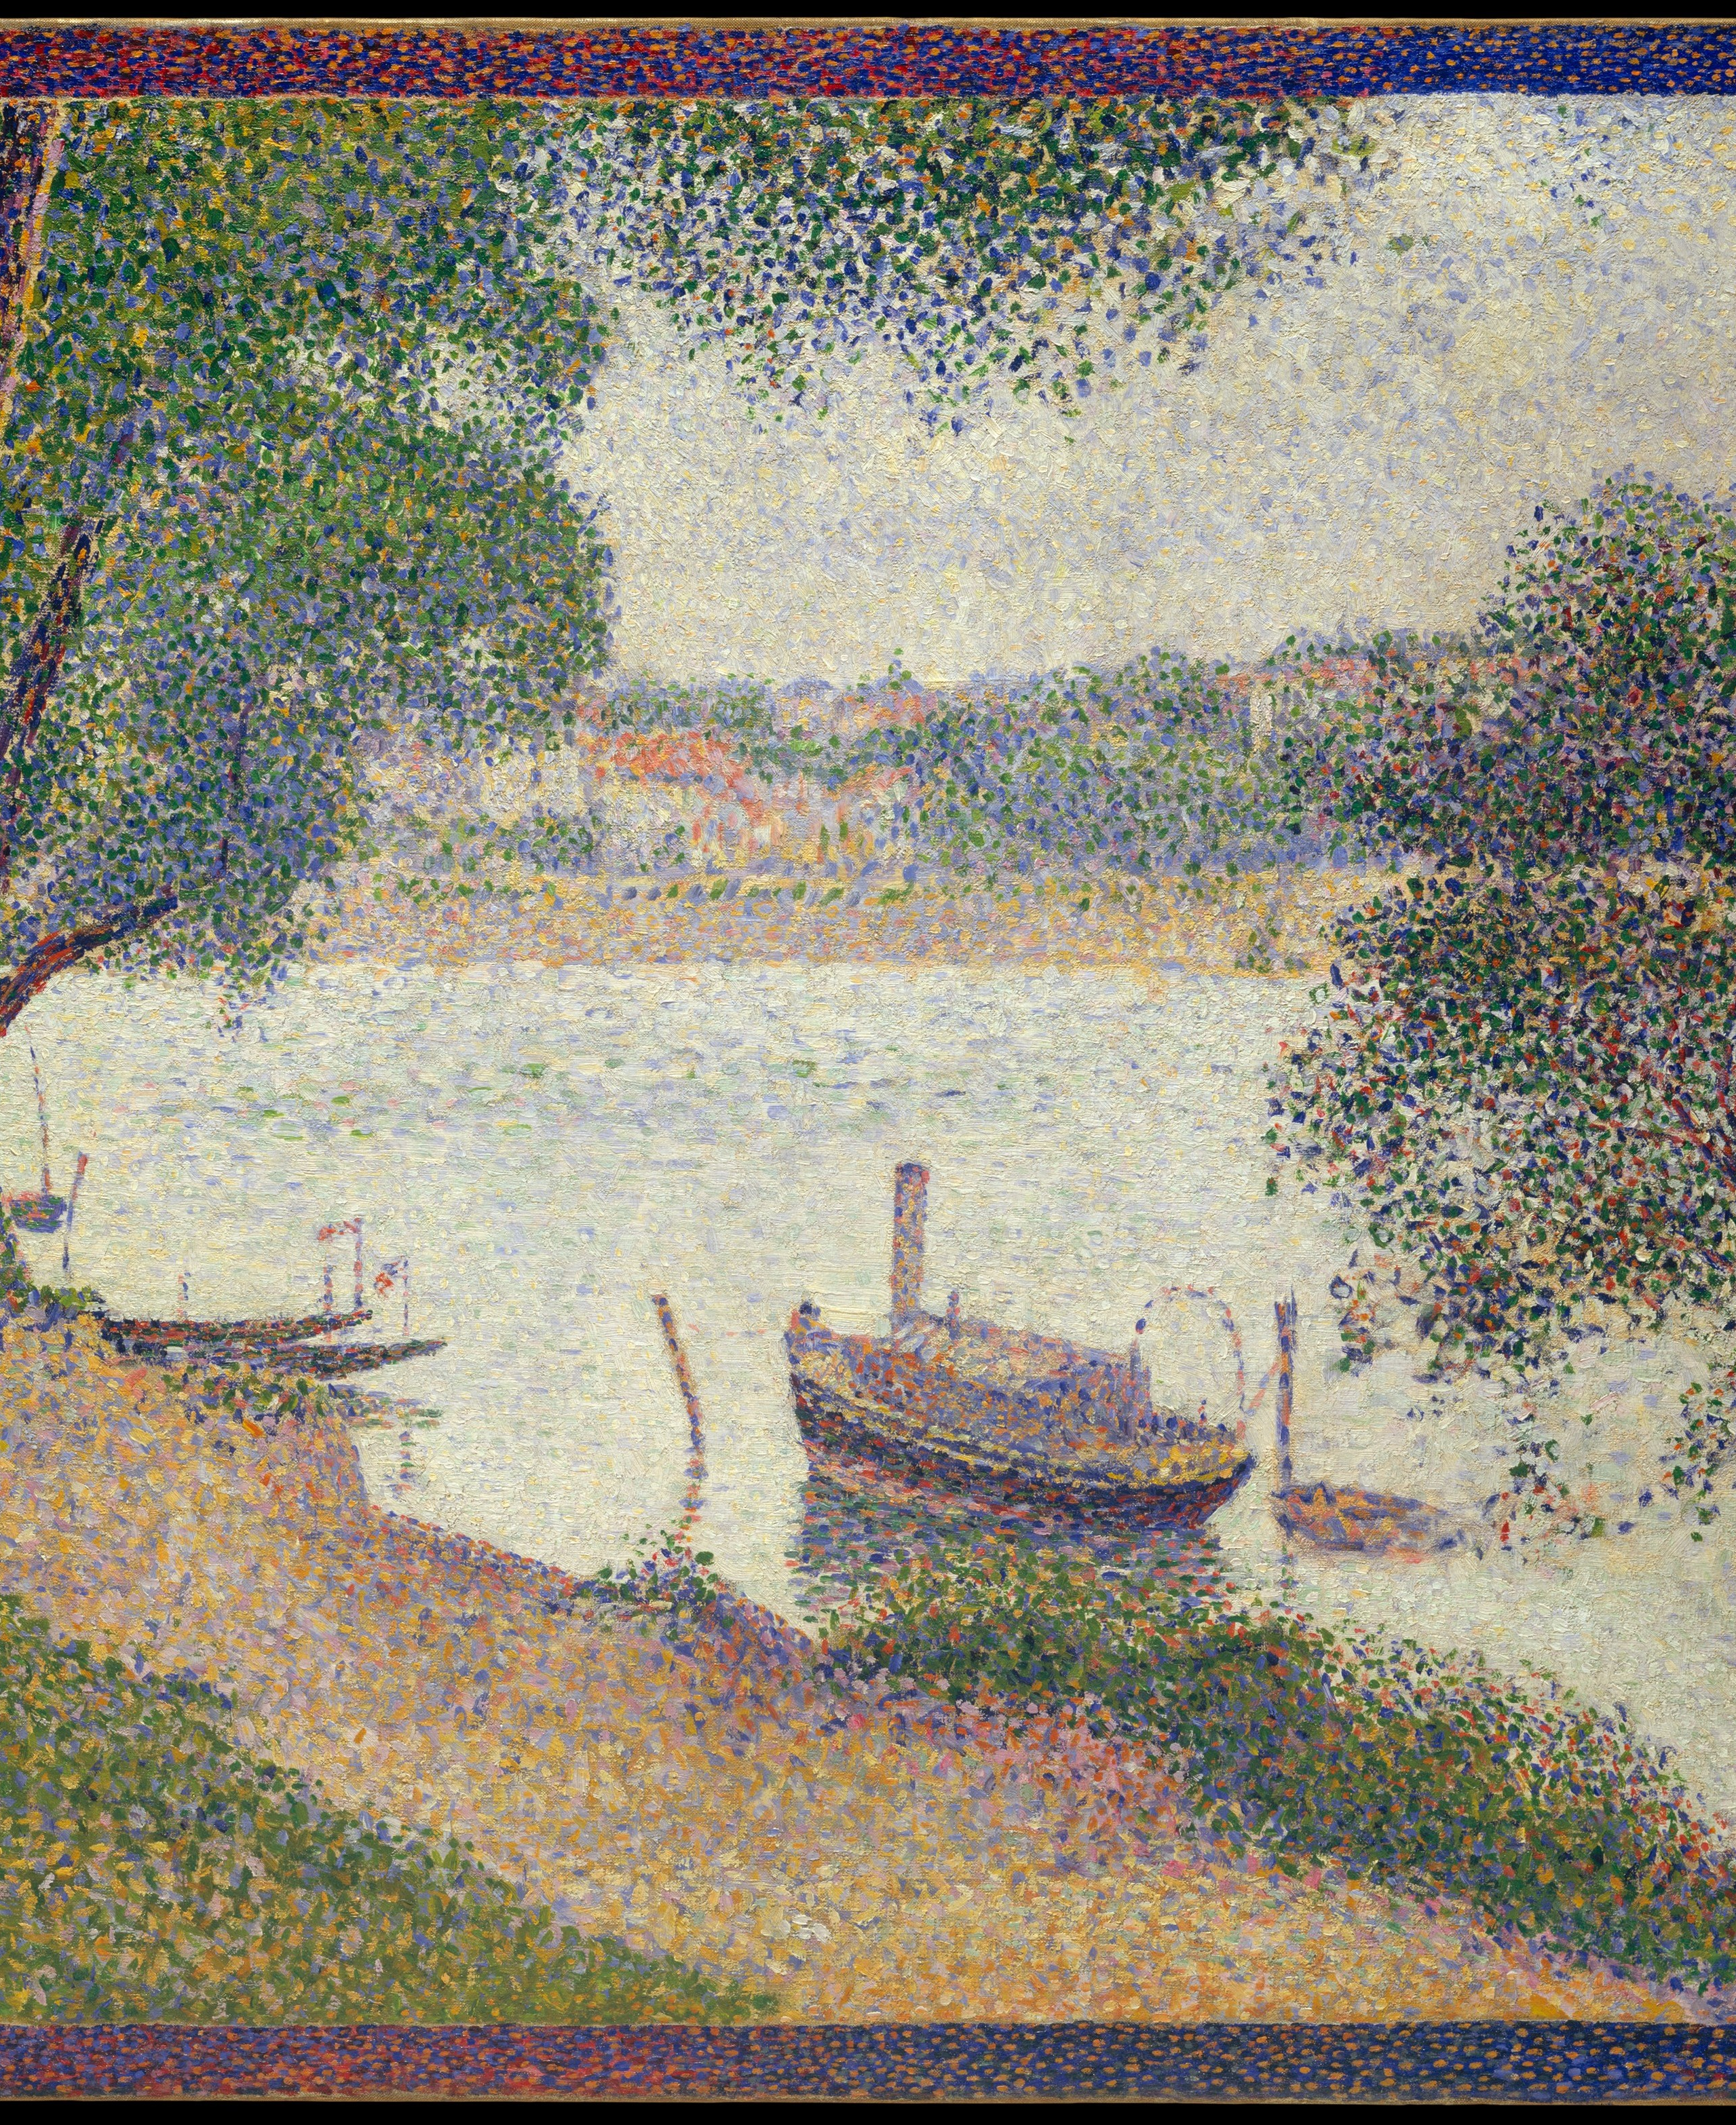







Georges Seurat
Georges Seurat
Georges Seurat
Marilyn Mylrea
Marilyn Mylrea
Marilyn Mylrea
Georges Braque
Georges Braque
Georges Braque
Kornell & Bjork (2008)
AAA BBB CCC
A C B C B A A B C
I > B
Kornell & Bjork, 2008
Georges Seurat
Marilyn Mylrea
Georges Seurat
Georges Braque
Marilyn Mylrea
Georges Braque
Georges Seurat
Georges Braque
Marilyn Mylrea

Slide 24
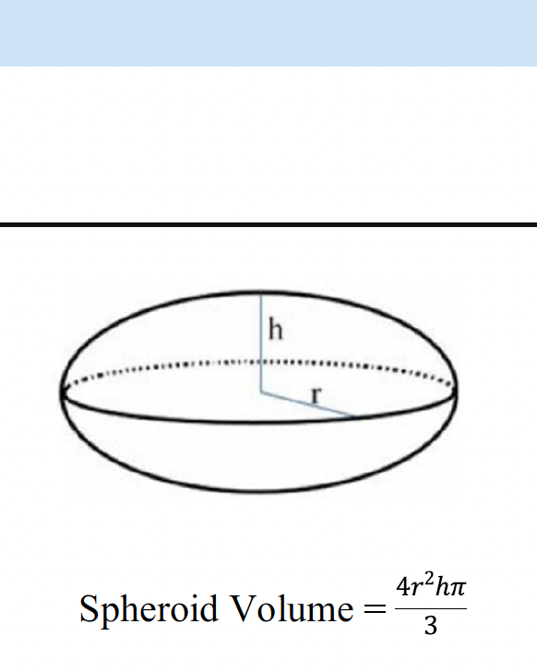
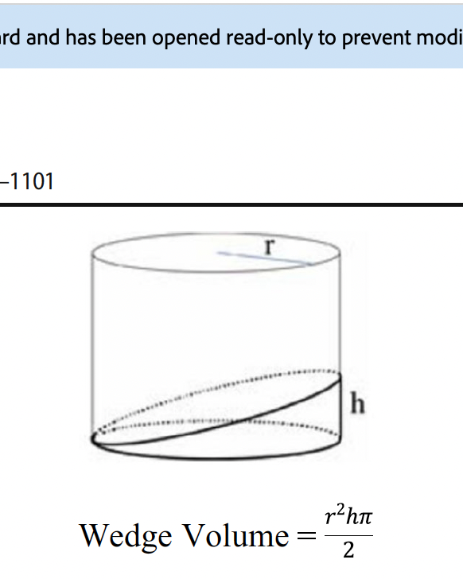
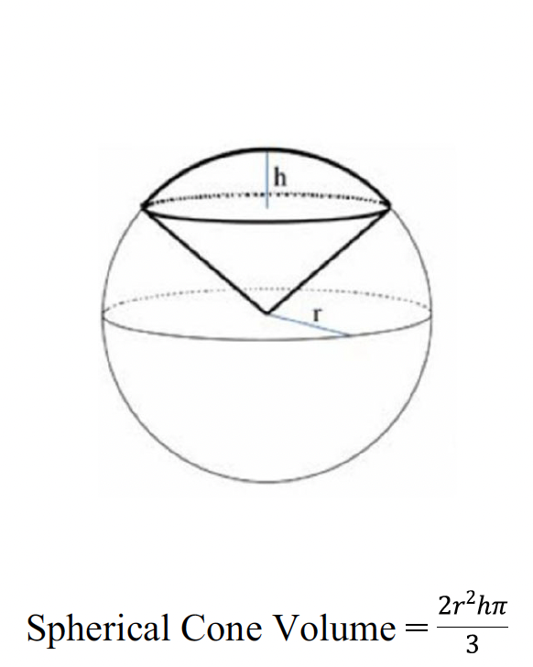
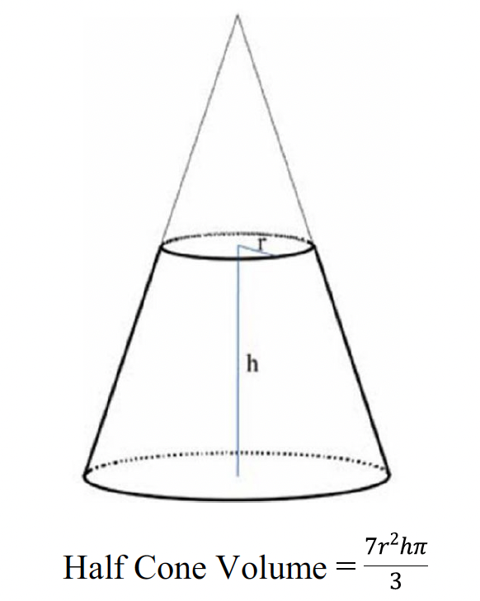
I ? B

Slide 26
Cognitive Processing
Rote Learning vs Elaborative Learning
Retrieval Effect
Spacing Effect
Generative Learning Effect
Interleaving*
Spaced Generative Retrieval Practice
Spaced
Generative
Retrieval
Practice

Slide 27
Procedure-based Learning/Strengthening Strategies
Steps
  Acquisition of step-by-step
Practice
  Repetition w/o goals, feedback, or intent to improve.
Purposeful Practice
  Goal directed and self-guided, w/self-monitored feedback
Deliberate Practice
  Expert directed and guided, w/expert feedback
  Expert targeted practice on specific aspects

Slide 28
What we process
we learn.

Slide 29
Cognitively
(thinking)
Behaviorally
(doing)
What we process,
we learn.
Affectively
(emoting)
Socially
(interacting)

Slide 30
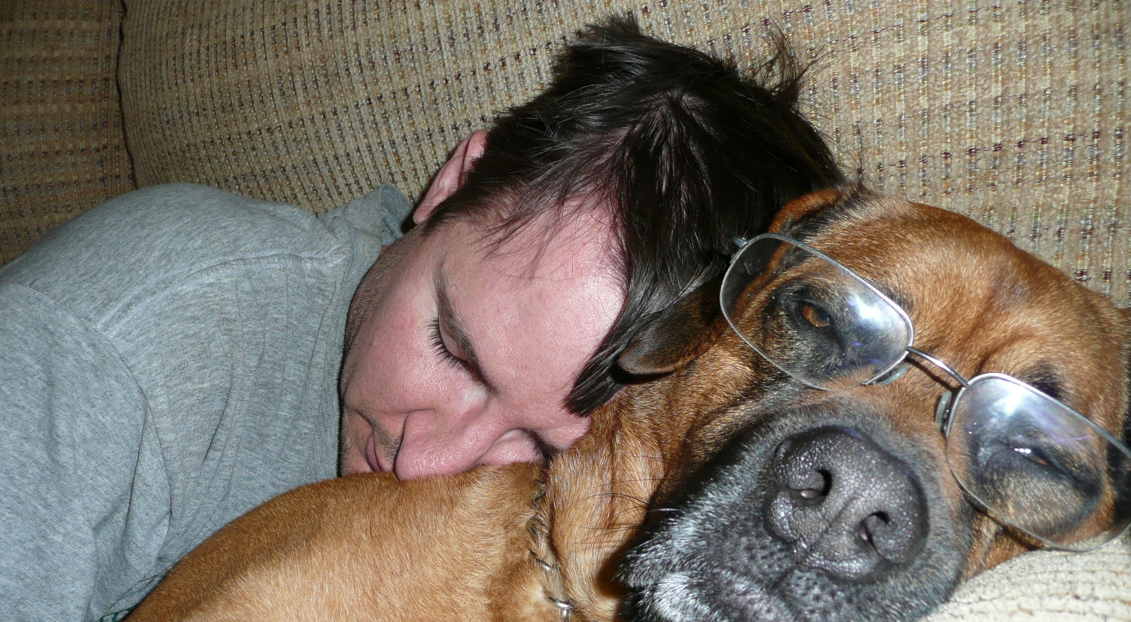
Pause (Paws)
Learning take time and effort – sleep on it.

Slide 31

7-9 hours
( exercise, nutrition )

Slide 32
all images from unsplash.com
Learning Takes Time and Effort
Making Meaning
Peter Doolittle
Educational Psychology, Virginia Tech
pdoo@vt.edu • peterdoolittle.org
Gracie
Stormy
Valentine

