Slide 1




all images from unsplash.com
MEANING
Meaning and Processing: Fostering Deep Understanding
Peter Doolittle
Educational Psychology, Virginia Tech
pdoo@vt.edu • peterdoolittle.org
Gracie
Stormy
Valentine

Slide 2

all images from unsplash.com
Veterinary Medicine
Why Are We Here?
Never let AI do your thinking for you.

Slide 3
Introduction
How do you learn?
Mostly, I …
Sometimes, I …

Slide 4
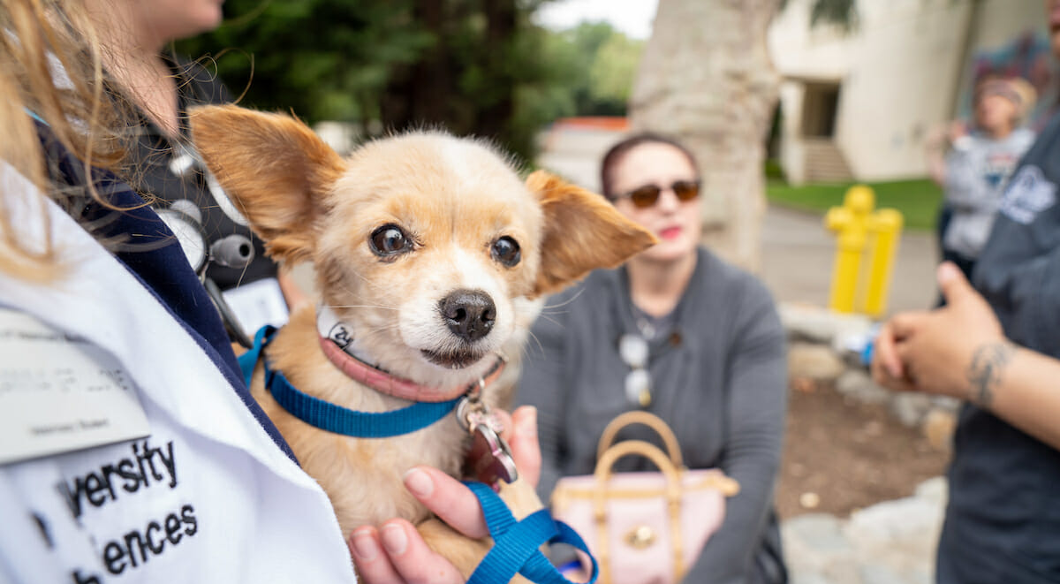
Meaning
Meaning is always inside out.
What is “meaning”?

Slide 5
Words
Rest
Tired
Awake
Dream
Snore
Bed
Eat
Slumber
Sound
Comfort
Wake
Night
Rest
Tired
Awake
Dream
Snore
Bed
Eat
Slumber
Sound
Comfort
Wake
Night
That’s all!
Notes:
1: Knowledge is connected; 2: Connections based on/form meaning; 3: Brain has a life of its own.

Slide 6
Making meaning is always
an inside out process.
(Bertsch et al., 2007; Chi et al., 1981; Dunlosky et al., 2013; Rawson 2016)

Slide 7
scíthe
tuirseach
dúiseacht
aisling
snor
leaba
ithe
pillín
fuaim
compord
úisigh
oíche
Rest
Tired
Awake
Dream
Snore
Bed
Eat
Slumber
Sound
Comfort
Wake
Night
Notes:
Scithe = sh-kee duiseacht = doo-shot
Tuirseach = tur-shah

Slide 8
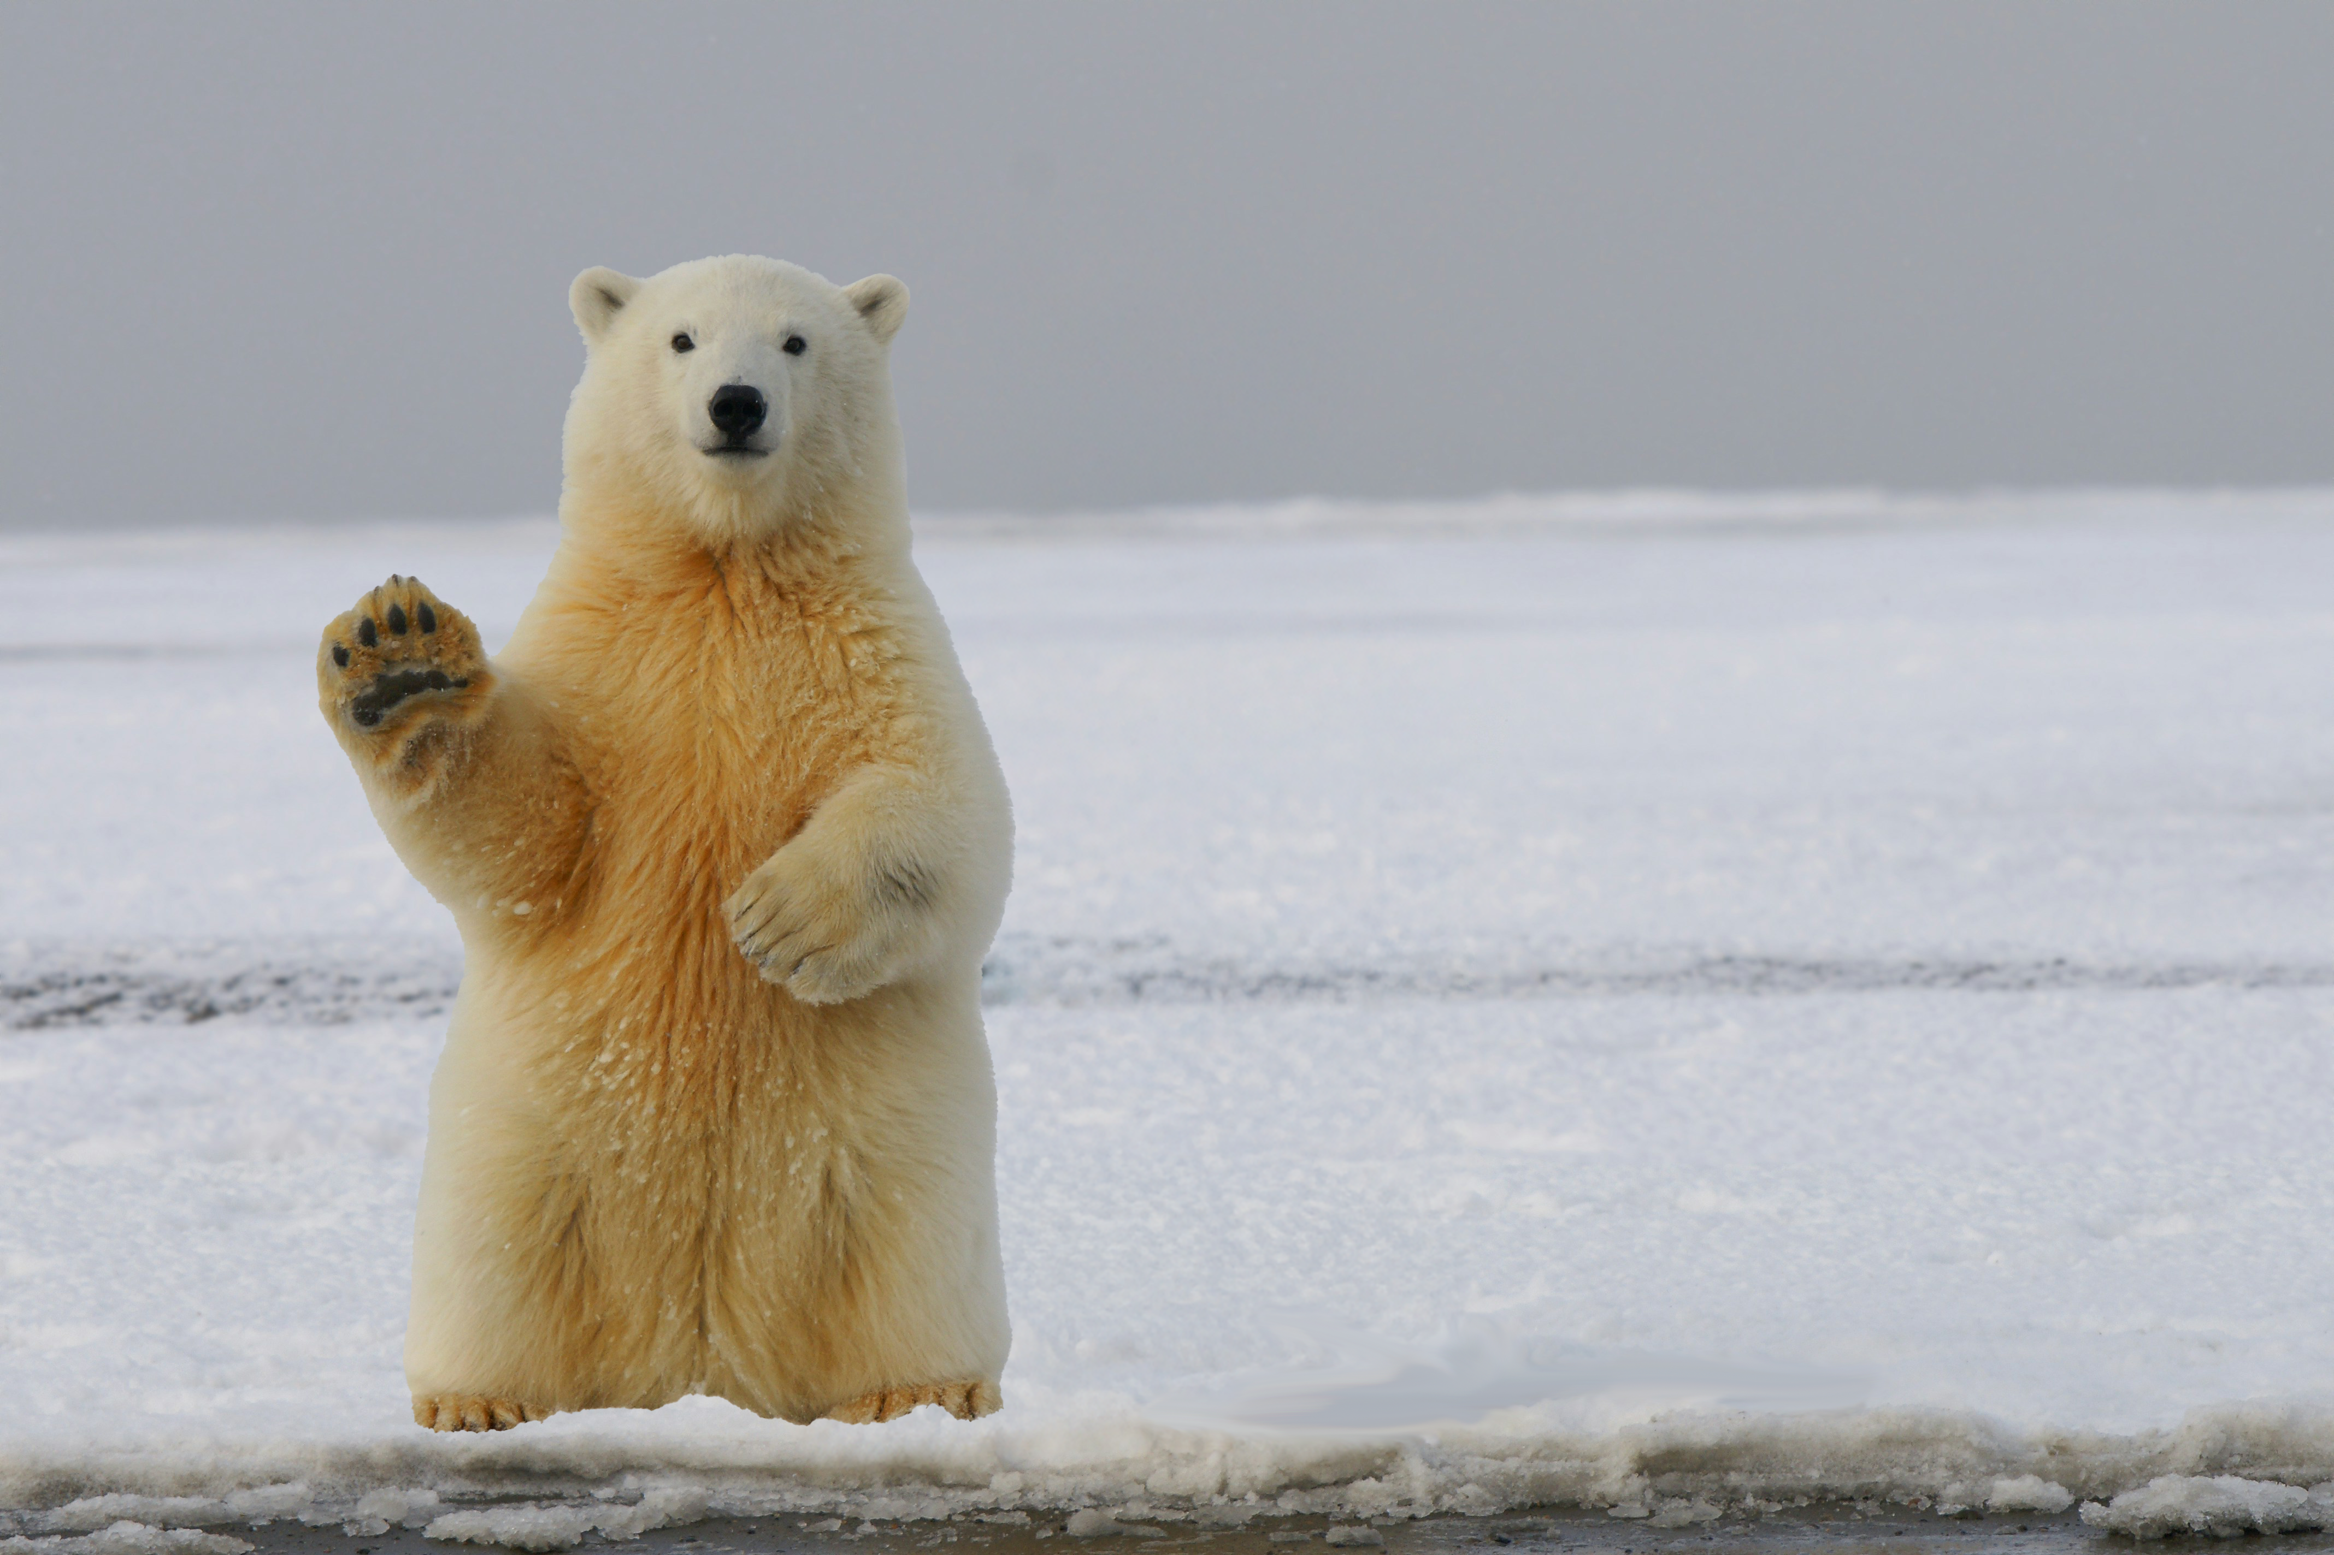
“Excuse me…
how do we create meaning?”

Slide 9
Making Sense of the World
Learning is fostered when experience is meaningful.
Connect new knowledge and experience to what you already know (and have experienced)
Recognize the functionality and usefulness of new knowledge and experience
Connect personally / socially / culturally / emotionally
Talk about it. Explain it to your cat.
meaning
connections
connections
connections
connections

Slide 10
↑
↑
↑
Meaning → Learning → Performing
Let’s dig deeper…

Slide 11
Attention
No Attention. No Meaning. No Learning

Slide 12
Attention-based Learning Strategies
Reduce distractions: mute/hide your phone, only open needed web tabs, find a “good” physical location to work.
Monitor Comprehension: assess every 10-15 minutes or the bottom of each page: “Does this make sense?”
Maintain Focus: take active notes, create your own examples, provide your own self-explanations. Plan a break.
Take Breaks: every 30 minutes or so, take a 5-minute thinking break, followed by planned re-engagement (re-set goals).

Slide 13
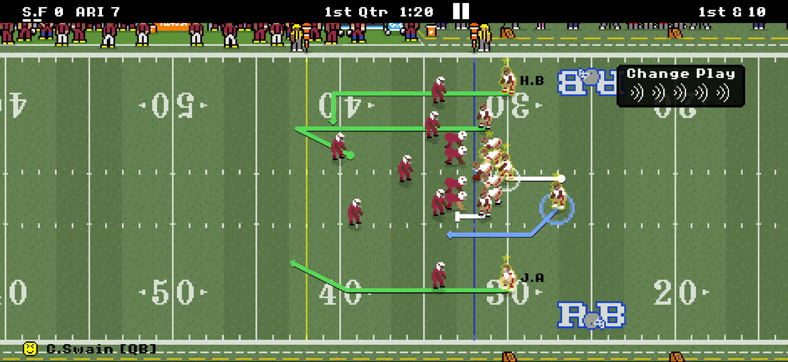

Slide 14

An Attention Caveat
Your brain has limits.

Slide 15
Directions

Slide 16
Task A
1. What is the state of mind mentioned?
2. What is the companion mentioned in the passage?
3. How is the companion described?
4. Where else can you get that kind of companionship?
5. What’s the point of the passage?

Slide 17
5
4
3
2
1
0
Task A
Task B
Task A

Slide 18
Task B
1. What does the author urge us to do in the passage?
2. What was the original name of the drink mentioned?
3. What was the subsequent name of the drink mentioned?
4. How many actual liquids are mentioned in the passage?
5. What was distilled in the passage?

Slide 19
5
4
3
2
1
0
Task A
Task B
Task A

Slide 20
Task C
1. What is a good name like?
2. Why is good name good?
3. What types of odors are "more durable?"
4. Odors are more durable than what?
5. What is the general point of the passage?

Slide 21
What are 2 conclusions based on these data?
5
4
3
2
1
0
Task A
Task B
Task A

Slide 22
Multitasking Self-Efficacy & Performance
10
8
6
4
2
0
8.45
Video Question Performance
Multitasking
Self-Efficacy
4.66
High
Medium
Low
Group A
Watch a Video
Group B
Watch a Video
Complete a Survey
( Doolittle, Terry, Watson, & Adams, 2024 )

Slide 23
Multitasking Findings
Multitasking ( or task switching) during class, leads to poorer learning and performance.
Sitting close to a student who is multitasking, leads to poorer learning and performance for the observer.
Students who believe they can multitask, can’t.
Students who believe they can multitask, tend to multitask more often.
(Aben et al., 2012; Chun et al., 2016; van Ede & Nobre, 2023; Wulf, 2013)

Slide 24
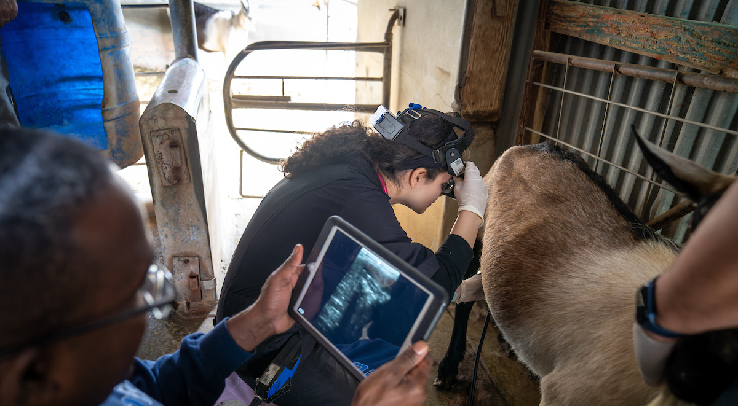
Processing
What we process, we learn.

Slide 25
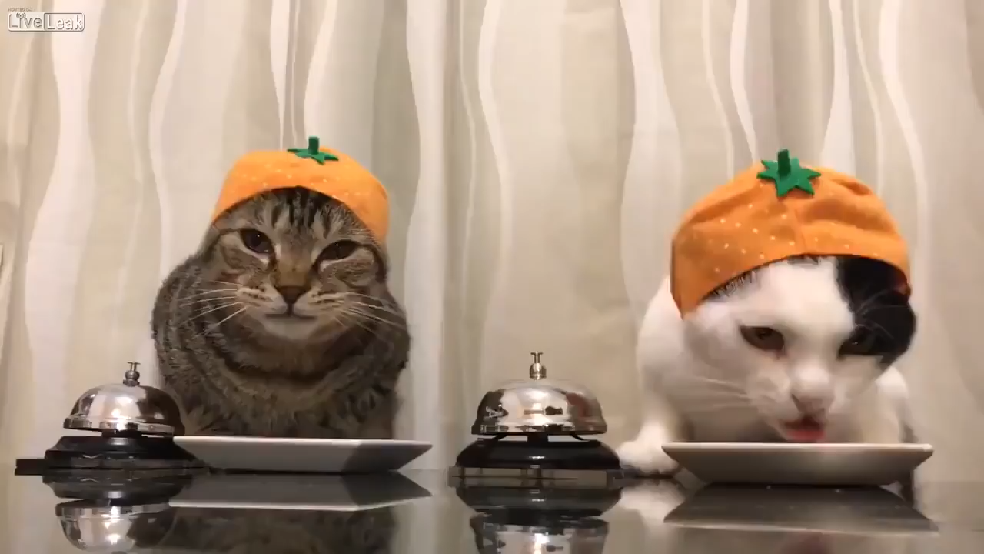

Slide 26
Directions
What do these results tell us?
Deeper Processing
Deeper Meaning
Performance
Shallower Processing
Shallower Meaning
Pronunciation
Mental Image
& Judgement

Slide 27
What we process
we learn.

Slide 28
Cognitively
(thinking)
Behaviorally
(doing)
What we process,
we learn.
Affectively
(emoting)
Socially
(interacting)

Slide 29
Concept-based Learning/Strengthening Strategies
Retrieval Practice
Retrieving knowledge > Rereading, Reviewing, Reexperiencing
Spacing Practice
Distributed retrieval > Single-session retrieval (cramming)
Generative Practice
Meaning-based retrieval > Rote retrieval
Ask yourself questions. Explain things while you drive/walk.
Draw diagrams in your notes or on a white board.

Slide 30
Roediger & Karpike 2006)
 | 5 Minutes | 1 Week
S S S S | 83% | 40%
S S S R | 78% | 56%
S R R R | 71% | 61%
SSSS SSSR SRRR
SSSS SSSR SRRR
1.0
0.8
0.6
0.4
0.2
0.0
Recall
5 Min 1 Week

Slide 31
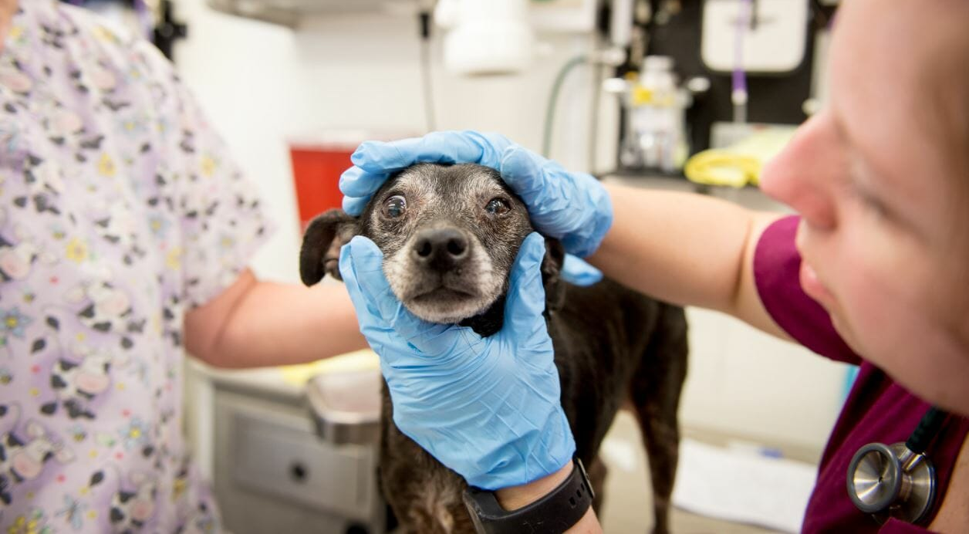

Slide 32
Procedure-based Learning/Strengthening Strategies
Steps
Acquisition of step-by-step
Purposeful Practice
Goal directed and self-guided, w/self-monitored feedback
Deliberate Practice
Expert directed and guided, w/expert feedback, on specific aspect
Practice
Repetition w/o goals, feedback, or intent to improve.

Slide 33
A Processing Caveat
Your brain has limits.

Slide 34
Working Memory
Working memory is the crucible of thought
Maintaining Current Goals for Processing
Store Immediate Experiences
Access Long-Term Memory, as needed
Process Experiences and Memory
(in the presence of distractions)
Capacity: Small (3-ish)
Duration: Short

Slide 35
Short-Term Memory & Working Memory
Working Memory
Short-Term Memory
Performance
2 4 6 8 10 12
STM = Storage WM = Storage + Processing

Slide 36
Working Memory Capacity
Activity Directions
What were the words . . . in order?
Cow, Star
(8 - 3) + 1 = 7 ? Star
(3 + 7) / 2 = 5 ? Cow
Operation Span Task (OSPAN)

Slide 37
Ready? (2)
What were the words . . . in order?
Grass, Phone
(9 - 6) / 3 = 2 ? Grass
(5 + 3) - 6 = 2 ? Phone

Slide 38
What were the words . . . in order?
Ready? (3)
(2 - 0) / 2 = 2 ? Pony
(7 + 2) + 1 = 9 ? White
(6 / 2) + 4 = 8 ? Cement
White, Cement, Pony

Slide 39
Ready? (4)
What were the words . . . in order?
Book, Printer, Speaker, Duck
(6 + 2) / 4 = 2 ? Printer
(3 + 2) - 4 = 2 ? Book
(4 / 2) - 4 = 4 ? Duck
(8 - 3) * 2 = 10 ? Speaker

Slide 40
PRACTICE
&
EXPERIENCE

Slide 41
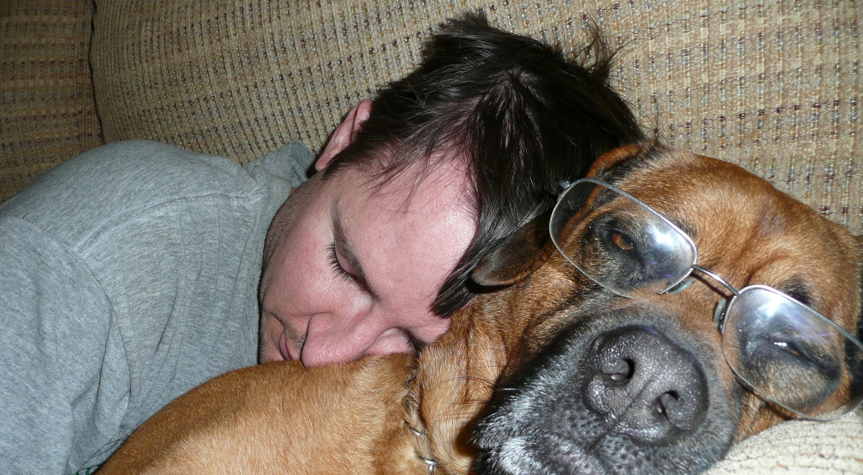
Pause (Paws)
Learning take time and effort – sleep on it.

Slide 42

7-9 hours
( exercise, nutrition )

Slide 43
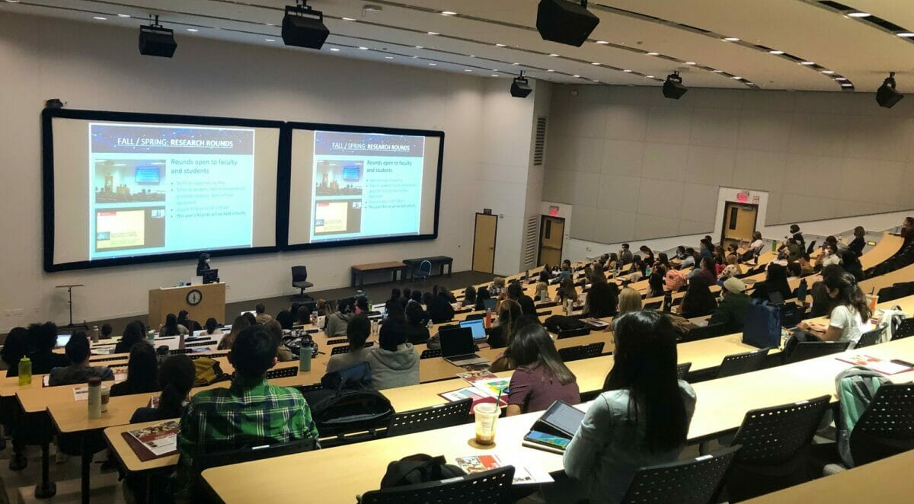
A Review
Learning is Messy.

Slide 44
↑
↑
↑
↑
↑
Attention → Processing → Meaning → Learning → Performing

Slide 45
all images from unsplash.com
MEANING
Meaning and Processing: Fostering Deep Understanding
Peter Doolittle
Educational Psychology, Virginia Tech
pdoo@vt.edu • peterdoolittle.org
Gracie
Stormy
Valentine

