Slide 1
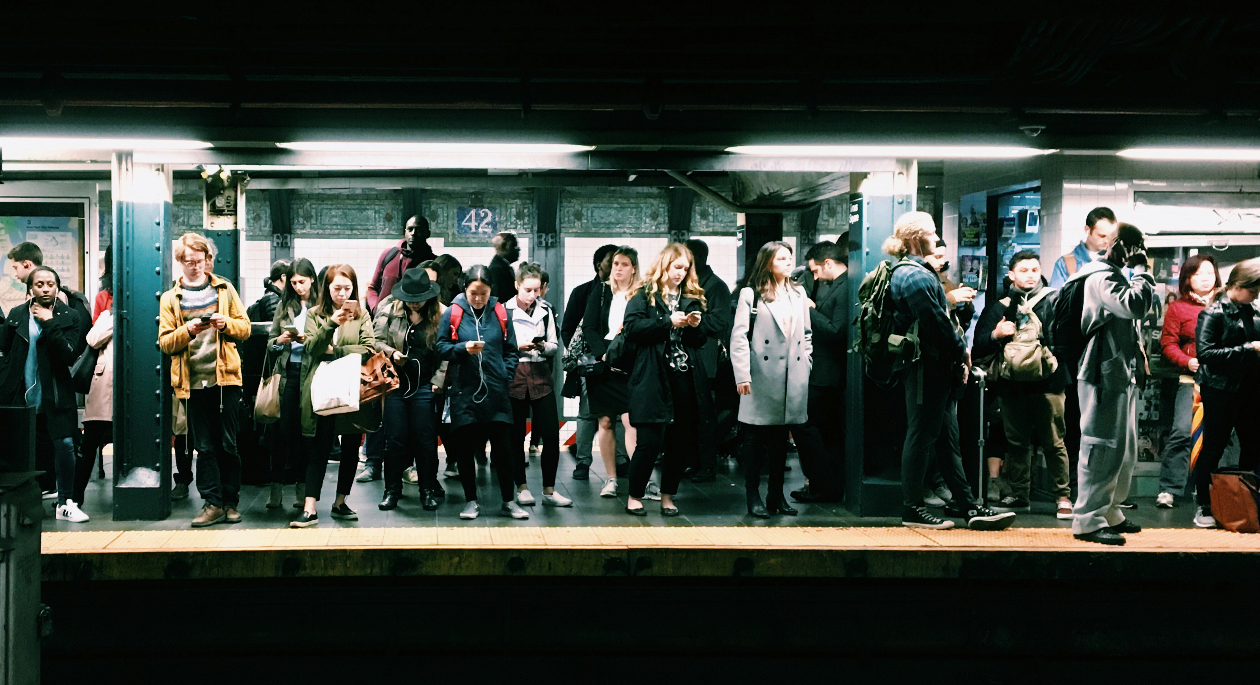
“ You Are A Wicked Problem ”
Collaborating, Questioning, and Engaging with Wicked Problems
Peter E. Doolittle, Professor • School of Education • pdoo@vt.edu • peterdoolittle.org

Slide 2

Anticipation Guide
Directions: For each of the following 3 sentences,
  Agree
  Disagree
  Edit into agreement

Slide 3
Anticipation Guide
Most of the questions I answer on any given day have direct answers that never vary.
I have learned my best problem solving through trial and error, policy manuals, and professional development.
Learning is easier when we can make meaning, apply information, and solve problems.

Slide 4
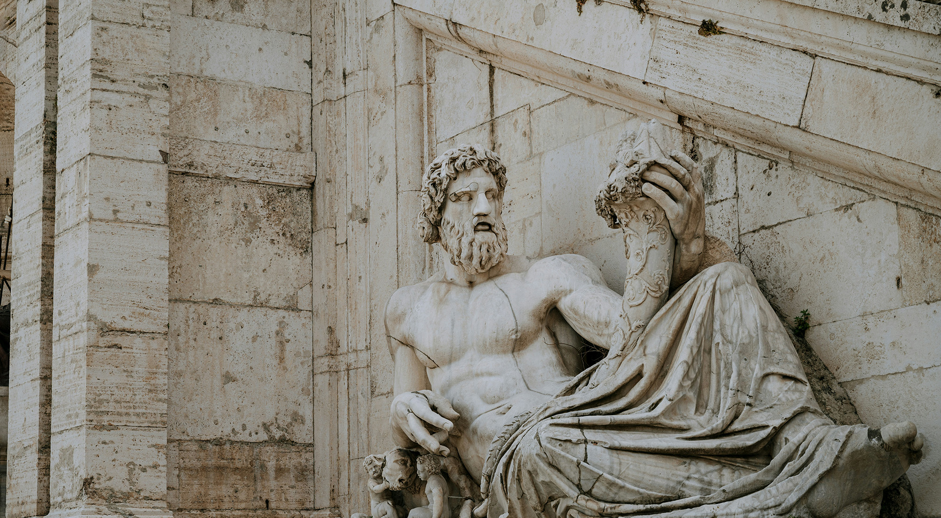
Meaning-Making

Slide 5
Words
Rest
Tired
Awake
Dream
Snore
Bed
Eat
Slumber
Sound
Comfort
Wake
Night
Meaning is always inside out.
Rest
Tired
Awake
Dream
Snore
Bed
Eat
Slumber
Sound
Comfort
Wake
Night
That’s all!
Notes:
1: Knowledge is connected; 2: Connections based on/form meaning; 3: Brain has a life of its own.

Slide 6
scíthe
tuirseach
dúiseacht
aisling
snor
leaba
ithe
pillín
fuaim
compord
úisigh
oíche
Notes:
Scithe = sh-kee duiseacht = doo-shot
Tuirseach = tur-shah

Slide 7
Engaging with wicked problems
requires the making of new meanings.

Slide 8
Problems

Slide 9
Problems
Well-Structured Problems
Ill-Structured Problems
Wicked Problems
Well-Structured
Ill-Structured
Wicked

Slide 10
Problems
Well-Structured
Ill-Structured
Wicked
Initial
State
Goal
State
Problem Space

Slide 11
Problems
Well-Structured
Ill-Structured
Wicked
2x + 4 = 20
x = 8
Clear
+ - × ÷
Substitution Property of Equality
Clear
Clear
Initial
State
Goal
State
Problem Space

Slide 12
Problems
Well-Structured
Ill-Structured
Wicked
How to
Mail a
Letter
Letter + Envelope
Address + Stamp
Mailbox
Letter
Mailed
Initial
State
Goal
State
Problem Space

Slide 13
Problems
Well-Structured
Ill-Structured
Wicked
Diagnosing Rare Disease
Differential Diagnosis
Additional Tests
Condition
Uncertain
Condition
Specific
Treatment
Fuzzy
Fuzzy
Fuzzy
Initial
State
Goal
State
Problem Space

Slide 14
Problems
Well-Structured
Ill-Structured
Wicked
Support Policies
Food Resources
Financial Resources
Food
Uncertainty
Potential
Solutions
Initial
State
Goal
State
Problem Space

Slide 15
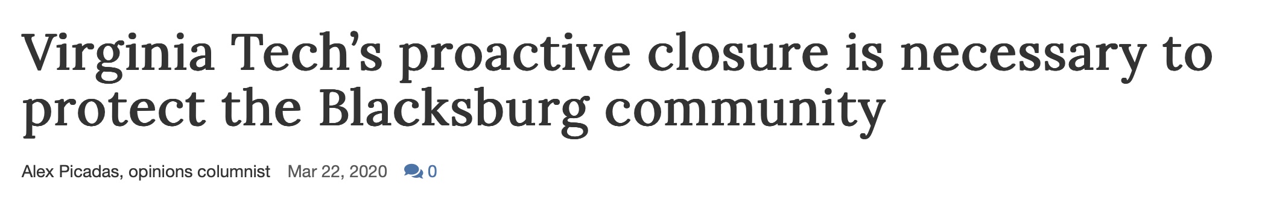

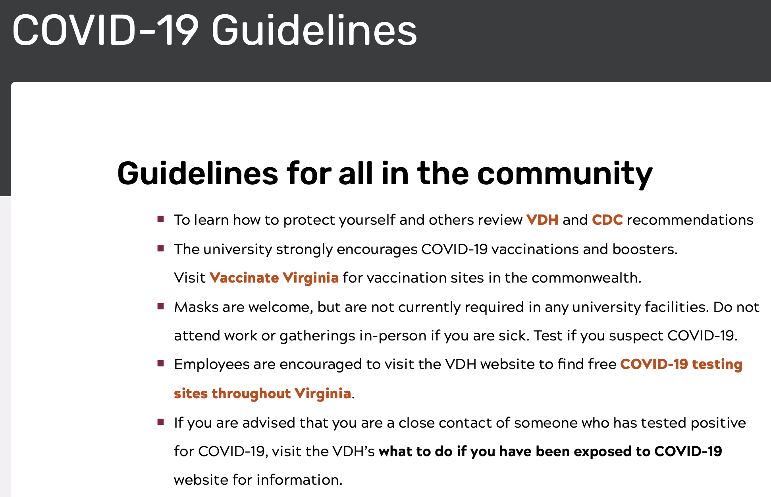
Wicked

Slide 16
Wicked
Well- and ill-structured problems ask for answers.
Wicked problems ask for judgment and leadership

Slide 17
Wicked
1a. Defining the Problem Shapes the Potential Solutions
1b. Different Stakeholders Will Define the Problem Differently
2. No “Problem Solved” Declaration… No Stopping Rule
3. Solutions are Better/Worse, Not Right/Wrong
4. No Immediate Test of a Solution… Solutions Resonate in Time
5. Every Solution Changes the Problem… there’s no going back

Slide 18
Wicked
The World
1. Climate Change
2. Economic Inequality
3. Homelessness
4. Refugee Migration
5. Misinformation / Public Trust
Higher Education
1. The Purpose of HE
2. Equity, Inclusion, Belonging
3. Faculty Workload, Productivity
4. Student Mental Health
5. Generative AI

Slide 19
Are You A Wicked Problem?
Is your understanding of the world shaped by your history, culture, relationships, and hopes for the future?
Is your understanding of yourself the same now as it was in high school? College? Five years ago?
Have you learned something new in the last day? Week? Month? Year?
Are your knowledge, beliefs, and motivations the same as all of your friends?

Slide 20
The meaning you make of your life
is not the solution to a problem;
it’s your current understanding
of who you are, which will change
with time, experience, and reflection…
and it never ends.

Slide 21

Learning and Meaning Making

Slide 22
Learning and meaning making:
some is well-structured,
some is ill-structured, and
some is wicked.

Slide 23
Wicked
Learning and
Meaning Making
Wicked Problems
1. Defining the Problem
2. No Stopping Rule
3. Solutions are Better/Worse
4. No Immediate Test of a Solution
5. Solutions Change the Problem

Slide 24

Word Pairs
Falling Snow
Laughing Child
Friendly Wolf
Picture Frame
Cold Food
Bright Sun
Writing Poetry
Windy Day
Quiet Forest
Big Airplane
Walking Tiger
Blue Sky
That’s it!

Slide 25
Let’s See What You Remember
Falling _____
Blue _____
Quiet _____
Friendly _____
Picture _____
Walking _____
_____ Sun
_____ Poetry
_____ Day
_____ Child
_____ Airplane
_____ Food
That’s it!

Slide 26
Performance
1
2
# of
Vowels
Create an
Image
Groups
Notes:
Meaning

Slide 27
Wicked
What is Wicked?
AI: Research, Learning, Thinking
Leadership & Excellence
Change & Technology
Inclusion, Generations, Access
Assessment
Wicked Problems
1. Defining the Problem
2. No Stopping Rule
3. Solutions are Better/Worse
4. No Immediate Test of a Solution
5. Solutions Change the Problem

Slide 28
Teaching Wicked
1. Teach Problem Classification
2. Teach Multi-Perspective Capacity
3. Teach Ambiguity Tolerance
4. Teach Iterative Hypothesis Tests
5. Teach Critical Reflection
6. Teach Collaboration/Networking
7. Design for the Long Term

Slide 29
Wicked and You
What is one problem in your VT world that is wicked?
Wicked Problems
1. Defining the Problem
2. No Stopping Rule
3. Solutions are Better/Worse
4. No Immediate Test of a Solution
5. Solutions Change the Problem

Slide 30
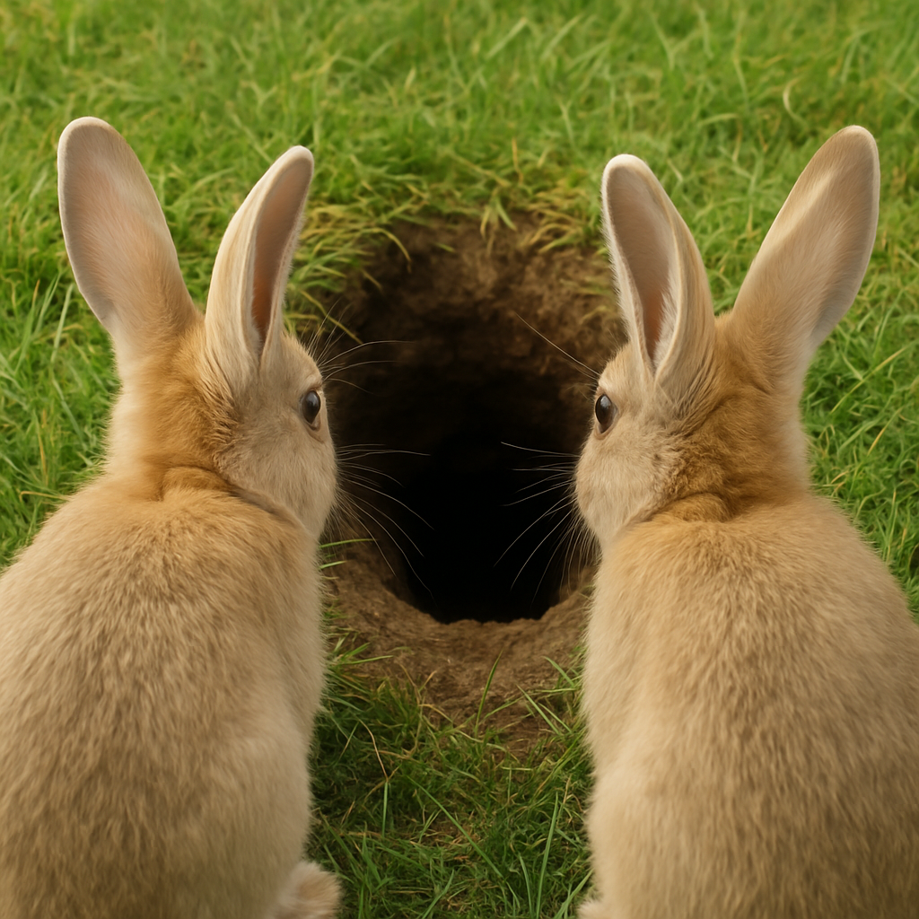
I almost wish I hadn’t gone down that rabbit hole
—and yet—and yet—
it’s rather curious, you know.
Alice’s Adventures in Wonderland, Lewis Carol

Slide 31
“ You Are A Wicked Problem ”
Collaborating, Questioning, and Engaging with Wicked Problems
Peter E. Doolittle, Professor • School of Education • pdoo@vt.edu • peterdoolittle.org

