Slide 1




The Science of Learning
&
Veterinary Medical Education
Peter E. Doolittle (pdoo@vt.edu)
Educational Psychology, Virginia Tech
peterdoolittle.org/temp/VetMed.pptx

Slide 2
Anticipation Guide
Directions: For each of the following 2 sentences,
  Agree
  Disagree
  Edit into agreement
peterdoolittle.org/temp/VetMed.pptx

Slide 3
Anticipation Guide
Deep learning is fostered by cases, lecture, and discussion
I have learned my best problem solving through trial and error, textbooks, and professional development.
peterdoolittle.org/temp/VetMed.pptx

Slide 4
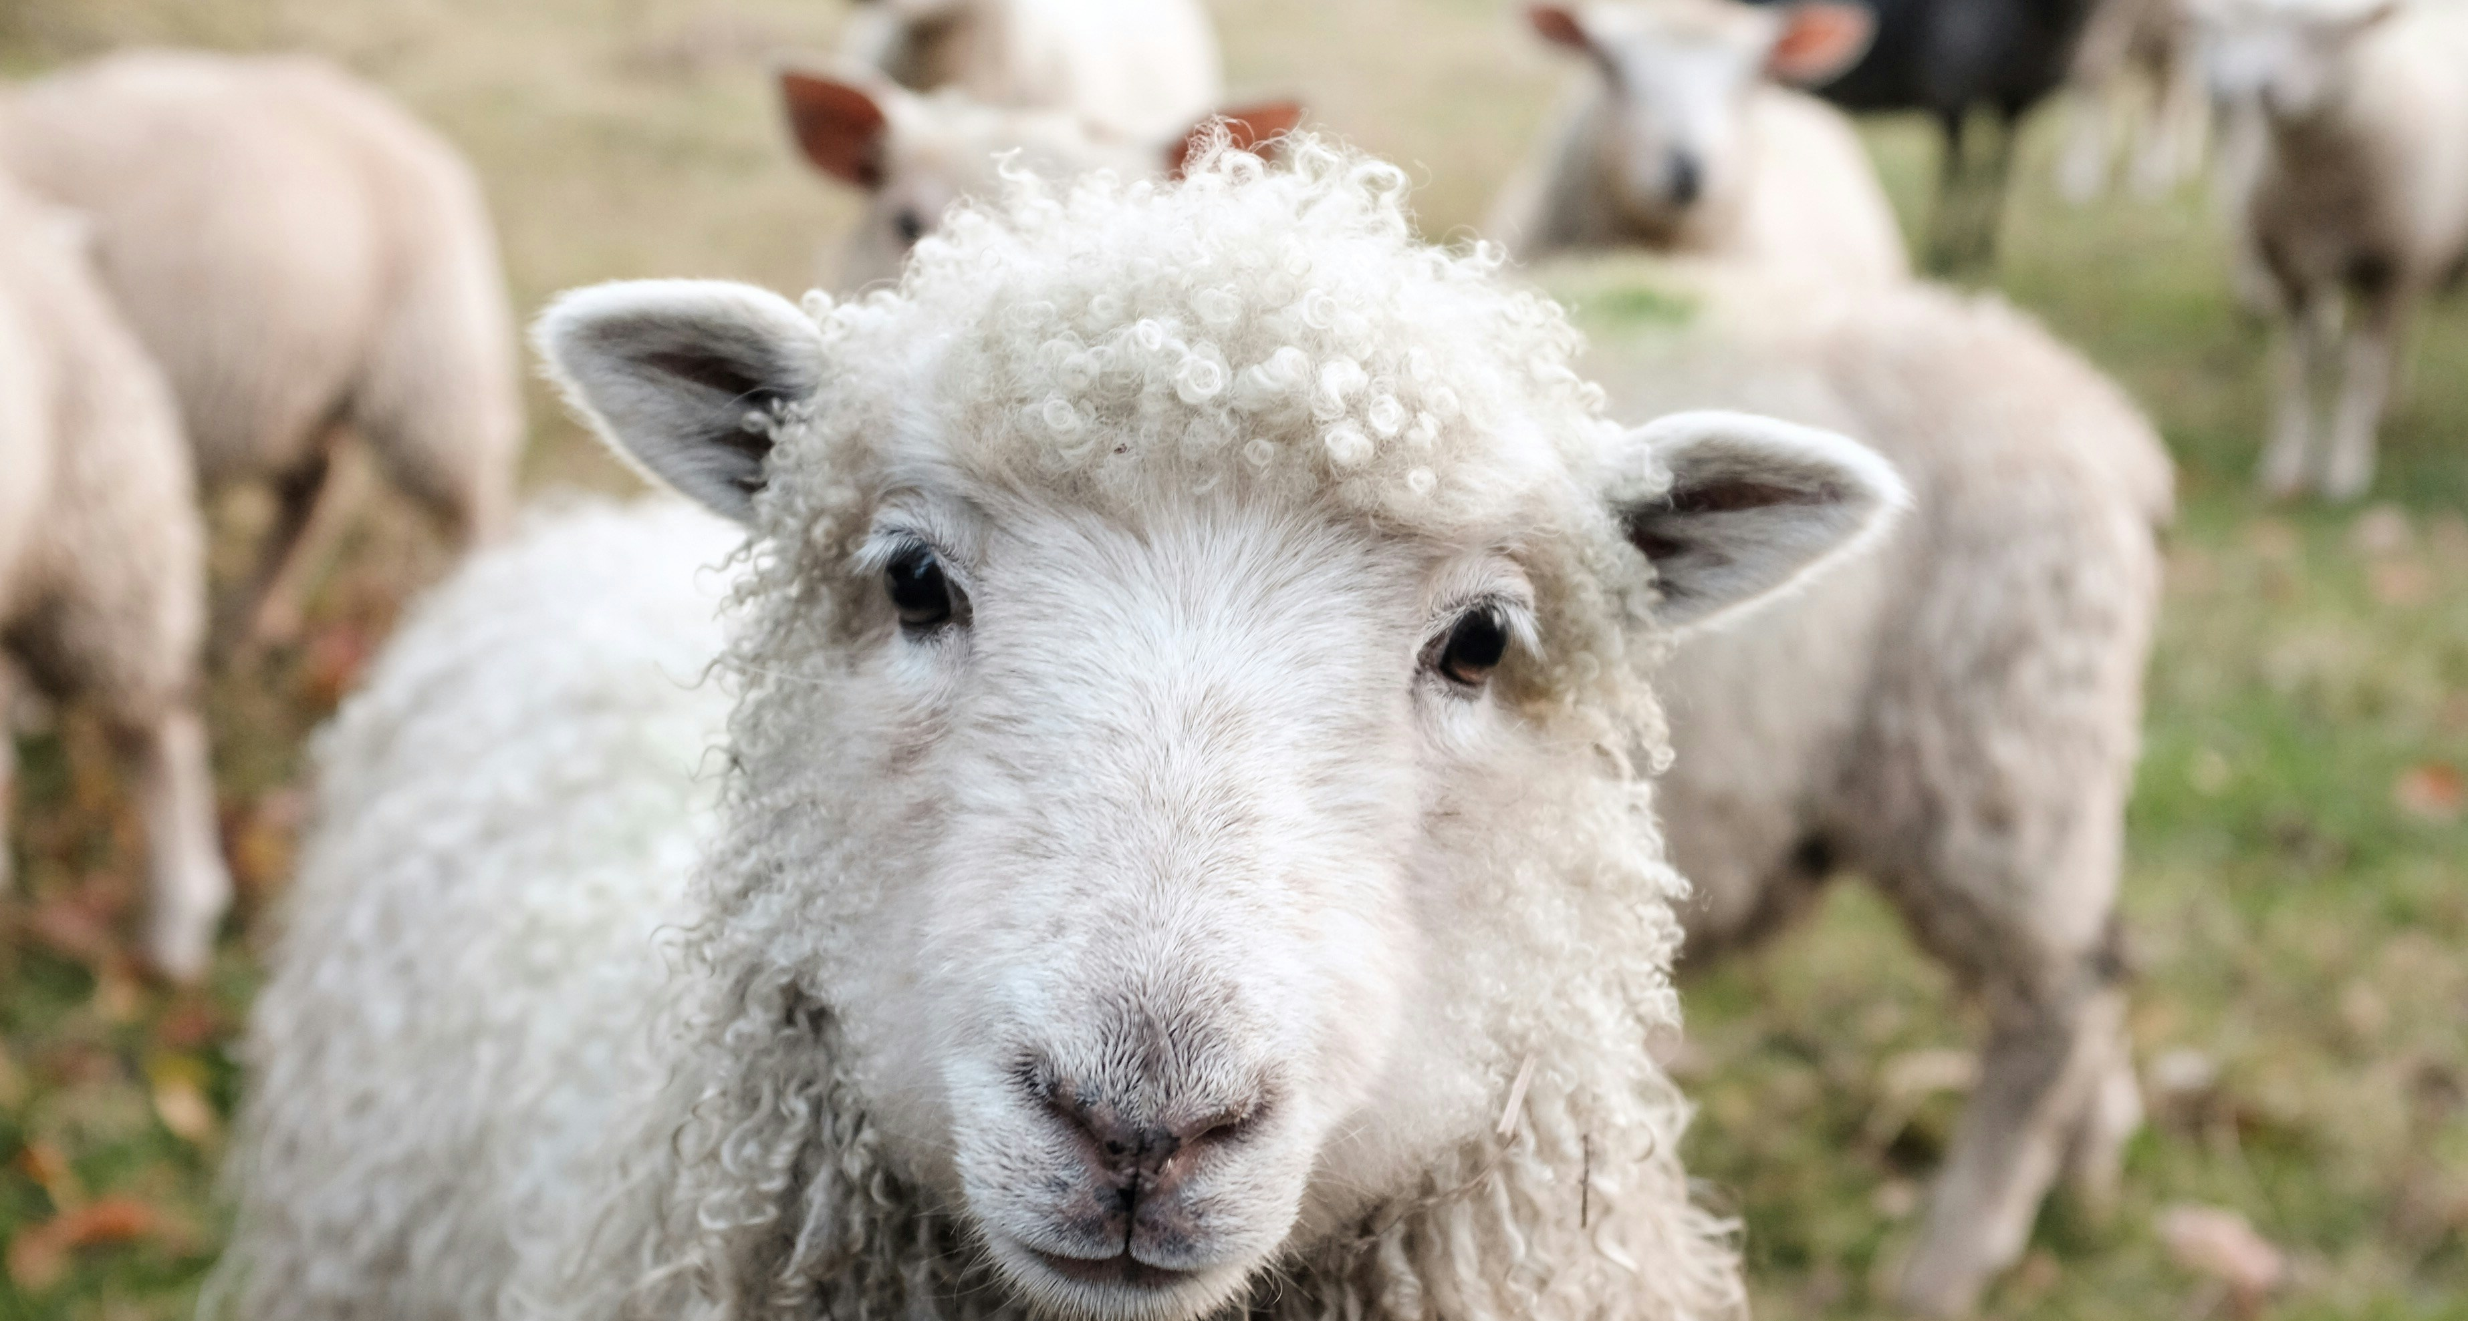
Meaning

Slide 5
Words
Rest
Tired
Awake
Dream
Snore
Bed
Eat
Slumber
Sound
Comfort
Wake
Night
Meaning is always inside out.
Rest
Tired
Awake
Dream
Snore
Bed
Eat
Slumber
Sound
Comfort
Wake
Night
That’s all!

Slide 6
scíthe
tuirseach
dúiseacht
aisling
snor
leaba
ithe
pillín
fuaim
compord
úisigh
oíche

Slide 7
Meaning is Everything

Slide 8
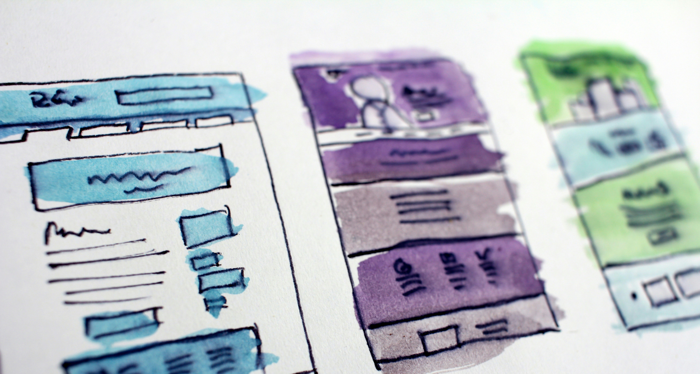
A Very, Very Small Model for the
Design of Instruction

Slide 9

Designing for Learning
alignment
inform
foster
causes
enables
infer
Objectives
Strategies
Processing
Learning
Performance
What we process, we learn.
Know
Do
Think
Feel
PBL
Visuals
Lecture
Discussion
Organization
Management
Think-Pair-Share
Cognitive
Behavioral
Social
Affective
Knowledge
Skills
Strategies
Emotions
Know
Do
Think
Feel

Slide 10
inform
foster
causes
enables
infer
Objectives
Strategies
Processing
Learning
Performance
Declarative Knowledge
(facts, concepts, schemas)
Procedural Knowledge
(skills, strategies, processes)
Initial
Learning
Activate relevant prior knowledge
Teach new skill/strategy steps
Prompt learners to form meaningful step-by-step including when and why to use the skill/strategy
Activate relevant prior knowledge
Teach new knowledge
Prompt learners to form meaningful connections between new knowledge and prior knowledge
Explicitly
Working
Memory

Slide 11
inform
foster
causes
enables
infer
Objectives
Strategies
Processing
Learning
Performance
Declarative Knowledge
(facts, concepts, schemas)
Procedural Knowledge
(skills, strategies, processes)
Subsequent
Strengthening
& Organization
Proceduralization
Composition
Integration
Differentiation

Slide 12
inform
foster
causes
enables
infer
Objectives
Strategies
Processing
Learning
Performance
Declarative Knowledge
(facts, concepts, schemas)
Procedural Knowledge
(skills, strategies, processes)
*
PRACTICE
* not all practice is created equal.

Slide 13
DK & PK Shared Practice Elements
If you’re not learning, you’re forgetting.
Practice → ↑ Learning & ↓ Forgetting
3
2
1
The Law of Learning
The Practice Effect
The Law of Forgetting

Slide 14
Declarative Knowledge

Slide 15
The faster you learn, the faster you forget.
Learning takes time, effort, and resources.
Tuesday
Monday
Friday
Monday
Massed Practice
Spaced Retrieval Practice
with Generative Learning

Slide 16
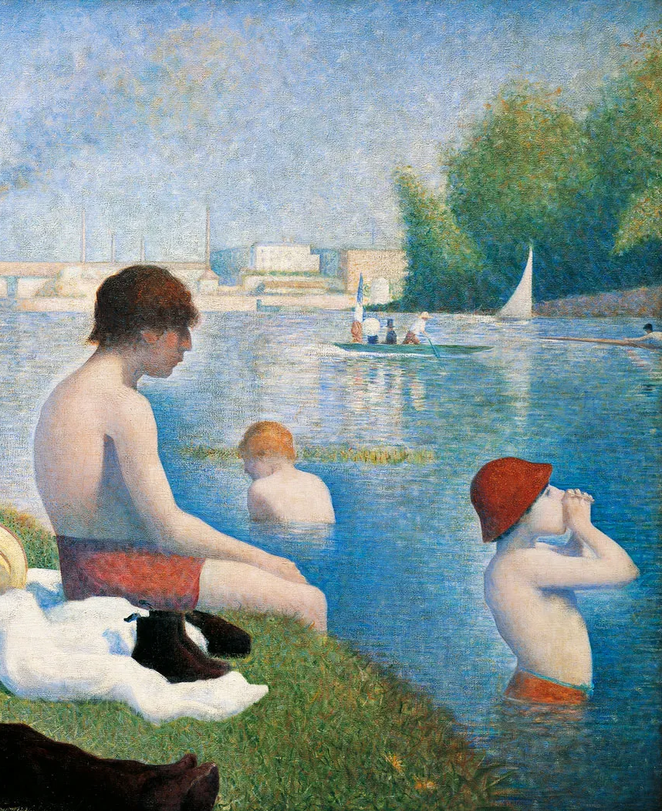
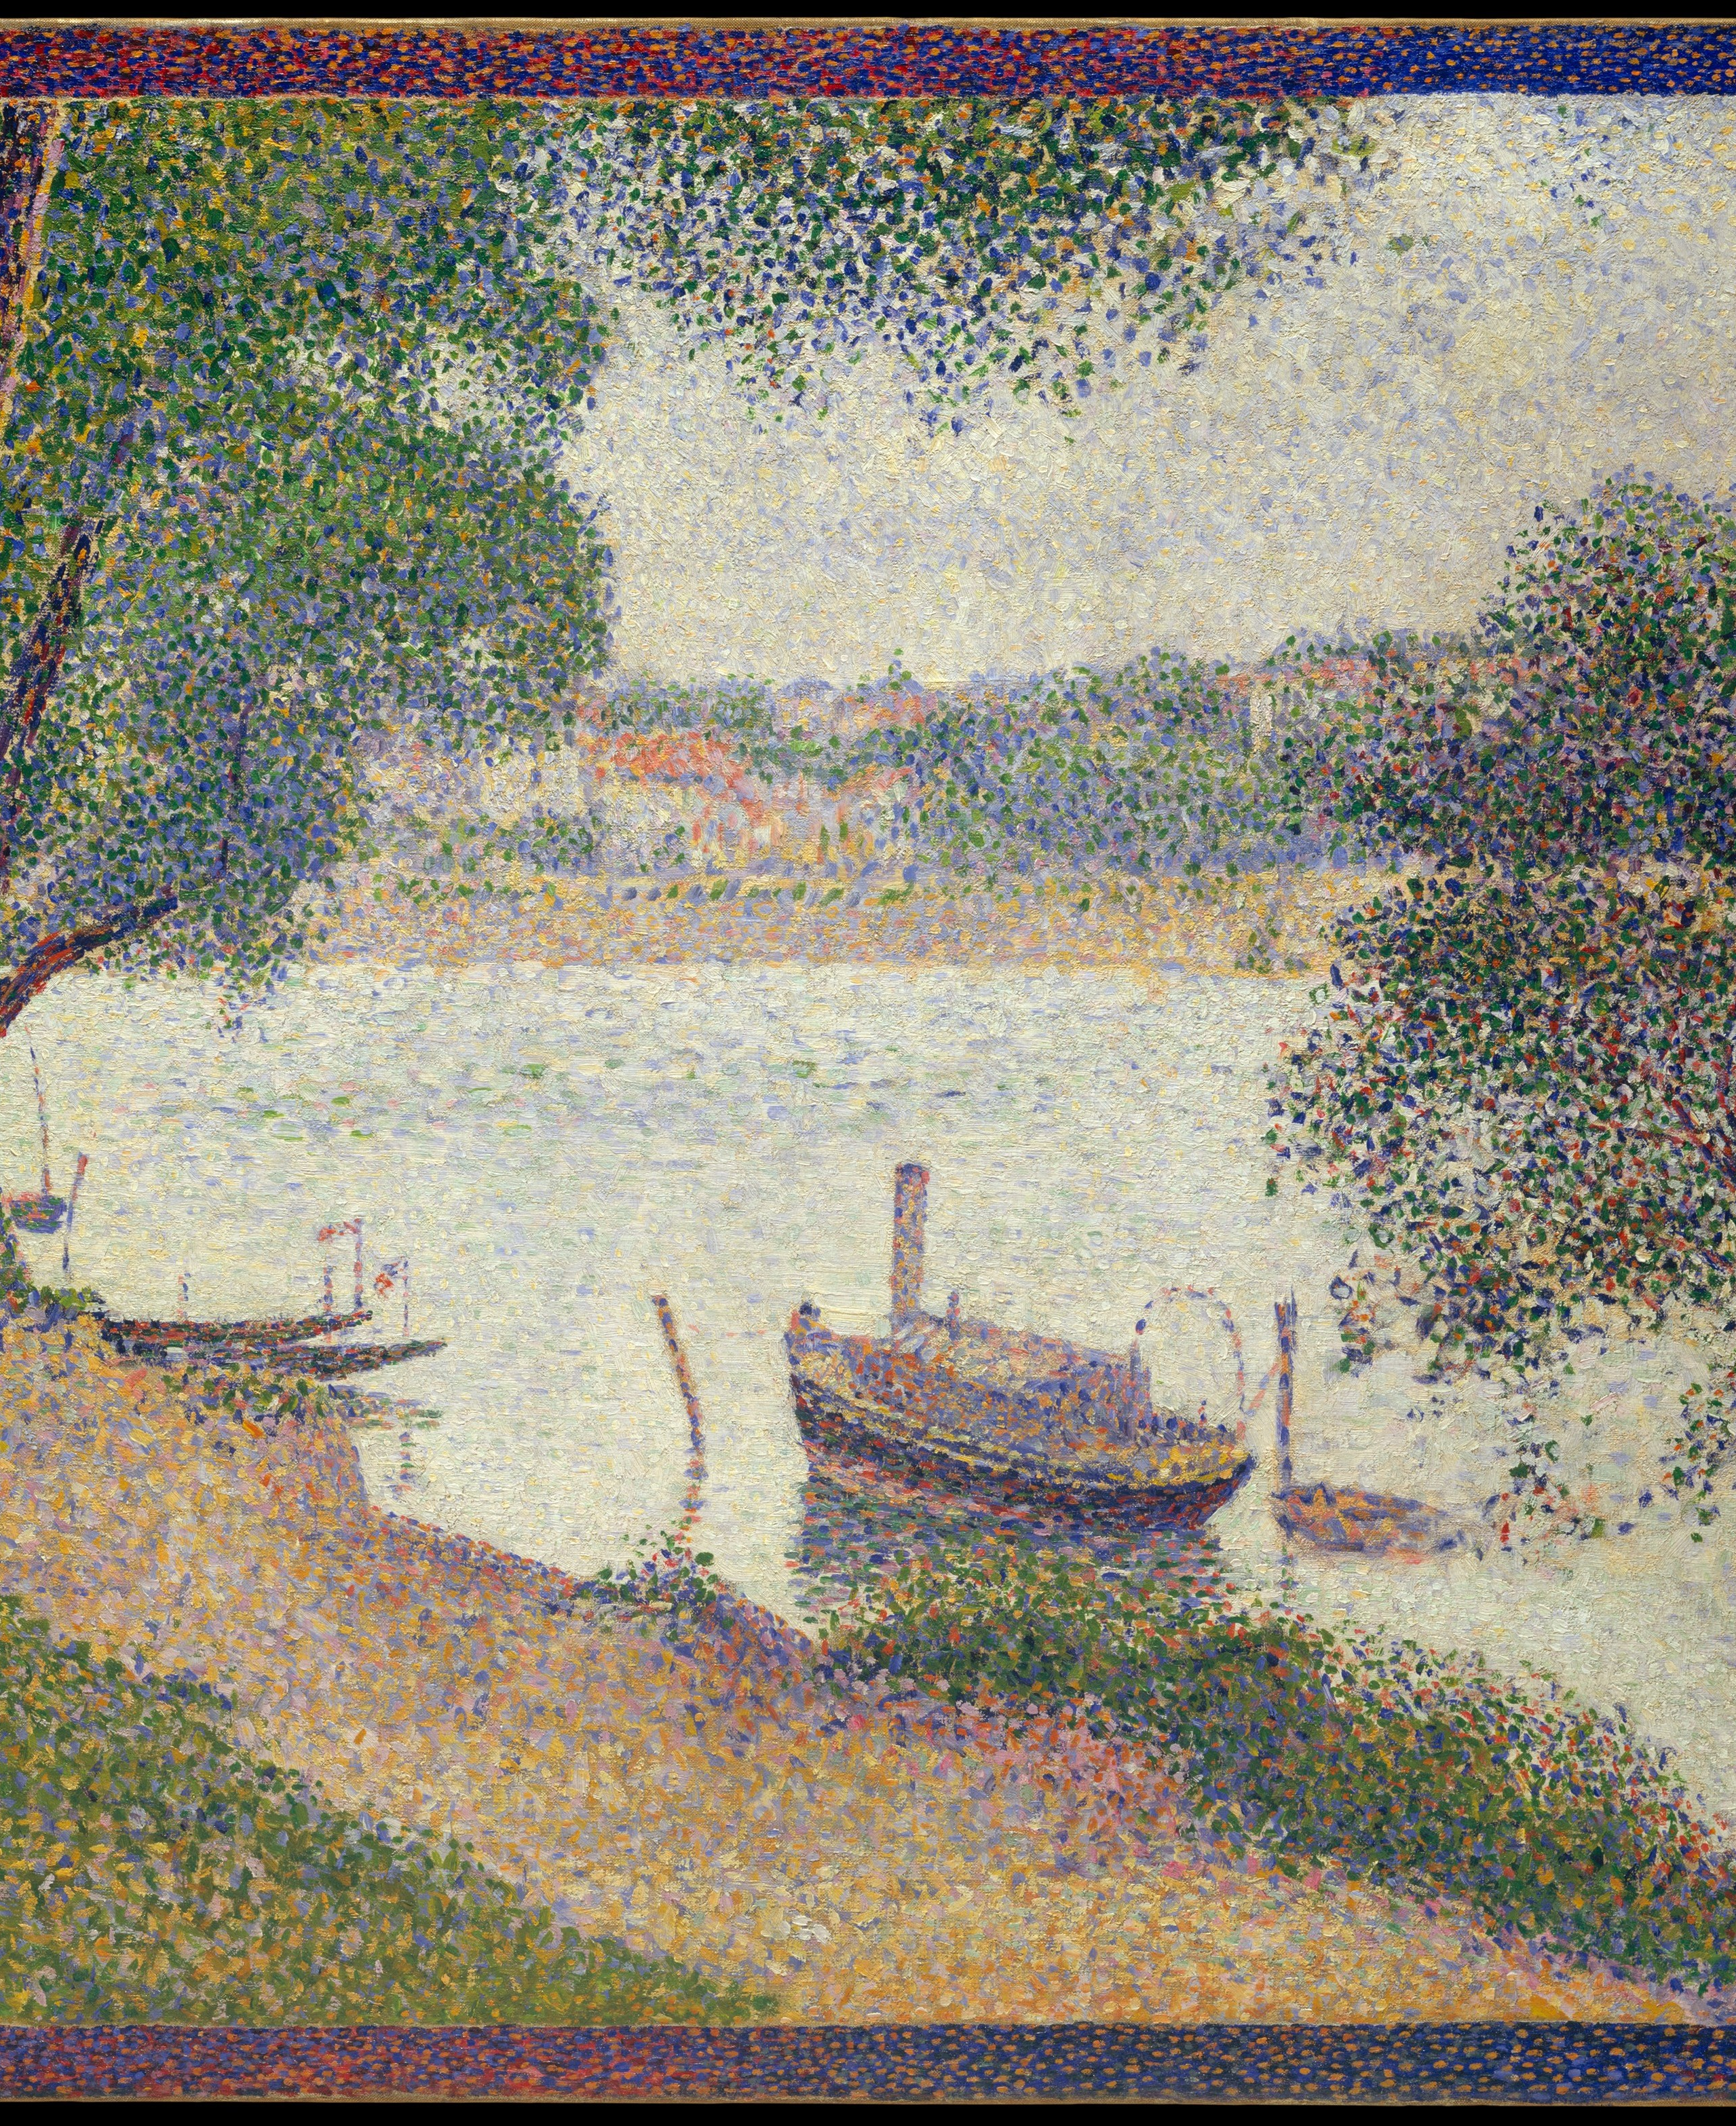







Georges Seurat
Georges Seurat
Georges Seurat
Marilyn Mylrea
Marilyn Mylrea
Marilyn Mylrea
Georges Braque
Georges Braque
Georges Braque
AAA BBB CCC
Blocked Practice
Interleaved Practice
Interleave when information is highly similar and easily confused.
A C B C B A A B C
Interleaved Practice
Georges Seurat
Marilyn Mylrea
Georges Seurat
Georges Braque
Marilyn Mylrea
Georges Braque
Georges Seurat
Georges Braque
Marilyn Mylrea

Slide 17
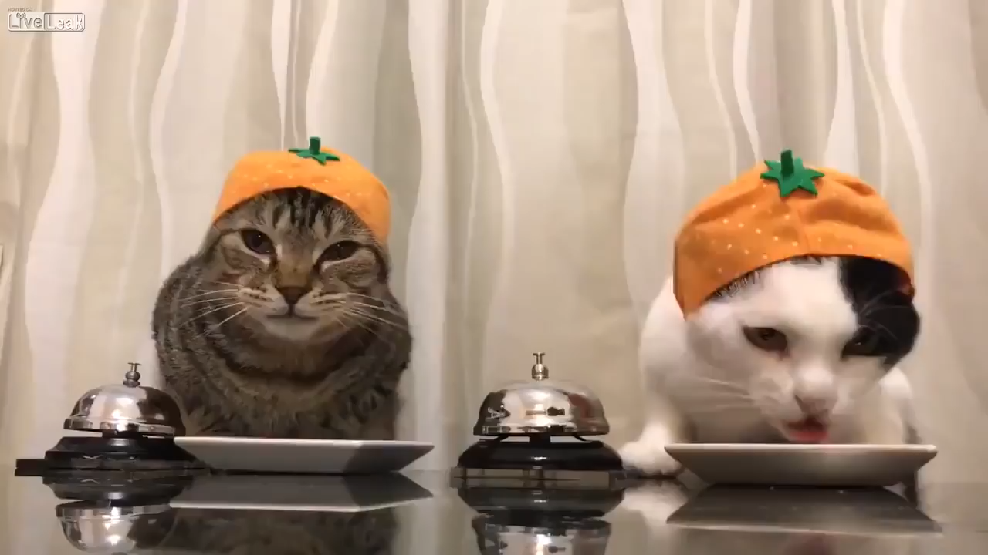
This does not count as interleaved practice.

Slide 18

Roediger & Karpicke (2006)
  Retrieval Effect
  180 undergraduate students
  Study = reading a 265-word passage, repeatedly for 5 min
  Test = write down as much as could be remembered for 7 min
  Recall = write down as much as could be remembered for 10 min

Slide 19
What did they find?
 | 5 Minutes | 1 Week
S S S S | 83% | 40%
S S S T | 78% | 56%
S T T T | 71% | 61%
SSSS SSST STTT
SSSS SSST STTT
1.0
0.8
0.6
0.4
0.2
0.0
Recall
5 Min 1 Week

Slide 20
 | 5 Minutes | 1 Week
S S S S | 83% | 40%
S S S T | 78% | 56%
S T T T | 71% | 61%
SSSS SSST STTT
SSSS SSST STTT
1.0
0.8
0.6
0.4
0.2
0.0
Recall
5 Min 1 Week
Short-Term
Performance
Meaningful
Processing
Long-Term
Learning
Short-Term Recall
Spaced Retrieval
w/Generative Lrn
Long-Term Retrieval

Slide 21
Procedural Knowledge

Slide 22
Procedural Knowledge
Support
High
Med
Low
Variable
Low
Med
High
Examples: Teacher demonstrates fully worked-out procedure; have student self-explain what they’re seeing
Guided Practice: Student attempts procedure with scaffolded support and immediate feedback
Varied Application Practice: Once student can complete the procedure, apply procedure to different contexts

Slide 23
What we process, we learn.
inform
foster
causes
enables
infer
Objectives
Strategies
Processing
Learning
Performance
Know
Do
Think
Feel
PBL
Visuals
Lecture
Discussion
Organization
Management
Think-Pair-Share
Cognitive
Behavioral
Social
Affective
Knowledge
Skills
Strategies
Emotions
Know
Do
Think
Feel

Slide 24
What we process, we learn;
what AI processes, we don’t.

Slide 25
The Science of Learning
&
Veterinary Medical Education
Peter E. Doolittle
Educational Psychology, Virginia Tech
pdoo@vt.edu • peterdoolittle.org

